Slide 1
Warm-Ups
List three reasons European nations explored.
God, Gold, Glory
What impact did Prince Henry have on exploration?
Portugal led the way in Exploration
List the three mistakes Columbus made.
Underestimated Earth’s size, did not know about N. and S. America, believe he landed in the East Indies

Slide 2
EUROPEANS EXPLORE ASIA

Slide 3
Why Asia?
Europeans had been trading with Asia before the Renaissance
The Black Death halted it
Europeans wanted to find a sea route to Asia because Muslims controlled the land routes

Slide 4
Why Asia?
Trade for exotic spices=$$$
Cinnamon, cloves, nutmeg, and pepper
Wanted to preserve food, add flavor, make medicines and perfumes
Notes:
Only a small percentage actually went to Europe

Slide 5
Geography of Asia
Asia consists of a mainland and 20,000+ islands
Mainland
Laos, Thailand, Cambodia, Vietnam, China, India
Islands
Singapore, Indonesia, Brunei, the Philippines
There are mountains, plateaus, and river valleys
Himalayas
Notes:
How could the geography impact development?

Slide 6
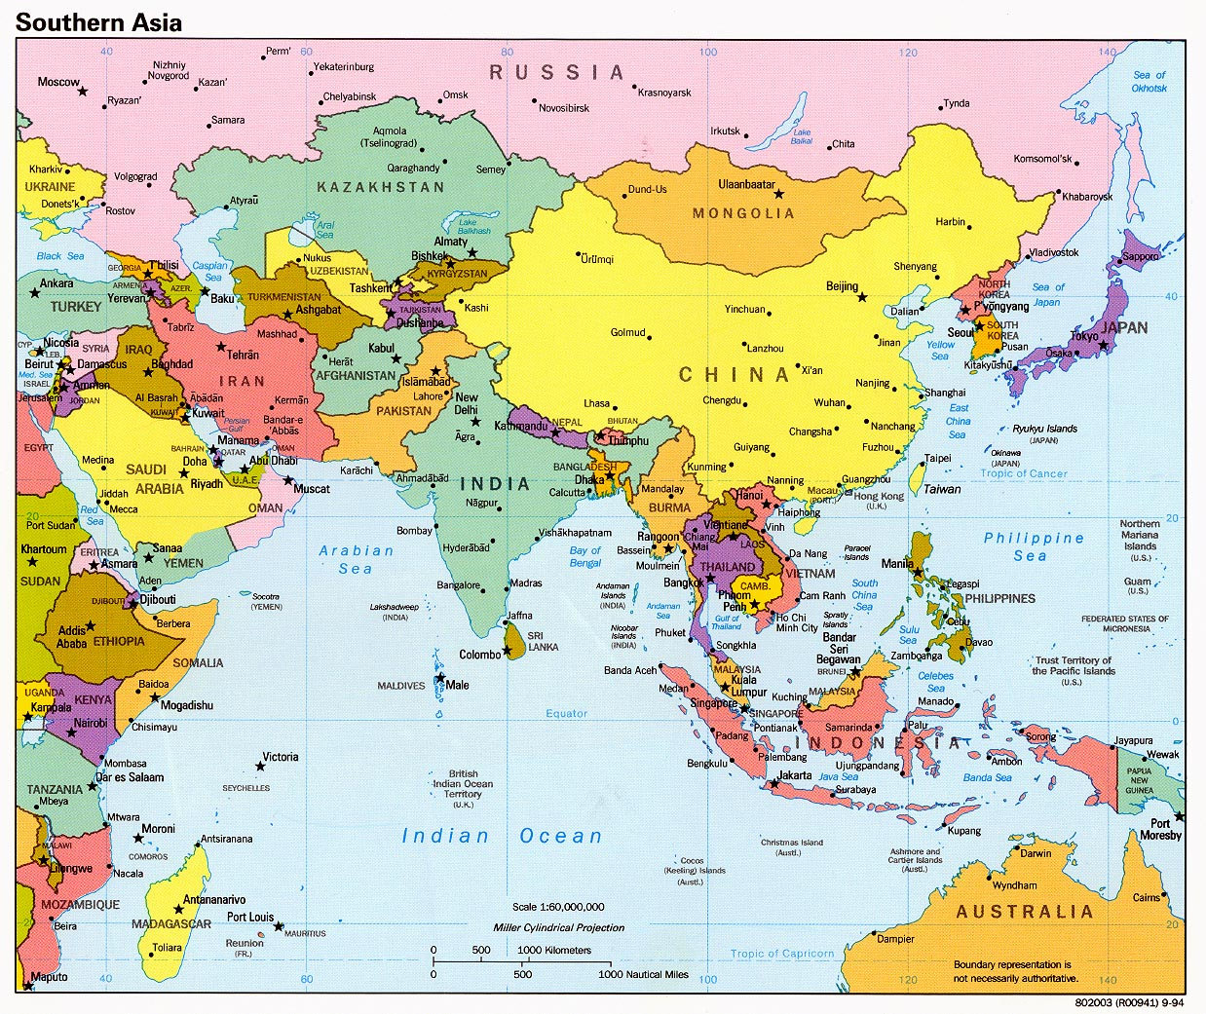

Slide 7
Cultural Development
Diverse ethnic groups, many languages
Women had greater equality
Could be merchants
Rule
Choose marriage partner, divorce
Indian traditions spread through trade
Chinese influence spread by conquest
Vietnam
Spain conquered and colonized
Philippines
Southeast Asia
Other Parts of Asia

Slide 8
Religion
Spain set out to convert the Filipino people to Christianity
India helped spread the idea of three major religions into southeast Asia-Hinduism, Buddhism, and Islam
Hindu priests from India
Buddhist monks
Muslims ruled northern India
Arab merchants

Slide 9
Group Work
Answer questions on the Group Response sheet (1 per group)
Read passages as a group and answer questions
Goals:
To understand how the countries of Asia responded to the European explorers.
Different approaches?
Does the approach impact development?

