Slide 1
VOCABULARY
E.O. 7

Slide 2
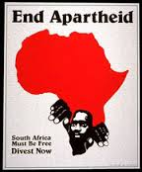
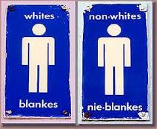
Apartheid
Nelson Mandela fought against apartheid in South Africa.
Definition: policy of strict racial segregation in South Africa

Slide 3
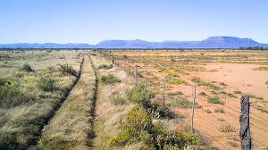
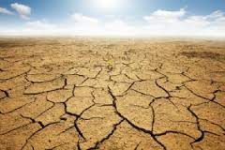
Desertification
Land in Africa has frequently undergone desertification.
Definition: process by which fertile or semi-desert land becomes desert

Slide 4
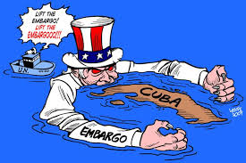
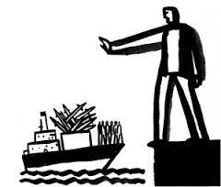
Embargo
The United Nations will frequently place sanctions and embargos on uncooperative nations.
Definition: ban on trade

Slide 5
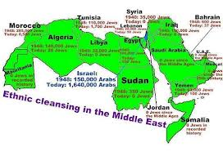
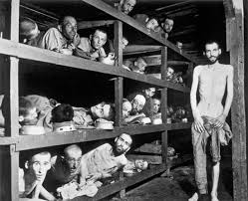
Ethnic Cleansing
Genocide is a synonym for ethnic cleansing.
Definition: killing or forcibly removing people of certain ethnic groups

Slide 6
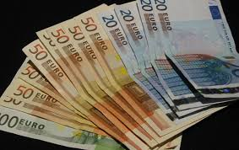
Euro
Many nations use the euro.
Definition: currency used by nations of the European Union

Slide 7
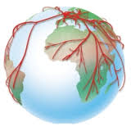
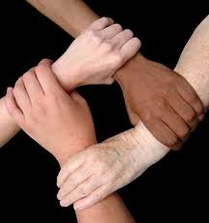
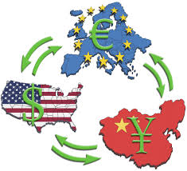
Interdependence
The United States and many developing nations are interdependent.
Definition: mutual dependence of countries on resources, goods, and knowledge

Slide 8
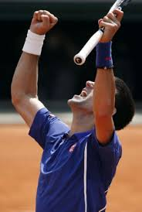
Jihad
Many Muslims use jihad to promote Islam.
Definition: vigorous, emotional crusade for an idea or principle

Slide 9
Modernization
Imperialism helped with modernization.
Definition: building a stable government while developing a country economically

Slide 10
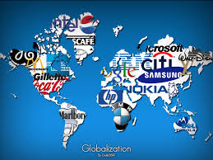
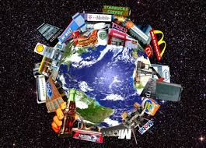
Multinational Corporation
Wal-mart is a multinational corporation.
Definition: enterprise with branches in many countries

Slide 11
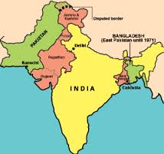
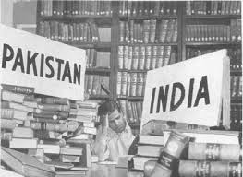
Partition
Berlin, Germany was partitioned after WWII.
Definition: to divide

Slide 12
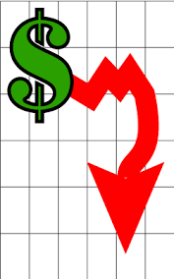
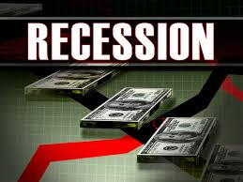
Recession
The U.S. and many other nations experienced a recession in 2008.
Definition: period of reduced economic growth

Slide 13
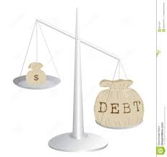
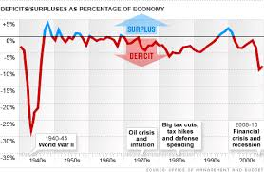
Deficit
The United States government is currently experiencing a major deficit.
Definition: gap between what a government spends and what it takes in

