Slide 1
Warm-Up 11/18
8. Discontent in Latin America resulted from the domination of social and political life by which group?
Peninsulares/Spaniards
9. What event(s) sparked revolutions in Latin America?
Napoleon’s invasion of Spain
Inequality

Slide 2
THE UNIFICATION OF ITALY

Slide 3
Obstacles to Italian Unity
At the Congress of Vienna, Italian nationalists had wanted to end centuries of foreign rule
Had not been united since Roman times
Italian nationalists were determined to build a united Italy
Would not be easy

Slide 4
Obstacles to Italian Unity
Frequent warfare and foreign rule had left Italy divided
Regional differences made Italy difficult to unite
Florence=Tuscans
Venice=Venetians
Naples=Neapolitans

Slide 5
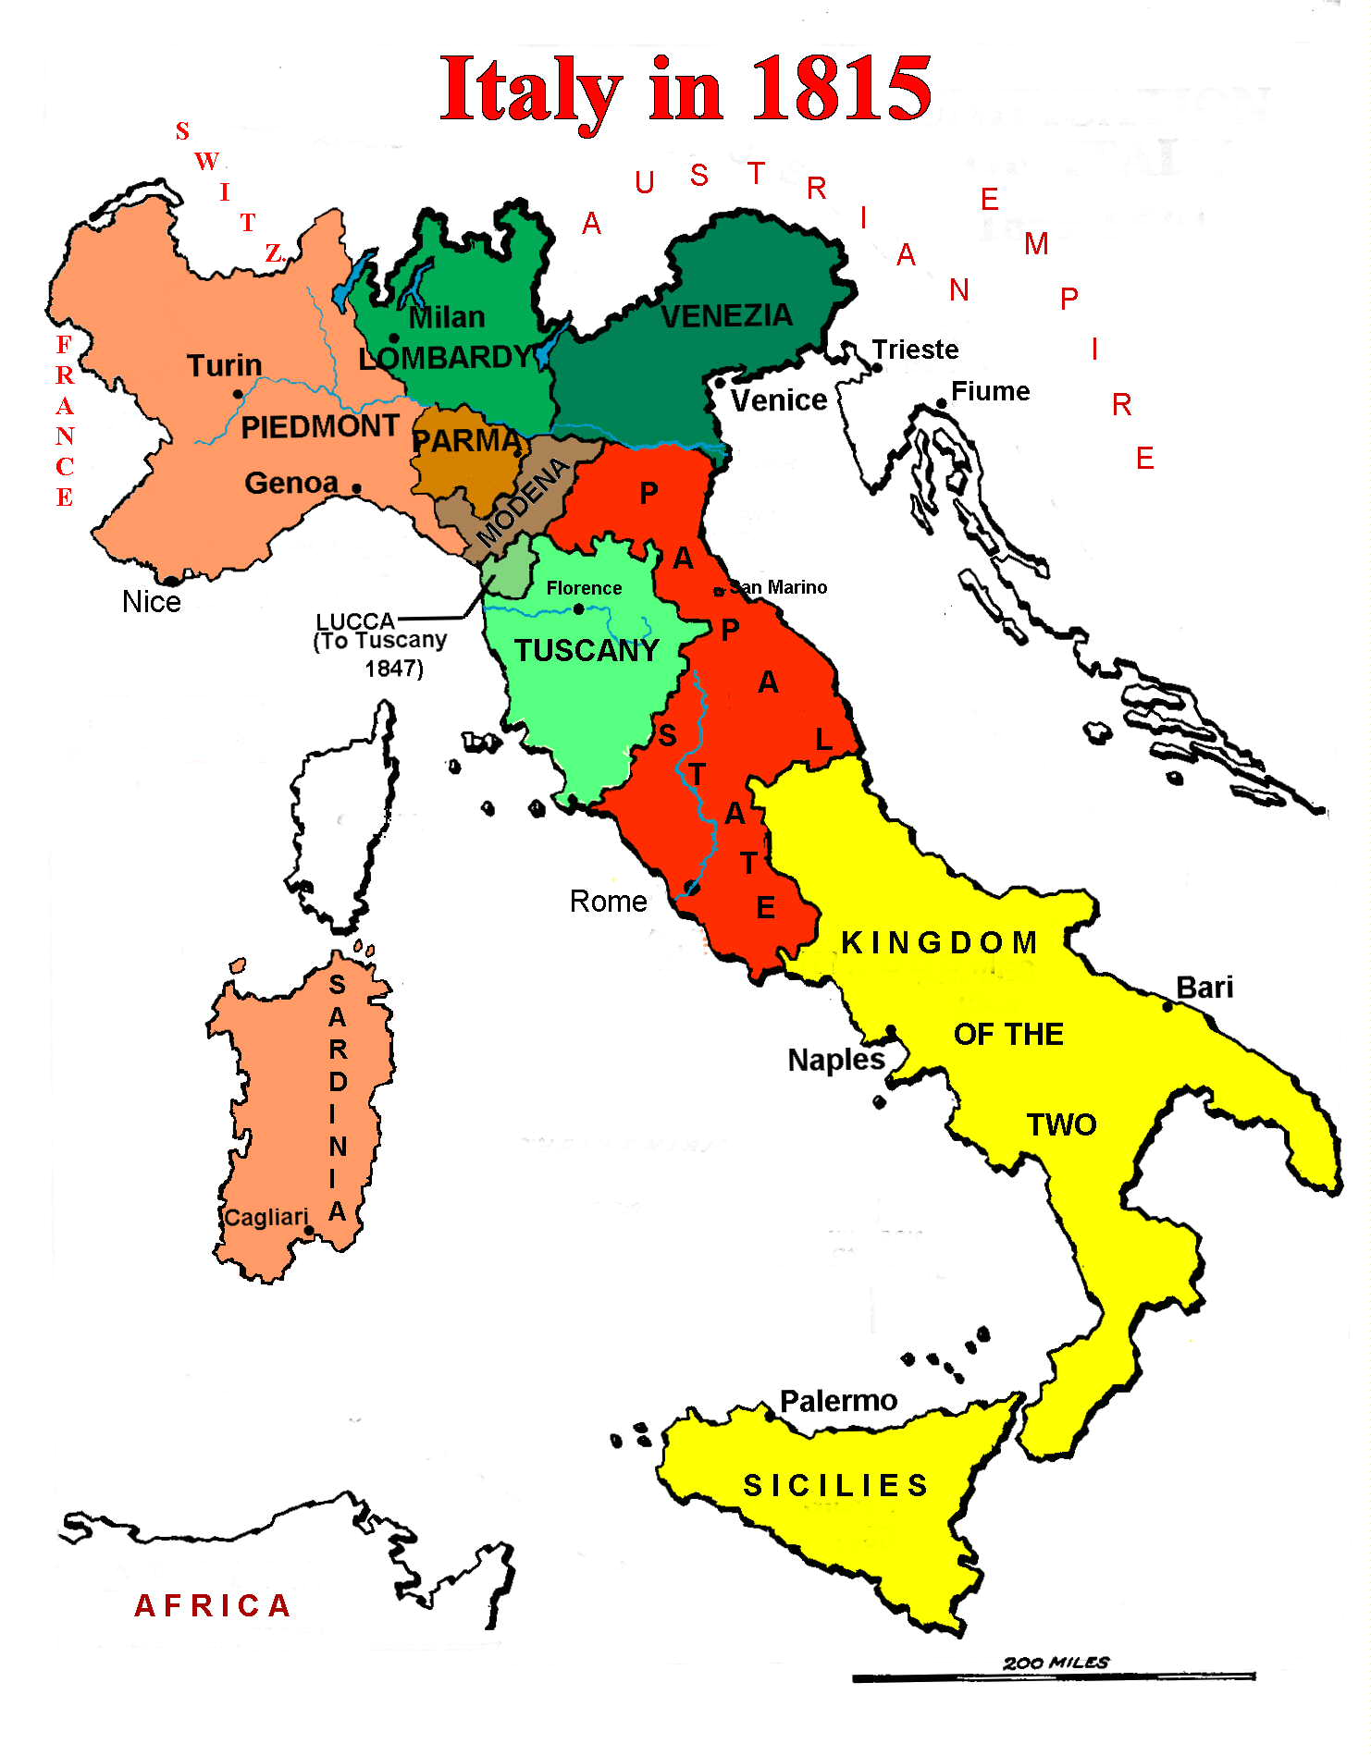

Slide 6
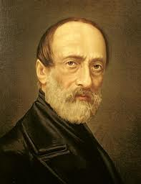
Giuseppe Mazzini
In the 1830s, the nationalist leader Giuseppe Mazzini founded “Young Italy”
Wanted a free, independent Italy
Shared the same language, geography, and history
Would end trade barriers and stimulate economic growth
Set up a revolutionary republic that was quickly toppled
While his revolution failed, he inspired others to revolt

Slide 7
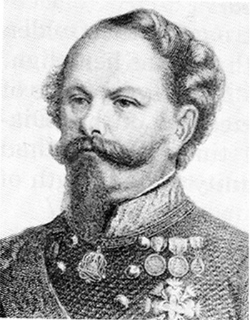
1848
In 1848, the Risorgimento, the Italian nationalist movement, gained support from Victor Emmanuel II
Constitutional monarch in Sardinia
Wanted to join other states to his own and increase his power

Slide 8
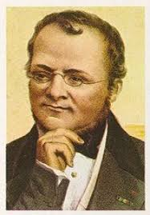
1852
In 1852, Emmanuel made Count Camillo Cavour his prime minister
Improved agriculture, had railroads built, and supported free trade
Realpolitik-policies based on the needs of the state
Wanted to end Austrian power in Italy and annex Lombardy and Venetia
Notes:
Cavour was a noble but favored liberal goals
He was willing to do almost anything to achieve his goals

Slide 9
1855
In 1855, Cavour led Sardinia in the Crimean War against Russia alongside Britain and France
Didn’t gain any territory
Gained attention of Napoleon III

Slide 10
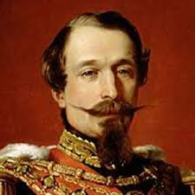
1858
In 1858, Cavour negotiated a secret deal with Napoleon III
France would help Sardinia defeat Austria
Annexed Lombardy
Other nationalist groups overthrew Austrian-backed rulers in other Italian states
Joined with Sardinia

Slide 11
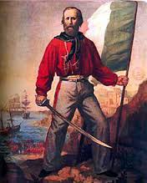
1860
In 1860, Giuseppe Garibaldi led his “Red Shirts” into Sicily and gained control of the land
Won control very quickly with aid from Cavour
Provided weapons and ships
However, his success worried Cavour
Didn’t want Garibaldi to set up his own republic

Slide 12
1861
In 1861, Cavour urged Victor Emmanuel II to send troops to deal with Garibaldi
The forces joined together and Victor Emmanuel II was crowned king of Italy

Slide 13
1870
Two areas remained outside the new Italian nation: Rome and Venetia
In a deal negotiated with Otto von Bismarck, Italy acquired Venetia
After the Franco-Prussian War France withdrew its troops from Rome
In 1870, Italy was finally a united land
Garibaldi is credited with uniting Italy

Slide 14
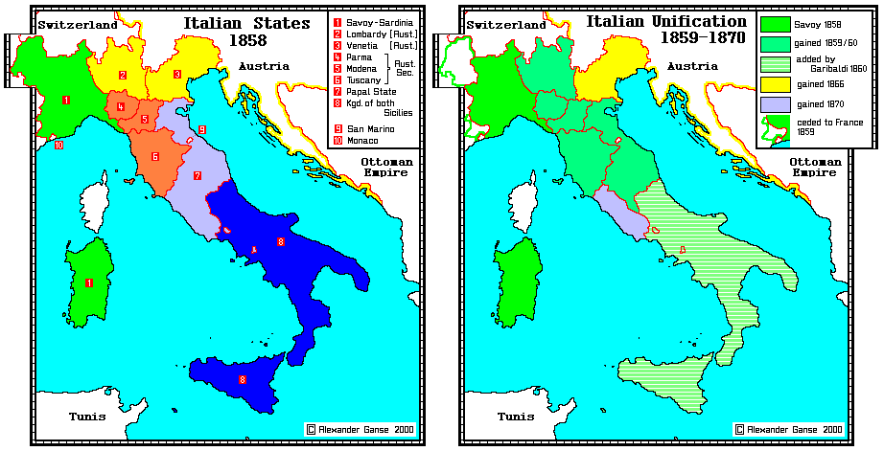

Slide 15
The New Nation
Regional differences
North was richer
South was rural and poor
The Roman Catholic Church
Competing ideologies
Radicals, socialists
Did develop economically
Natural resources
Industrialized

