Slide 1
Nationalism
What is nationalism?
What are some of the positive and negatives associated with nationalism?

Slide 2
Otto von Bismarck and German Unification
Chapter 10, Section 1

Slide 3
Why Unite Germany?

Slide 4
Why Unite Germany?
In the early 1800s, Germany was divided into several states
Share common culture
Located in Prussia and the Austrian Hapsburgs

Slide 5
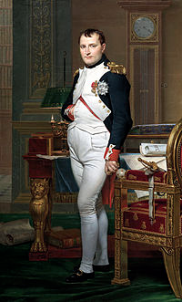
Why Unite Germany?
Napoleon’s Impact
Annexed lands
Dissolved the Holy Roman Empire
Organized German states as he saw fit

Slide 6
Why Unite Germany?
Napoleon’s Impact
At first, some Germans welcome the modern policies
Freed the serfs
Made trade easier
Abolished laws against the Jews
Other resented France’s significant impact
Wanted to free their lands and unite Germany

Slide 7
Why Unite Germany?
Prussia tries to help by introducing the Zollverein
Encouraged economic unity among German states
States still divided
William IV rejects throne
Does not want a throne offered by “the people”

Slide 8
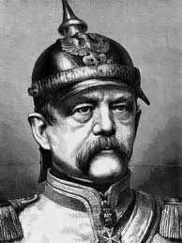

Slide 9
Otto von Bismarck
Early Years
Otto von Bismarck was born in Prussia
His family belong to the Junker class
He will serve as a diplomat until 1862
In 1862, he is named chancellor by King William I
United German states within a decade under Prussian rule

Slide 10
Otto von Bismarck
Realpolitik
Realistic politics based on the needs of the state
Believed that power was more important than principles
His ultimate goal was to gain power by strengthening the army

Slide 11
Otto von Bismarck
Wars with Denmark and Austria
Wanted to form an alliance with Austria
Seized provinces in Denmark and “liberated” them
Bismarck will turn on his former ally
Starts a war with Austria

Slide 12
Otto von Bismarck
Wars with Denmark and Austria
War lasted 7 weeks
Bismarck will be victorious
Annexed other German states
Dissolved the Austrian-led German Confederation

Slide 13
Otto von Bismarck
The Franco-Prussian War
French leader Napoleon III became nervous after Bismarck’s victory in Austria
Bismarck uses propaganda to remind Germans of previous invasions by Napoleon

Slide 14
Otto von Bismarck
Franco-Prussian War
Bismarck’s forces are stronger than Napoleon’s
France was unorganized and poorly supplied
Napoleon III was forced to surrender

Slide 15
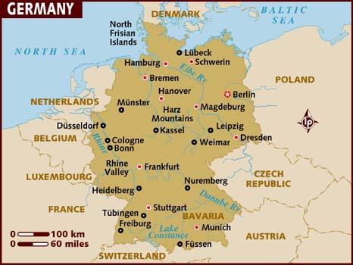
German Unification
Unified in 1871
Today

Slide 16
The following painting shows William I being crowned emperor of a united Germany.
What does the predominance of military uniforms suggest?

Slide 17
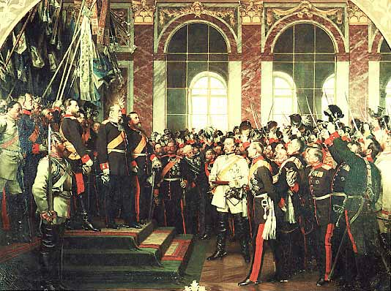

Slide 18
The German Empire
After Germany was unified, Bismarck established a legislature and drafted a constitution
Bismarck still had the power to veto, held a lot of power still

Slide 19
The German Industrial Giant
Germany emerged as the industrial giant in Europe
What factors may have lead to this?
Large, educated population
Ample iron and coal resources
Had built railroads and founded companies

Slide 20
Science, Government, and Industry
Government supported research and development
Hired trained scientists to work at universities
Developed synthetic chemicals and dyes
Issued a single currency and reorganized the banking system

Slide 21
The Iron Chancellor
What do the following quotes tell us about Bismarck’s rule?
“When you want to fool the world, tell the truth.”
People never lie so much as after a hunt, during a war, or before an election.”

Slide 22
Foreign and Domestic Policy
Foreign
Domestic
Keep France weak
Build up Austria and Russia
Leave Britain alone
Crush all opposition to his rule

Slide 23
Campaign Against the Church
Bismarck distrusted Catholics
Believed their true allegiance was to the Church not state
Launched Kulturkampf
“battle for civilization”
Passed laws so state could supervise Catholic education
Wanted to approve appointments of priests
Plan backfired, learns from his mistake

Slide 24
Campaign Against Socialists
Bismarck feared socialism would cause a revolution
Passed laws that dissolved socialists groups; shut own newspapers; banned meetings
Backfired, is forced to change stance
Awards German workers health insurance, retirement benefits

Slide 25
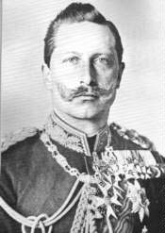
Kaiser William II
William II will replace his grandfather as kaiser (emperor)
Wanted to leave his own mark on Germany
Asked Bismarck to resign
Implemented social welfare programs
Improved education
Focused on military dominance

