Slide 1
Terrorism
In your head or on a scratch piece of paper, think of how you would define TERRORISM.
What are examples of terrorism that you can think of?

Slide 2
Group Work
Read through your group’s definitions of terrorism
Write down the similarities and differences between the definitions
Phrases, words, examples?
As a group, write a definition of terrorism
Based upon that definition, write down examples of terrorist acts
Notes:
Show video clip

Slide 3
Defining Terrorism
How do you define Terrorism?

Slide 4
What is Terrorism?
The use of violence and intimidation in the pursuit of political aims

Slide 5
Types of Terrorism

Slide 6
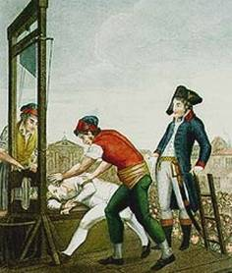
Historical Terrorism
Reign of Terror
First time “terrorism” was used to describe events
After WWII terrorism was used to gain independence from colonial rule
Nationalists in Israel, Kenya, and Algeria helped win their independence

Slide 7
Modern Terrorism
The Olympics of 1972 ushered in the modern age of terrorism
Munich Olympics
A Palestinian group, Black September, took Israeli athletes hostage in the Olympic Village
Wanted Palestinian prisoners in Israel released
Demands were denied
11 Israelis, 1 German, 5 out of 8 terrorists were killed
Notes:
Escalates terrorists attacks-frequency and destruction
Two hostages were killed immediately
German authorities agreed to give terrorists helicopter to fly to Arab country (planned to ambush)-went horribly wrong

Slide 8
Types of Terrorism
Religiously-Motivated Terrorism
State-Sponsored Terrorism
Domestic Terrorism

Slide 9
Religiously-Motivated Terrorism
Characteristics:
Terrorist groups have religious affiliation
Increased in the past decade
4 types
The World Gone Wrong
No Other Options
Cosmic War Against the Enemy
Symbolism and Violence
Examples:
9/11
Wisconsin Sikh Temple (2012)
Wade Michael Page
White supremacist
Murdered six people
Notes:
WGW-Losing their identity, globalization, actions are defensive
NOO-Cannot use political campaigns or social movements, feel powerless
CW-Struggle between good and evil, defend culture
SV-Targets chosen for symbolic value

Slide 10
State-Sponsored Terrorism
Characteristics:
Supported anonymously by government
More lethal
Weaker attack stronger
Example:
Iranian Hostage Crisis
Bombing of Korean Airlines (1987)
Notes:
52 Americans held hostage for 444 days
Protesting admittance of overthrown shah to the U.S. for medical treatment
Hostages were released at the start of the Iran-Iraq War
Commercial flight to S.K., bomb placed in overhead cabins

Slide 11
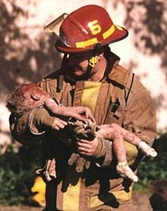
Domestic Terrorism
Characteristics:
Commit acts against their own country
Anti-government
White supremacists
Example:
Oklahoma City Bombing (1995)
OKC
McVeigh later justified his killing of children in the bombing: "I didn't define the rules of engagement in this conflict. The rules, if not written down, are defined by the aggressor. It was brutal, no holds barred. Women and kids were killed at Waco and Ruby Ridge. You put back in [the government's] faces exactly what they're giving out."
Notes:
Timothy McVeigh and Terry Nichols
Militia supporter, upset with the way government handled Branch Davidian standoff in Waco
Detonated bombs left inside a parked Ryder truck at 9:00 am on April 19, 1995
168 died, 19 were children (3 months)

Slide 12
Terrorism
Is it possible to argue that terrorism is effective and can be used for a “good” cause?
Case Studies

