Slide 1
TOTAL WAR
WWI

Slide 2
Total War
As the war continued, nations realized that this modern war required the total commitment of their whole society
Resulted in total war-the channeling of a nation’s entire resources into a war effort

Slide 3
Total War
Early on, both sides set up systems to recruit armies in the millions
All nations except Britain imposed conscription
The draft
Required all young men to be ready for military or other service
Between ages of 18 and 51
Notes:
Originally married men were exempt and age was 41

Slide 4
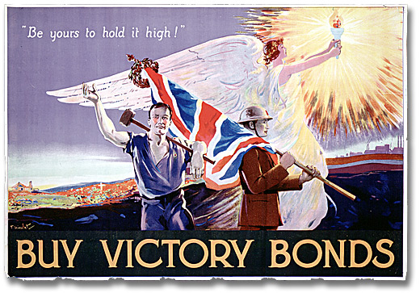
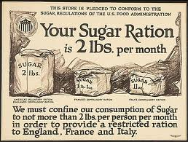
Total War
Governments also had to raise millions of dollars to support the war effort
Raised taxes
Rationed food
Rationed books, gasoline, sugar
Forbid strikes
War (Victory) bonds
Notes:
Bonds helped the government raise money for the war effort.
Sell for a certain price, earn interest, cash in later.

Slide 5
Impact on Women
Women played a critical role in WWI
Women took men’s jobs to help keep the economies going
Women also
Grew food
Victory Garden Plan
Worked as nurses

Slide 6
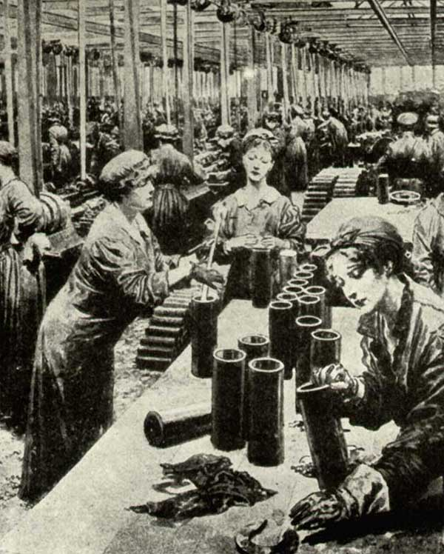
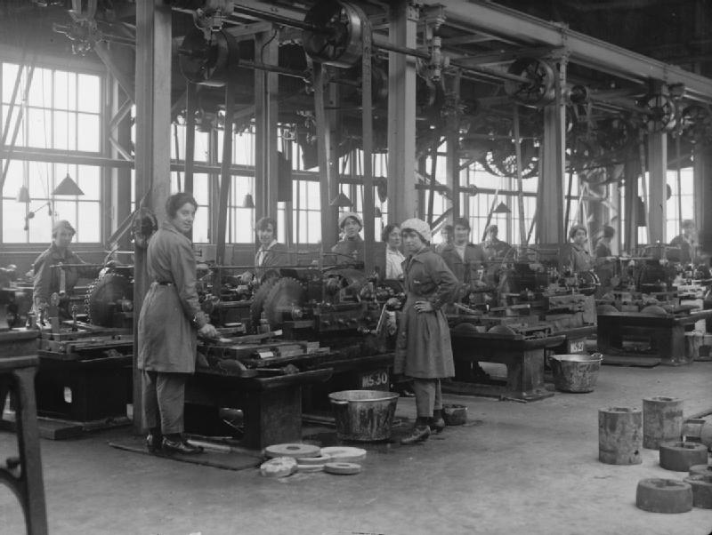

Slide 7
Impact on Women
War work gave women a new sense of pride
When men returned home they were forced to give up their jobs, but they proved women weren’t “delicate”
In many countries (Britain and the U.S.) women were given the right to vote

Slide 8
Propaganda
Total war meant controlling public opinion
In most countries the press and the arts were censored
Wanted to keep discouraging news and casualty numbers from reaching the public

Slide 9
Propaganda
Both sides of the war also waged a propaganda war
Propaganda is the spreading of ideas to promote a cause or to damage an opposing cause
Wanted to gain support for the war effort and encourage citizens to join

Slide 10
Total War
How did WWI impact all citizens?
Conscription
Rationed
Women served
Paid more taxes

