Slide 1
Warm-Up
Stalin rose to power by using what?
Propaganda
Loyal followers
The main purpose of Stalin’s Five-Year Plans was to?
Industrialize the Soviet Union
What were the effects of Stalin’s Five-Year Plans?
Industry rose
Low wages
Goods were scarce

Slide 2
The Rise of Fascism in Italy

Slide 3
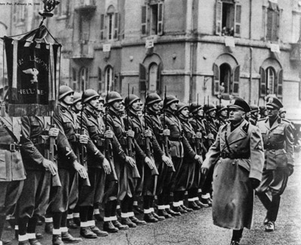
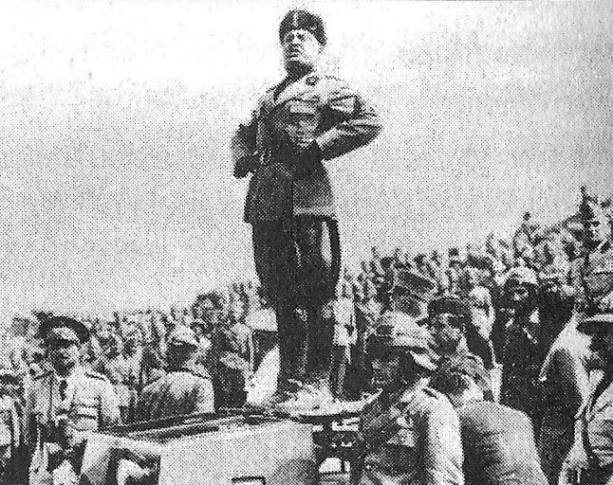
Fascism
Characteristics (choose 3):
Extreme nationalism
Blind loyalty to the state
Violence
Harsh discipline
Antidemocratic
Anti-Enlightenment
Citizens serve the state
Glorified warfare
“Survival of the Fittest”

Slide 4
Fascism
Fascists were sworn enemies of communism
Major difference:
Communists wanted international change while fascists pursued nationalist goals

Slide 5
Fascism
Fascism was mainly supported by business owners, wealthy landowners, and the lower-middle class
Communism was mainly supported by urban and agricultural workers

Slide 6
Fascist Government Structure
Six components (choose 3):
Single-party dictatorship
State control of the economy
Use of secret police
Strict censorship
Propaganda

Slide 7
Fascism in Italy
Why would Italians accept Mussolini’s rule?
Sense of power and control at a time of disorder and despair
Strong, stable government
End to political feuding
Revived nationalism

Slide 8
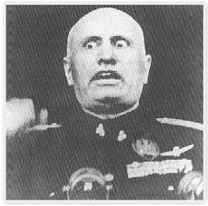
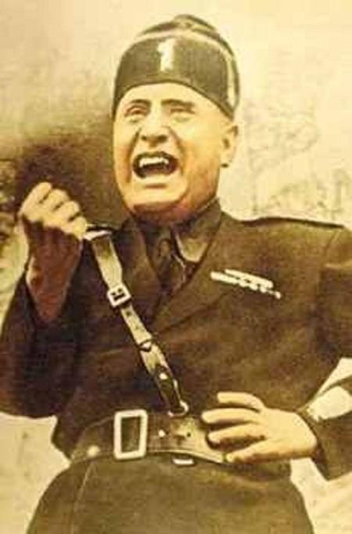
Benito Mussolini
Benito Mussolini would rise as the fascist leader of Italy
Led the country through WWII

