Slide 1
Warm-Up
Take out your “Wanted” worksheet.
Put your name on it and pass it forward.
What are characteristics of absolute monarchs?
Are the following people absolute monarchs? Why or why not?
The leader of Germany was elected and does not interfere with state governments. His people are allowed to vote.
The leader of Egypt seized power he believed was granted by God. He controls every part of the citizens’ lives. He has put many people to death who do not agree with his plans.

Slide 2
ABSOLUTE MONARCHS
Spain

Slide 3
5 Modern World Powers
After the age of exploration, 5 major world powers are going to emerge
Spain
France
England
Russia
Austria-Prussia

Slide 4
Spain’s Power
By the 1500s, Spain had emerged as the first modern European power
Queen Isabella and King Ferdinand had rid of the Muslim rulers and enforced unity
Also, they financed Columbus’s trip to the Americas

Slide 5
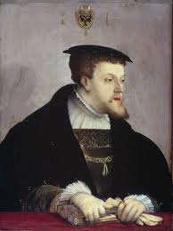
Charles V
In 1519, Charles V inherited the crown
Was in control of Spain and the Austrian Hapsburgs
Holy Roman Empire and the Netherlands

Slide 6
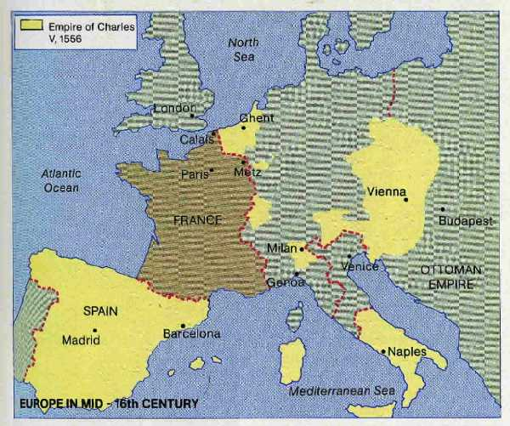

Slide 7
Charles V
This caused Charles to be in constant warfare
He was Catholic and wanted to suppress the Protestant movement, but he was unsuccessful
He also had to face the strong Ottoman Empire
Challenged Spanish forces in the Mediterranean

Slide 8
Philip II
Eventually Charles V felt overwhelmed and abdicated. He entered a monastery.
He left the Hapsburg Empire to his brother
He gave his son, Philip II, Spain and the overseas Spanish empire
The Philippines are named after him…

Slide 9
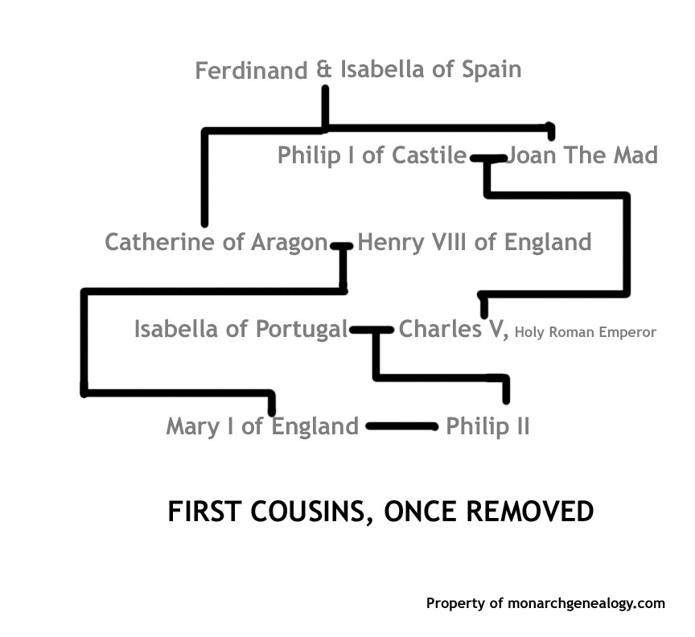

Slide 10
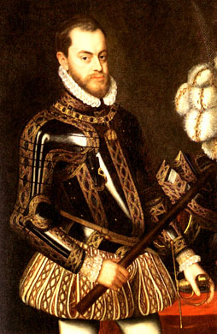

Slide 11
Reading
Read through the passage that discusses Philipp II’s impact on Spain
List at least three IMPORTANT/SIGNIFICANT facts

Slide 12
Philip II and Divine Right
Philip II wanted to expand Spanish influence, strengthen the Catholic Church, and make his own power absolute.
Spain was the foremost power in Europe, much in part from the silver in the Americas.
He asserted that he ruled by divine right.
Philip saw himself as the guardian of the Roman Catholic Church. He enforced religious unity.

Slide 13
Horrible Histories
In an attempt to expand Spanish influence Phillip II marries the Queen of England
https://www.youtube.com/watch?v=zL08qqQVrxM

Slide 14
The Wars of Philip II
By the 1580s, Philip saw England’s Queen Elizabeth I as his Protestant enemy.
Elizabeth I supported the Dutch independence from Spain.
She encouraged Sea Dogs to plunder Spanish treasure ships.
Francis Drake looted Spanish cities in the Americas. Elizabeth I made him a knight.

Slide 15
Spanish Armada
In 1588, Philip II the Spanish sent an armada to defeat the English.
The weather was a disadvantage and the Spanish armada was defeated.
In the 1600s and 1700s, Dutch, English and French fleets challenged, and surpassed, Spanish power in Europe and around the world.

Slide 16
The Spanish Armada

Slide 17
Spanish Armada video
http://www.schooltube.com/video/76ffa64c917142b5ae6a/The%20Spanish%20Armada

