Slide 1
THE PARIS PEACE CONFERENCE

Slide 2
The End of WWI
In 1918, a final battle was underway
Allied forces pushed German forces back across France and Belgium
In September, generals told the kaiser that war could not be won
German commanders advised William II to step down amid uprisings
Fled into exile in the Netherlands
Austria-Hungary was also headed for collapse
Nationalities revolted, splintering the empire

Slide 3
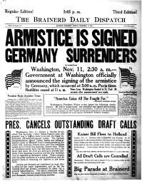
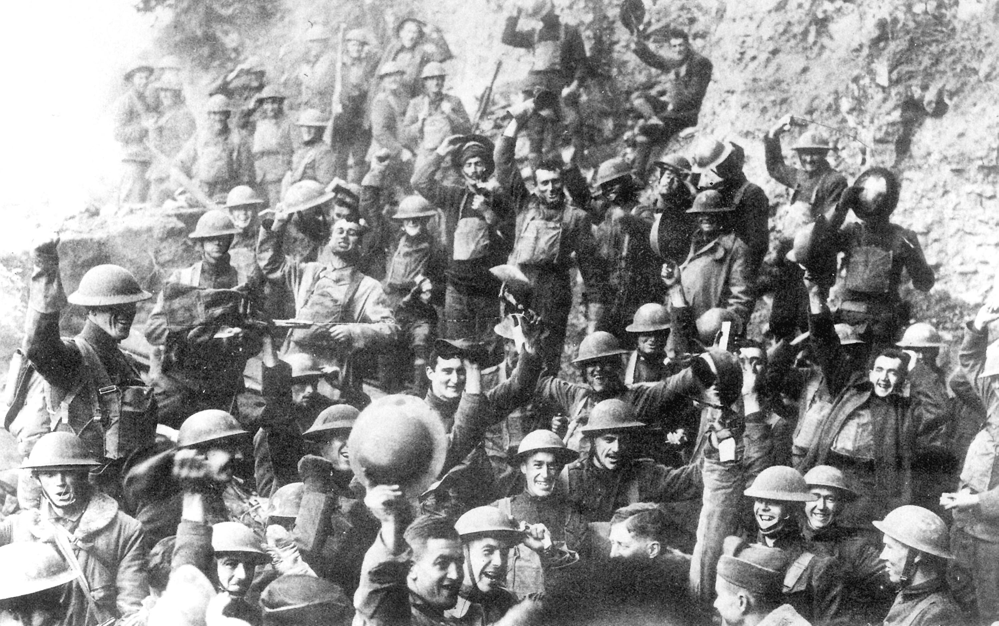
The Armistice
The new German government sought an armistice, or agreement, to end the fighting
At 11 a.m. on November 11, 1918, the Great War came to an end

Slide 4
The Paris Peace Conference
The Big Three (along with other leaders), Wilson, George, and Clemenceau, met in Paris to negotiate plans for the postwar world
They all had separate agendas:
Wilson: Fourteen Points
George: Harsh punishment for Germany
Clemenceau (“the Tiger”): Weaken Germany
Orlando: Wanted lands returned to Italy
Others: Wanted independent states

Slide 5
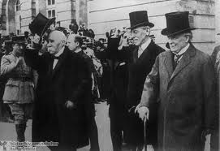
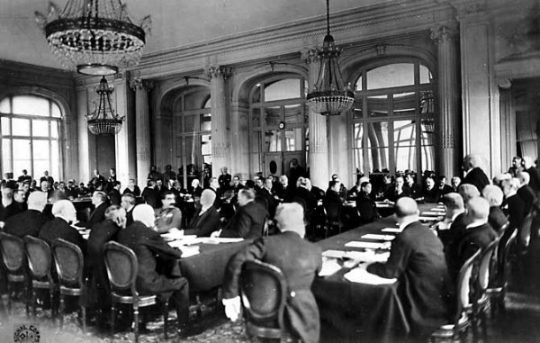

Slide 6
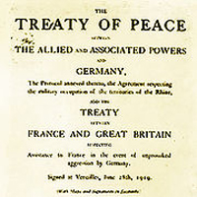
The Paris Peace Conference
In June 1919, the peacemakers met in the Palace of Versailles
The Germans would be ordered to sign the treaty drawn up by the Allies
The document horrified the Germans

Slide 7
The Treaty of Versailles
Conditions:
Germany accept blame
Reparations
Weakened Germany

Slide 8
The Paris Peace Conference
Other Effects:
New nations in the Baltic States
Latvia, Lithuania, Estonia
Poland regained independence
New republics in the Hapsburg Empire
Czechoslovakia, Austria, and Hungary
Slavic state
Yugoslavia
Mandate system
Britain and France took over German colonies in Africa and Middle East

Slide 9
The Paris Peace Conference
Other nations besides Germany were also angered by the outcome of the conference
Japan was ignored
Italy was not given lands
Russia was excluded from peace talks
However, League of Nations was formed

