Slide 1
Warm-Up 10/7
4. What were some of the economic issues France was facing under Louis XVI?
Overspending or deficit spending
Poor harvests
Failing to call the Estates General
5. What was the Tennis Court Oath?
Third Estate became the National Assembly
Refused to leave until a constitution had been created
6. Explain key points from the French Declaration of the Rights of Man and of the Citizen.
Equality
No cruel or unusual punishment
Right to property
Natural rights
Equal opportunity for jobs
Innocent until proven guilty
Freedom of expression

Slide 2
Warm-Up
10. Who was Robespierre?
The leader of the Committee on Public Safety
11. What was the goal of the Reign of Terror?
To crush all opposition to the revolution
BONUS:
Why did Robespierre use such violent methods?

Slide 3
Was the Reign of Terror Justified?
Be able to analyze and answer the following question:
Did the government have good reason to conduct a violent campaign against those who they believe to be against the goals of the French Revolution?
Read through the document and answer the questions.
If time permits, discuss and decide as a group if this information justifies the Reign of Terror.
Write your response on the board.
Word to Know:
Émigrés: French soldiers and aristocrats who fled France
Often wanted to start a counterrevolution

Slide 4
THE REIGN OF TERROR

Slide 5
Review
What happened to Marie Antoinette and Louis XVI?
Were forced back to Paris
Tried to escape
Were caught and returned to Paris

Slide 6
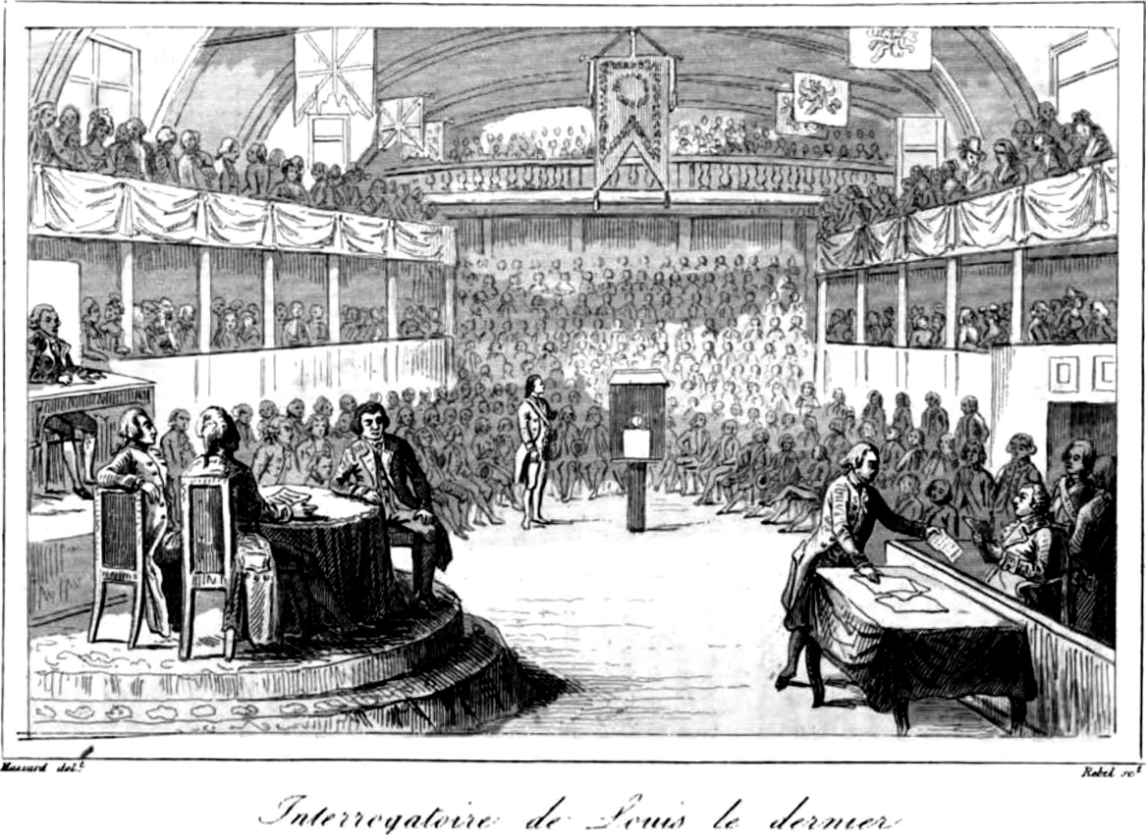
The Monarchy Abolished
As the revolution strengthened, radicals gained control of the National Assembly
Supported by those who were angered by France losing battles
They called for the election of a new legislative body called the National Convention

Slide 7
The Monarchy Abolished
The goals of the National Convention were to:
Extend suffrage
Abolish the monarchy
Declare France a republic
They made a new constitution for France

Slide 8
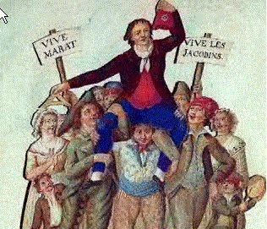
The Monarchy Abolished
The Jacobins, radicals who wanted France to be a republic, seized the lands of nobles and abolished their titles

Slide 9
The Monarchy Abolished
The Jacobins also put the king and queen on trial, Louis XVI was charged as a traitor
They were eventually executed by guillotine
Louis XVI was killed in January, Marie in October
The Guillotine
Notes:
Their son died of unknown causes.
Executed anyone who was closely related to avoid monarchy.

Slide 10
The Convention Responds
France was facing threats from war and a divided Convention
At was with Britain, the Netherlands, Spain, Prussia
Peasants and sans-cullotes
Jacobins and the Girondins
Counterrevolutionaries
To deal with these threats, the Convention created the Committee of Public Safety
Had almost absolute power as it battled to save the revolution
Notes:
Armies formed to fight wars (were successful)
Crushed peasant revolts
Girodins were more conservative
Made other monarchies nervous-revolutionary ideas

Slide 11
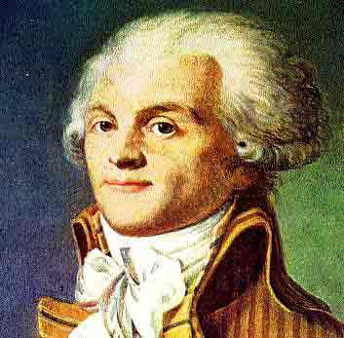
Maximilien Robespierre
As counterrevolutionaries began to act, Maximilien Robespierre took control of the government
He promoted religious tolerance, abolishing slavery
He wanted to crush any opposition to the the revolution
Notes:
Robespierre was a lawyer, a politician
Quickly rose through the ranks
“The incorruptible”
Enemies-tyrant

Slide 12
Maximilien Robespierre
He believed that France could become a republic only through the use of terror
“Liberty cannot be secured unless criminals lose their heads.”
The time period he was in control is known as the Reign of Terror
It is estimated the 40,000 people died
15% were nobles and clergy
15% were middle-class
The rest were peasants and sans-cullotes
Quickly became a witch-hunt

