Slide 1
The End of the Great War

Slide 2
Russia Exits the War
Revolution in Russia
Rumors that Russia was losing the war because of incompetent generals and corruption led to unrest
The Russian monarchy was overthrown
Allied Powers thought Russia would institute a democracy and become more powerful
1918, Vladimir Lenin signed the Treaty of Brest-Litovsk

Slide 3
Russia Exits the War
Impact on the War
Germany benefitted from Russia’s withdrawal
Could concentrate troops on Western front

Slide 4
U.S. Enters the War
Lusitania
May 1915, German U-Boat sank the Lusitania
Lusitania was carrying weapons
Germany agreed to restrict warfare so the U.S. would maintain relationship
However, in December 1916, Germany announced unrestricted submarine warfare
U.S. denounced Germany

Slide 5
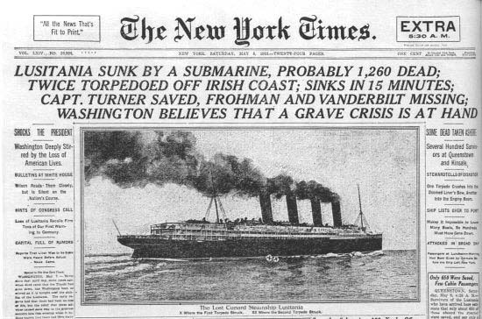
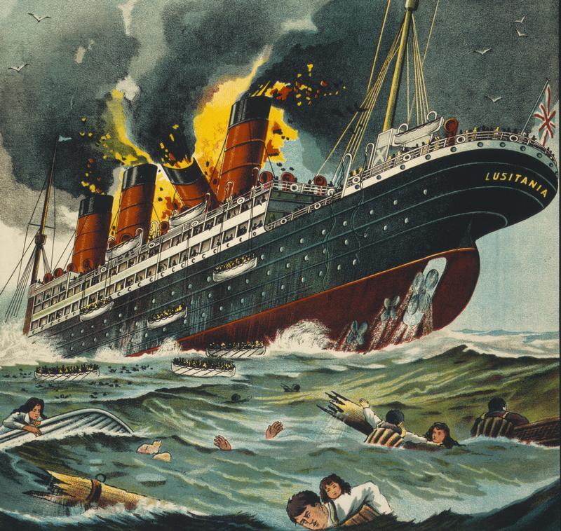

Slide 6
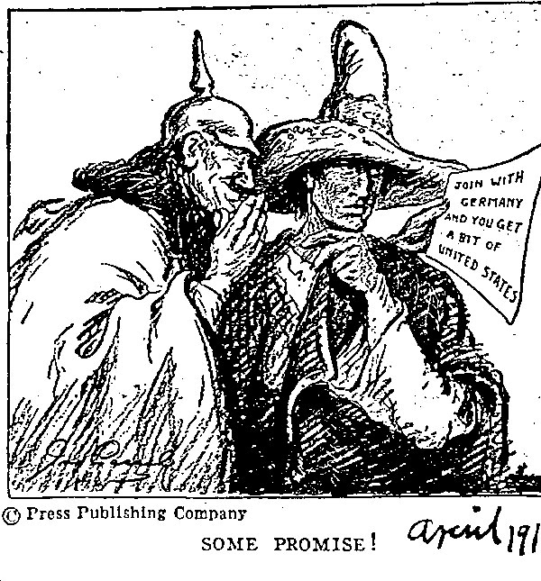
U.S. Enters the War
Zimmermann Note
In 1917, German foreign minister, Arthur Zimmermann sent a note to the ambassador in Mexico urging them to join the war
Britain intercepts the note and shares it with America

Slide 7
U.S. Enters the War
Declaring War
In April 1917, President Woodrow Wilson asked Congress to declare war on Germany
Provided a much-needed morale boost

Slide 8
End of the War
Germany and Austria-Hungary
Fighting continues for about another year
In September 1918, Germany realizes they will not win the war
U.S. helps Allies rebound
Nationalists revolt, protests increase
Ask Kaiser to bow out

Slide 9
End of the War
Armistice-agreement to end fighting
Declared at 11 A.M. on November 11, 1918

Slide 10
The Costs of War
8.5 million people died
Many were handicapped for life
Famine was widespread

Slide 11
The Costs of War
Financial Burdens
In battle zones, everything was destroyed
Homes, factories, farms, roads, churches
Everyone is looking for someone to blame
Allied Powers wanted to make losers and enemies pay for damages
The Central Powers looked for a scapegoat

Slide 12
The Costs of War
Political Turmoil
Governments collapsed under the stress of war
Revolutions begin
Many were cynical

Slide 13
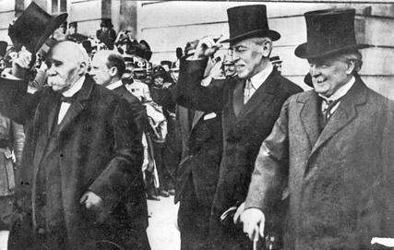
The Paris Peace Conference
The Big Three
World leaders meet in Paris in 1919 to work out peace terms
Woodrow Wilson
Peace
David Lloyd George
Blame Germany
Georges Clemenceau
Weaken Germany

Slide 14
The Paris Peace Conference
Difficult Issues
Peace conference is not without problems
Self-determination
Italy received lands once ruled by Austria-Hungary
Nationalists wanted own states

Slide 15
The Paris Peace Conference
Two other ideas emerged during the conference
The Treaty of Versailles
Wilson’s Fourteen Points

Slide 16
Woodrow Wilson’s Fourteen Points
1. No more secret agreements ("Open covenants openly arrived at").
2. Free navigation of all seas.
3. An end to all economic barriers between countries.
4. Countries to reduce weapon numbers.
5. All decisions regarding the colonies should be impartial
6. The German Army is to be removed from Russia. Russia should be left to develop her own political set-up.
7. Belgium should be independent like before the war.
8. France should be fully liberated and allowed to recover Alsace-Lorraine
9. All Italians are to be allowed to live in Italy. Italy's borders are to "along clearly recognisable lines of nationality."
10. Self-determination should be allowed for all those living in Austria-Hungary.
11. Self-determination and guarantees of independence should be allowed for the Balkan states.
12. The Turkish people should be governed by the Turkish government. Non-Turks in the old Turkish Empire should govern themselves.
13. An independent Poland should be created which should have access to the sea.
14. A League of Nations should be set up to guarantee the political and territorial independence of all states.

