Slide 1
THE COLD WAR: AN OVERVIEW

Slide 2
Imperialism
After WWII, colonial empires that western powers had built began to fall apart
Nationalist movements in Africa and Asia began in the 1930s
Imperial powers tried to maintain control, however, they lacked the will to fight for them
WWII had exhausted their military and financial resources

Slide 3
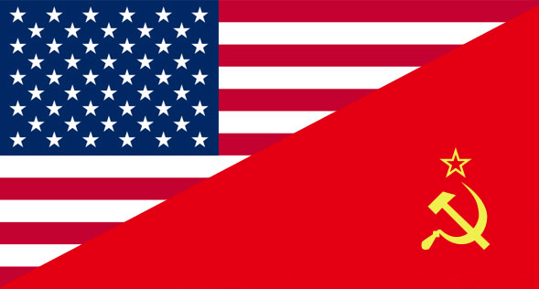
Imperialism
The Cold War also undermined imperialism

Slide 4
The Cold War Begins
After WWII, the Soviet Union and the United States will emerge as the world’s superpowers
Each sought allies in the newly emerging colonies
What are they fighting about?
Political ideologies
Communism vs Capitalism/Democracy

Slide 5
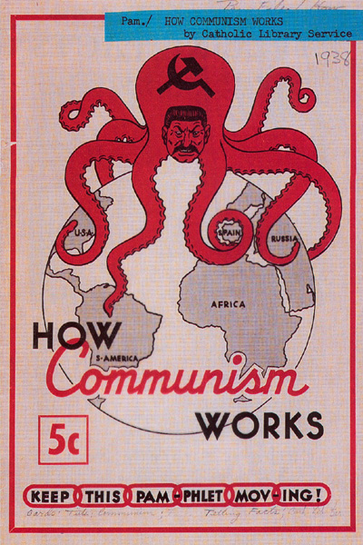
The Cold War Begins
America’s goal during the Cold War was to stop Communism from spreading
Did not want the newly emerging nations to turn to communism

Slide 6
The Cold War Turns Global
In Africa, Latin America, and Asia, local conflicts became entangled in the Cold War
U.S. supported one side, the Soviets supported the other
Examples:
Korea
Vietnam

Slide 7
International Organizations
During the Cold War, nations became increasingly interdependent and involved
Technology and communication
This interdependence has created some conflicts/issues along with opportunities

Slide 8
International Organizations
A number of organizations have been established to deal with this issues
United Nations
Peacekeeping organization
World Health Organization
Access to healthcare
General Agreement on Tariffs and Trade
Fair trade policies
World Trade Organization
Establish rules of trade
International Monetary Fund
Loans money to developing nations

