Slide 1
Opening Activity
Grab the worksheet with a graph from the front table.
Answer the questions over the graph.
Put your homework assignment on the corner of your desk.

Slide 2
THE AFTERMATH
WORLD WAR II

Slide 3
The Aftermath
Costs of War
75 million people were killed
In Europe, 38 million people died-many civilians
22 million people died in the Soviet Union alone
Video clip

Slide 4
The Aftermath
Horrors of the Holocaust
While the Allies knew about the Nazi concentration camps, many underestimated the full extent of the conditions
People around the world were horrified and outraged

Slide 5
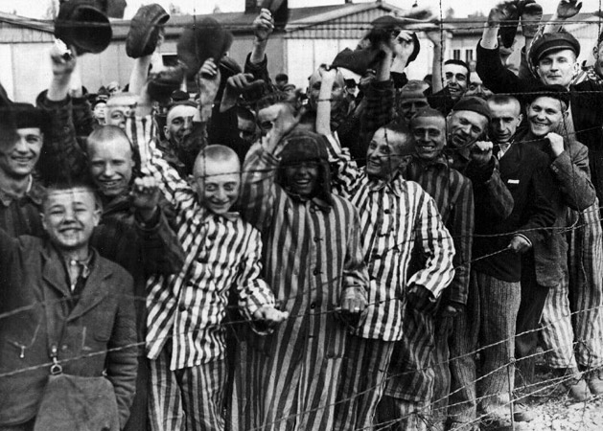

Slide 6
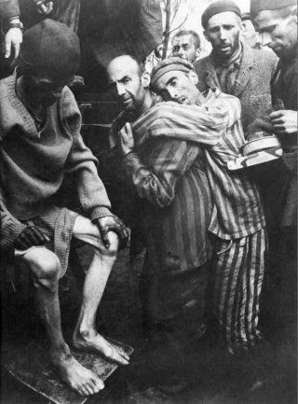

Slide 7
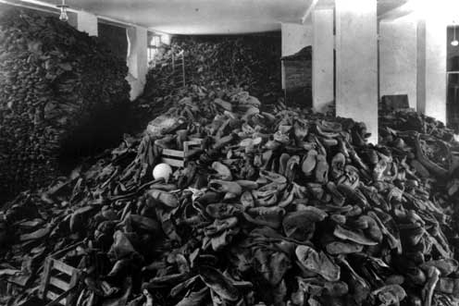

Slide 8
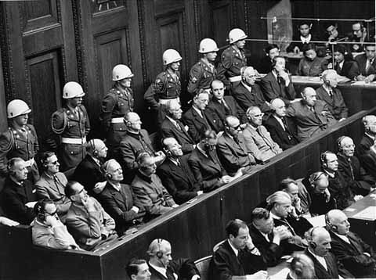
The Nuremberg Trials
At a meeting, the Allies decided that many Axis leaders needed to be held accountable for their actions in wartime

Slide 9
The Nuremberg Trials
The trials were held in Nuremberg, Germany
177 people were tried
142 were found guilty
12 people were executed

Slide 10
The Nuremberg Trials
The trials served an additional purpose
Discredited Nazism, Fascism, and Militarism regimes
Strengthened principles of democracy

Slide 11
The United Nations
In April 1945, delegates from 50 nations met to draft a charter for the United Nations
There were five permanent members of the UN
U.S., Soviet Union, Britain, France, China
Security Council

Slide 12
The United Nations
Goals:
Peacekeeping
Prevent disease
Protect refugees
Help nations

Slide 13
The Alliance Breaks Apart
During the war, Allied Powers cooperated to defeat Nazi Germany
After the war ends distrust will grow
Leads to the Cold War

Slide 14
New Conflicts Develop
Churchill had long distrusted the Soviet Union
Described the Soviet Union’s control of Eastern Europe as an “iron curtain”
Symbolized the growing fear of communism

Slide 15
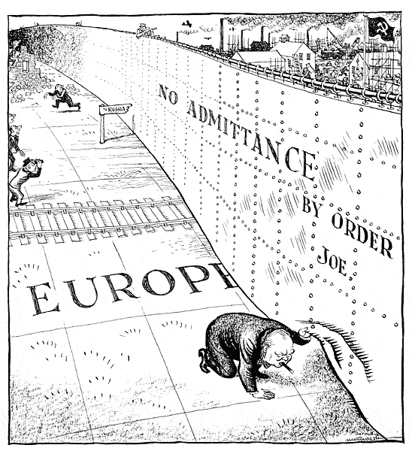

Slide 16
New Conflicts Develop
President Truman also sees communism as an evil force
After a series of conflicts involving the Soviet Union, the U.S. takes action
The Truman Doctrine wanted to contain communism to countries already under Soviet control

Slide 17
New Conflicts Develop
U.S. enacts another plan to help out Western Europe
The Marshall Plan
The U.S. sent aid to help countries rebuild

Slide 18
New Conflicts Develop
Stalin saw the plan as a trick to win Eastern Europe over to capitalism and democracy
He forbade Eastern European countries to accept help

Slide 19
New Conflicts Develop
Defeated Germany became another focus of the Cold War
Germany was divided into two zones
Soviet Union controlled one zone (Communist)
Britain, France, and the U.S. supported the other (Democratic)

Slide 20
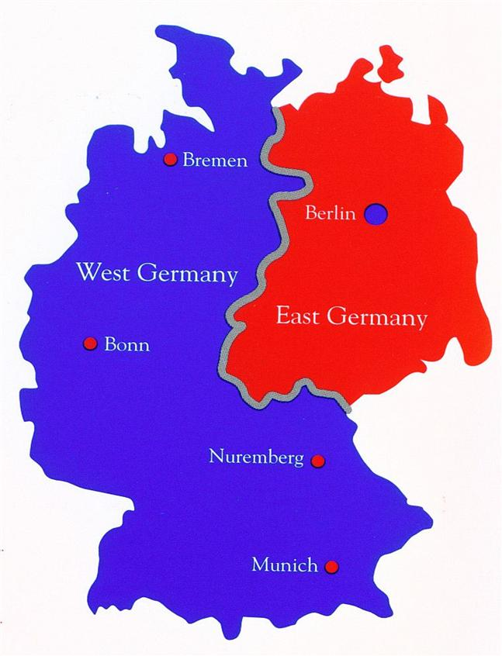

Slide 21
Looking Ahead
Military Alliances were created
NATO
Warsaw Pact
Arms Race began
Cold War will last until 1991

