Slide 1
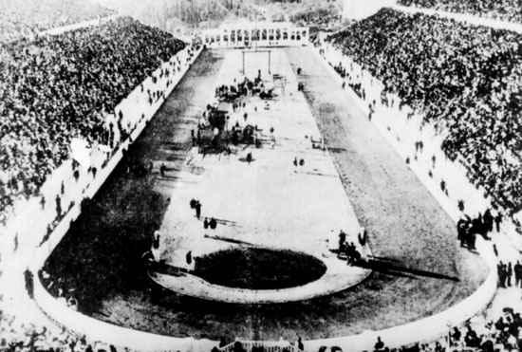
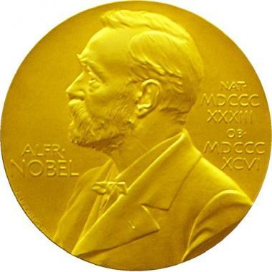
The Pursuit of Peace
By the early 1900s, efforts were underway to end war and foster understanding between nations
Olympics in 1896 (Athens)
Nobel Peace Prize
Women’s International League for Peace and Freedom
First Universal Peace Conference
Hague Tribunal
Notes:
Olympics wanted to promote “love of peace and respect for life.”
Alfred Nobel regretted how dynamite was used, wanted to reward people who worked for peace.
Women wanted right to vote-prevent war as they do not feel the same about it as men.
Hague Tribunal used to settle dispute between nations

Slide 2
The Pursuit of Peace
Despite all of these efforts war will eventually break out
What would be some reasons?
Militarism
Alliances
Imperialism
Nationalism

Slide 3
Leaders of wwi

Slide 4
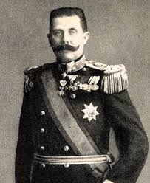
Archduke Franz Ferdinand
Heir to the Austrian-Hungarian throne
Assassination “sparked” WWI

Slide 5
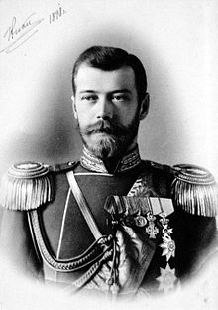
Czar Nicholas II
Leader of Russia during WWI

Slide 6
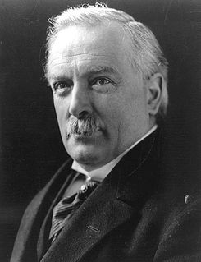
David Lloyd George
British prime minister during WWI

Slide 7
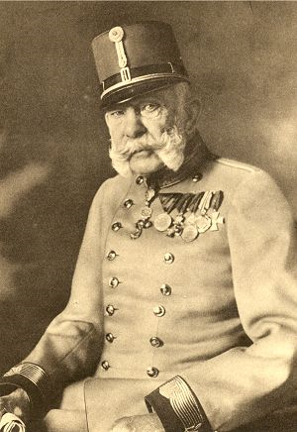
Franz Joseph
Emperor of Austria-Hungary during WWI

Slide 8
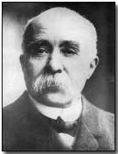
Georges Clemenceau
French president during WWI

Slide 9
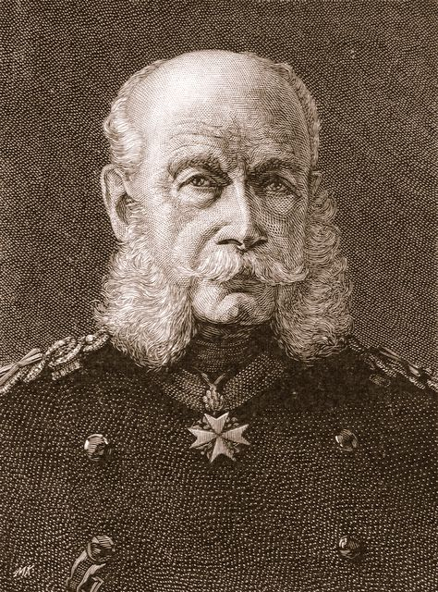
Kaiser Wilhelm II
German monarch during WWI

Slide 10
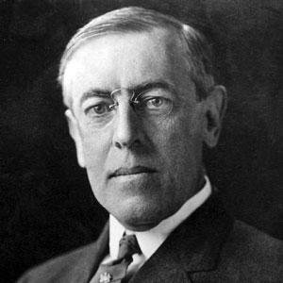
Woodrow Wilson
U.S. president during WWI

Slide 11
The “Spark”
The Beginning of WWI

Slide 12
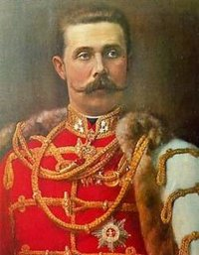
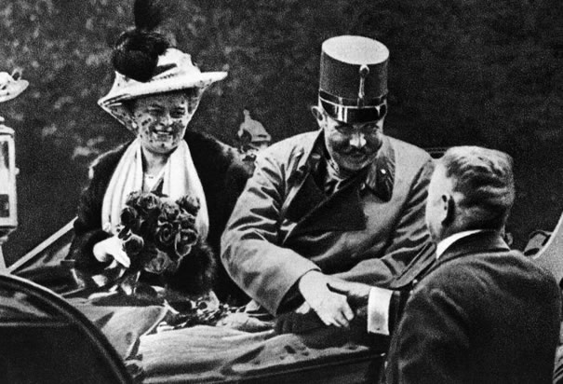
The “Spark”
Archduke Franz Ferdinand
Heir to the Austrian-Hungarian throne

Slide 13
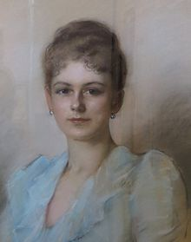
Archduke Franz Ferdinand
Decided to visit Sarajevo-capitol of Bosnia
Bosnia was ruled by Austria-Hungary before WWI
Wanted to check on Austro-Hungarian troops
He decided to take his wife Sophie with him

Slide 14
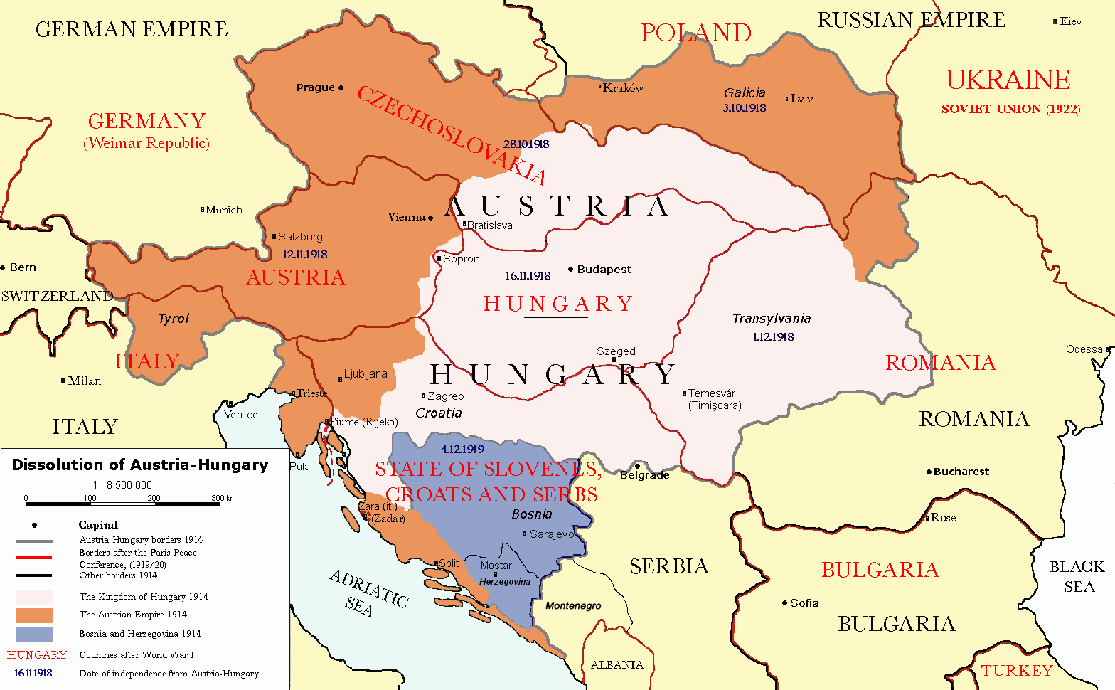

Slide 15
The Plot
Archduke was to arrive on June 28, 1914
The Serbian nationalists were angered by this
They viewed the Austrians as foreign oppressors
Wanted to control Bosnia
The terrorist group, The Black Hand, vowed to tack action and decided he needed to be assassinated

Slide 16
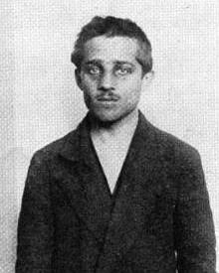
The Assassination
Several mistakes are made before the actual assassination
Gavrilo Princip assassinated the Archduke and his wife
He was apprehended and eventually died of tuberculosis
The assassination of Archduke Franz Ferdinand is considered the “spark” that began WWI

Slide 17
The Conflict Widens
The death of Archduke Franz Ferdinand shocked the world
Austria sent Serbia an ultimatum
End all anti-Austrian sentiment and punish those involved
Serbia only agreed to certain demands-not all
On July 28, 1914 Austria declared war on Serbia

Slide 18
War Begins
Normally, a war between a large country and a smaller country would not have exploded into a world war
However, alliances will change this

Slide 19
A System of Alliances
Germany pushes Austria-Hungary to war
Kaiser Wilhelm II horrified by assassination
Serbia seeks help from Russia
Russia asked Germany to urge Austria to soften demands
Russia asks France for help
France wanted to avenge Franco-Prussian War
Germany urged France to stay out
They refuse and Germany declared war

Slide 20
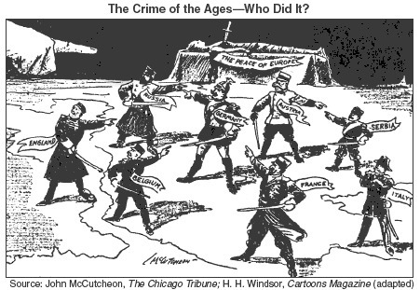

Slide 21
A System of Alliances
At this point, Italy and Britain were not involved in the war
However, Germany’s war plan would soon change this
General Alfred von Schlieffen developed a plan of attack against France
It’s goal was to avoid a two-front war against France and Russia
Notes:
Thought Russia would be slow to mobilize, could defeat France first

Slide 22
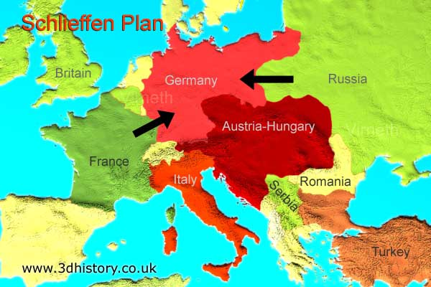

Slide 23
The Schlieffen Plan
Germany first needed to march through Belgium
On August 3, 1914 troops invaded Belgium
However, Britain had signed a treaty to protect Belgium’s neutrality
Britain declared war on Germany

Slide 24
Early Battles
“The Great War” had begun
French mobilized 8.5 million troops, Britain 9 million, Russia 10 million, and Germany 11 million
Enthusiasm for the war began to fade early on
No easy victories
Deadlier than any other conflict

Slide 25
War and the Colonies
European colonies were drawn into the struggle
Many were reluctant to serve
Others wanted to help
Thought they would gain independence

Slide 26
A Global Conflict
More and more nations continue to join the war
China
Japan
Australia (British colony)
Ottoman Empire
Egypt
Sudan

