Slide 1
TERRORIST ORGANIZATIONS

Slide 2
Terrorist Organizations
The following organizations are terrorist organizations recognized by the US
Criteria for designation
Must be a foreign organization
Must engage in terrorist activities
Must threaten the security of US or US interests
National defense
Foreign relations
Economic interests

Slide 3
Hamas
Locations:
Mainly Palestine
Qatar
Goals:
To liberate Palestine from Israeli occupation
Israel return to 1967 borders AND allow Palestinian refugees to return to what is now Israel
Provide social services to Palestinian refugees
Soup kitchens, orphanages, sports leagues
Was designed as a “charitable organization”
Notes:
Worth: $1 billion

Slide 4
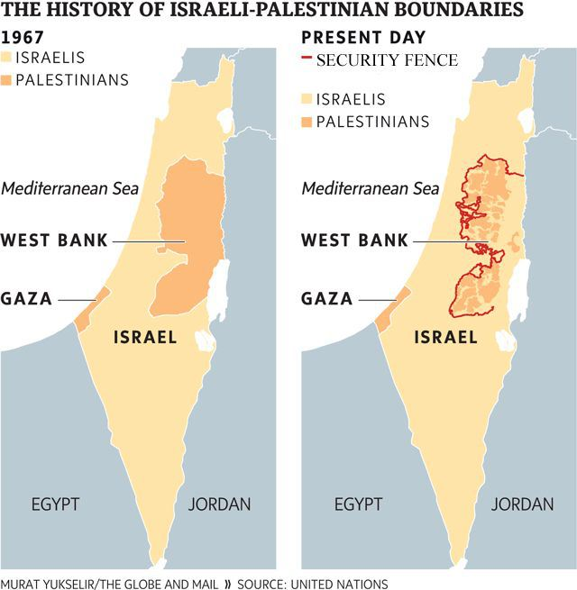

Slide 5
Hamas
Actions:
Rocket attacks on Israel
Suicide bombings
Notes:
Almost 50% of their funding comes from Saudi Arabia (US ally)

Slide 6
FARC
Revolutionary Armed Forces of Colombia
Location:
Colombia
Goals/Philosophies
Represent the poor people of Colombia
Militant wing of Communist party
Notes:
Worth: $600 million

Slide 7
FARC
Actions:
Kidnapping
Drug production and sales
Extortion
Notoriously uses landmines to injure civilians and military personnel

Slide 8
Hezbollah
Location:
Lebanon
Goals/Philosophies
End Israel’s occupation of southern part of Lebanon
Completed in 2000
Claim still occupy farms in Syria
Spread Islamic revolutionary ideas
Anti-Holocaust
Spread anti-Semitic ideals
Notes:
Worth: $500 million

Slide 9
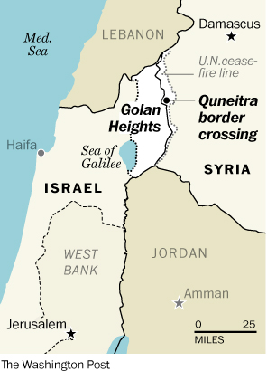

Slide 10
Hezbollah
Actions:
Political party
Missile attacks on Israel
Israeli embassy attack in Argentina 1992
Major presence in Syria
Notes:
29 killed, almost 300 injured

Slide 11
al-Qaeda
Locations:
Worldwide
Originated in Afghanistan
Soviet invasion
Goals/Philosophies:
Wants to replace man-made laws with sharia law
Believes Jewish-Christian coalition is seeking to destroy Islam
Notes:
20,000+ members
Worth: $150 million
Money from bin Laden’s personal account, heroin trade
Sharia: law made from prophecy

Slide 12
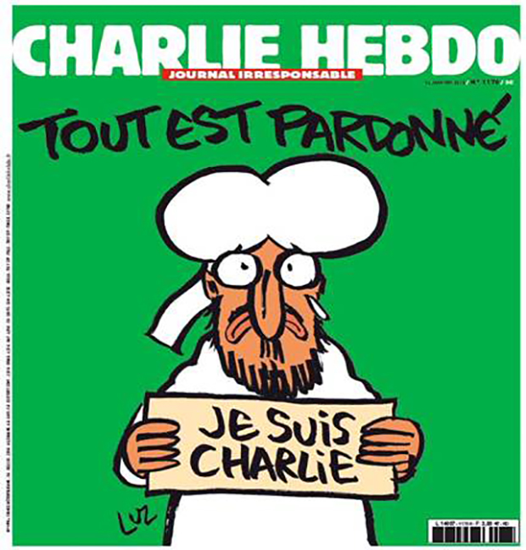
al-Qaeda
Actions:
9/11
1998 US Embassy bombings
2002 Bali bombings
1993 WTC Bombing
Charlie Hebdo 2015
Notes:
Bombings in Tanzania and Kenya

Slide 13
Lashkar-e-Taiba
Locations:
South Asia
Mainly Pakistan
Afghanistan, India, Bangladesh
Goals/Philosophies:
Create Islamic state in South Asia
“Free” Muslims living in Indian Kashmir
Notes:
Worth: $100 million
Banned by Pakistani government, once supported
Funneled relief aid

Slide 14
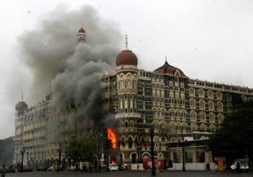
Lashkar-e-Taiba
Actions:
2008 Mumbai Attacks
2001 Indian Parliament
Various bombings and attacks on Indian civilians and military
Notes:
12 coordinated shooting and bombings; killed 164, injured over 300
14 killed in Parliament attack

Slide 15
Al-Shabaab (youth)
Locations:
Somalia
Yemen
Kenya
Uganda
Goals/Philosophies:
Off-shoot of al-Qaeda
Believe in strict interpretation of Islamic law
Create Islamic state
Notes:
7.000-9,000 members
Worth: $70 million

Slide 16
Al-Shabaab
Actions:
Persecuted Christians
Westgate Mall Attacks 2013
Kenya-Garissa University attack 2015
Use the media
Operate own radio station from stolen equipment
Notes:
Mall: killed 64

Slide 17
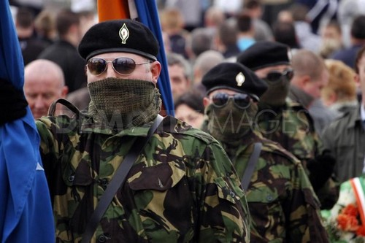
Real Irish Republican Army
Location:
Ireland
Goals/Philosophies:
United Ireland
Rid of British control of Northern Ireland
Notes:
Partitioned in 1921; northern under British control; Protestants remained loyal to Britain; Catholics felt oppressed

Slide 18
Real Irish Republican Army
Actions:
Target British military and Northern Ireland police force
Omagh 1998
Killed 29
Injured over 200
Notes:
Omagh-worst incident

Slide 19
Boko Haram
Locations:
Nigeria
Chad
Cameroon
Niger
Goals/Philosophies:
Name
Loosely translated: Westernization is evil
Establishment of Islamic state in Nigeria
Supports ISIS/ISIL
Notes:
7,000-10,000
Worth: $52 million

Slide 20
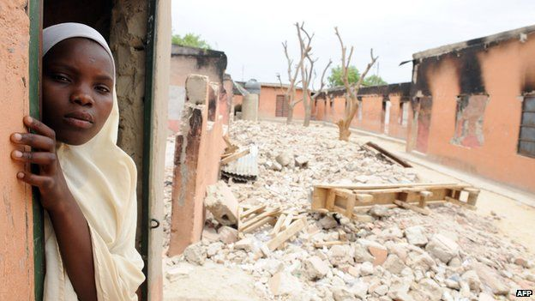
Boko Haram
Actions:
Kidnapping
Schoolgirls in 2014
Suicide bombings
Estimated they have killed 13,000 civilians between 2009 and 2015
School attacks

Slide 21
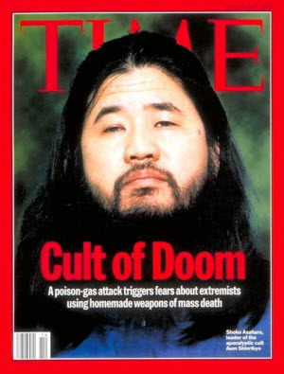
Aum Shinrikyo
Location:
Japan
Goals/Philosophies:
Restore “original Buddhism”
Founder was “Christ”
Followers would be saved when WWIII occurred
Instigated by US

Slide 22
Aum Shinrikyo
Actions:
Held members against their will
Extortion
Assassinations of critics
Tokyo subway attacks 1995
Sarin gas
Killed 13
Injured thousands

Slide 23
Abu Sayyaf
Locations:
Philippines
Malaysia
Goal:
Want an independent Islamic province in the Philippines
Flag of Jihad
Notes:
They have 200 to 400 members

Slide 24
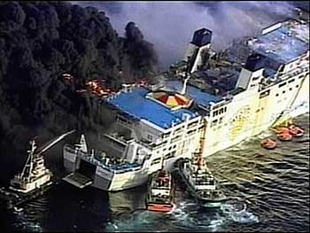
Abu Sayyaf
Actions:
Bombings, kidnappings, drug trafficking, extortion, and assassinations
Bombing of Superferry in 2004
Killed 116 people
Worst terrorist attack in the Philippines

Slide 25
ISIS/ISIL
Islamic State of Iraq and Syria
Islamic State of Iraq and the Levant
Locations:
Iraq
Syria
Nigeria
Libya
Sleeper cells
Goals/Philosophies
Claim religious, political, and military authority over Muslims worldwide
Create an Islamic state
Promotes religious violence
Notes:
Establish a caliphate-leadership under caliph-direct descendant of Mohammed
Worth: $2 billion (richest)
80,000+ members

Slide 26
ISIS/ISIL
Actions:
Killing of Syrian soldiers
Religious and ethnic killings of civilians
Created sharia schools
Taken over parts of Iraq and Syria
Kidnappings and beheadings of westerners
Child soldiers

Slide 27
Project
Choose one terrorist attack to research
Create visual aid that summarizes terrorist attack
Other students will use this to gather information
Who, What, When, Where, Why, How
Were they caught/punished?
What type of terrorism is it?
Must include an APPROPRIATE picture

Slide 28
Attacks
1993 WTC
Boston Marathon
Pan AM Flight 103 (1998)
Baruch Goldstein
Tokyo Subway Attacks
Westgate Shopping Mall (2013)
Benghazi (2012)
Charlie Hebdo (2015)
Beltway Sniper
Anthrax (2001)
Madrid Train Bombings (2005)
Beslan School Siege (2004)
Mumbai Attacks (2008)
London Bombings (2005)
Beltway Sniper Attacks (2002)
Garissa University (2015)
Paris Attacks (2015)
San Bernardino (2015)

