Slide 1
Set your homework assignment on the corner of your desk!

Slide 2
Warm-Ups
Why did Spanish explorers travel to the Americas?
Gold, spread Christianity, glory
Why did some native people help defeat the Aztec empire?
Hated rulers-sacrifices
What is one major negative impact of encounter between the Spanish and Native Americans?
Disease, killed 90% of population
BONUS: What are the three reasons the conquistadors able to defeat the Aztec and Incan empires?
Technology, alliances, disease

Slide 3
POWER AND INFLUENCE IN THE AMERICAS
World History

Slide 4
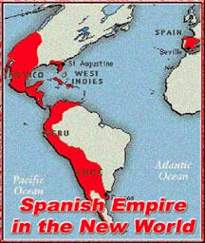
Spain (Location & Economy)
Location
California to South America including Mexico (New Spain), Central America, Peru
Economy
Colonies export raw materials only to Spain, no trading with other colonies
Gold, sugar cane, slaves to Caribbean
Notes:
Forced Native Americans to work under brutal conditions.
Resist? Hunted down and killed.

Slide 5
Spain: Culture
Cultural Blending
Social Structure
Strict, dividing social structure
See pyramid
Cities
Mexico City became largest Spanish speaking city by 1550
Education
Built universities to meet need for educated priests
Women could be educated if join a convent
Religion
Missionaries convert natives to Christianity
Built missions and churches
Notes:
Native, Americans, African, and European peoples and traditions blended to create a new culture

Slide 6
Portuguese Territories (orange)
Notes:
A large area of South America remained outside the Spanish empire, ruled by Portugal
Treaty of Tordesillas allowed Portugal to claim Brazil

Slide 7
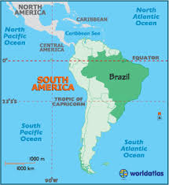
Portugal (Location & Economy)
Location
Brazil (South America)
Economy
Brazilwood, plantation, agriculture, and cattle raising
Forced Natives and Africans in to slavery
No gold or silver

Slide 8
Portugal: Culture
Blended European, Native American and African culture
European culture dominated the upper and middle classes
Native American and African influences were still powerful

Slide 9
The Struggle for North America
In the 1600s, other European powers moved into the Americas and began building settlements
France, the Netherlands, England, and Sweden began claiming parts of North America
The English and French dominate the territory
Notes:
Were not able to find the vast treasures or water route to Asia they had hoped, but began growing tobacco, building fishing villages, and trading fur.
They developed their own governments as well.

Slide 10
Notes:
Based on this map, which nation do you think would eventually dominate North America?

Slide 11
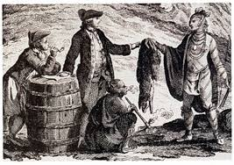
France (Location & Economy)
Location
France’s territory extended from Quebec to the Great Lakes to Louisiana and the Gulf of Mexico
Economy
Based mostly on fishing and fur trading
Canadian climate was too harsh for farming

Slide 12
France (Growth & Government)
Government
Louis XIV supported colonies
Boosted taxes
Officials oversaw colonies
Population
Larger territory
Population was smaller than the English colonies – less people

Slide 14
England (Location & Economy)
Location
East coast of North America
Economy
Based on farming

Slide 15
England (Growth & Government)
Government
Ruled by overseas monarchs
Was a larger degree of self-government
Population
Larger population, less amount of land
Established 13 colonies

Slide 16
Notes:
Who ends up “winning” North America?

Slide 17
Group Work
Goal: Understand the impact of exploration on the native populations.
Read through the poems, passages, examine the pictures
Discuss and write your initial reactions
Then, write down what these items tell us about the impact of exploration
One sheet per group!
Turn in with everyone’s name on it

