Slide 1
Sociology
Need green book and folders!
Chapter 1
Mrs. McVey

Slide 2
Student Info Notecards
Name at the top (First and Last)/ Sociology
Guardian/Parents’ name(s), email addresses, phone numbers (fill in what you know)
Your daily schedule (1st hour through GPS)
  Include room # and teacher’s last name please
On the back….
  Extracurricular activities (sports, clubs, work etc.)
  Anything you want me to know about you

Slide 3
Note card example
Mrs. McVey Sociology 1st hour
Vanessa Wheeler mom@mom.com
Dan Wheeler Daddy@dad.com 402-123-5678
1^{st Sociology McVey}
2^{nd Government Williams}
3^{rd English Smith}
4^{th Choir Reimer}
5^{th Study hall Ross}
6th
7th
GPS

Slide 4
Respect
Reliable, responsible, real, reasonable, retain, reason, relate
Empathy, equality, eager, excited
Sensitive, sympathetic, social, self-control, silence
Patience, polite, perspective, participate, pride, productive, positive
Extremely nice, effort, expectation, encouragement
Compassion, caring, courteous, composure, common sense
Trust, timely, truthful, tolerant, thoughtful

Slide 5
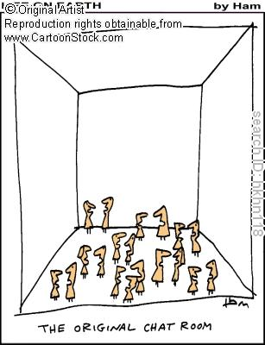

Slide 6


Slide 7
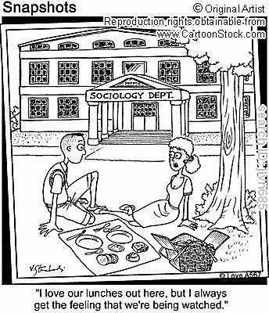

Slide 8
What is Sociology?
The systematic study of human society.
The systematic study of human social interaction.
The systematic study of social and physical environments and their effects on our experience and behavior as individuals.

Slide 9
The Sociological Perspective
This is a distinctive point of view at the core of the discipline of Sociology.
Seeing the general in the particular – (sociology helps us see the general patterns in the behavior of particular people).
Seeing the strange in the particular – (we come to experience the variations that exist in society).
Seeing individuality in social context – (social forces are at work in society to influence our most personal actions) _Emile Durkheim.

Slide 10
Benefits of the Sociological Perspective
Helps us critically assess ‘common sense’ ideas.
Reveals the opportunities & constraints in our lives
Empowers us to be active participants in our society (identifying social forces and understanding their consequences).
Helps us live in a diverse world by facilitating a critical assessment of our way of life.

Slide 11
What Sociologists Do
-Applied Sociology
Shaping public policy and law
Various professional fields –
Advertising, Banking, Criminal Justice, Education, Government, Healthcare, Public Relations and Research
Other areas of concentration-
-Clinical Sociology (focuses on a person’s web of social relationships)
-Evaluation research

Slide 12
A Global Perspective
-The study of the larger world and our society’s place in it.
Where we live makes a great deal of difference.
Societies throughout the world are increasingly interconnected (the ‘global village’ concept).
Many social problems that we face in the US are far more serious elsewhere.
Thinking globally helps us learn more about ourselves – why do we deal with circumstances differently?

Slide 13
THE ORIGINS OF SOCIOLOGY
Social Change & Sociology
Industrial technology
When large mills and factories replaced subsistence agriculture and small scale manufacturing, the new system separated families and weakened long-standing traditions
The growth of cities – Urbanization
Former land owners who lost their land migrated to the cities in search of work in the factories. With urbanization came problems such as pollution, crime, homelessness
Political change – (Individualism)
Economic development gave rise to expressions such as: individual liberty and individual rights.

Slide 14
Science and Sociology
The early thinkers were fascinated by the nature of human society and were more interested in conceiving an ideal society rather than analyzing it as it was.
The founding fathers of Sociology, on the other hand cared about how it can be improved.
The name Sociology was coined by Auguste Comte (a French thinker). He saw Sociology as the product of a three-stage historical development:
  Comte favored positivism – a way of understanding based on science

Slide 15
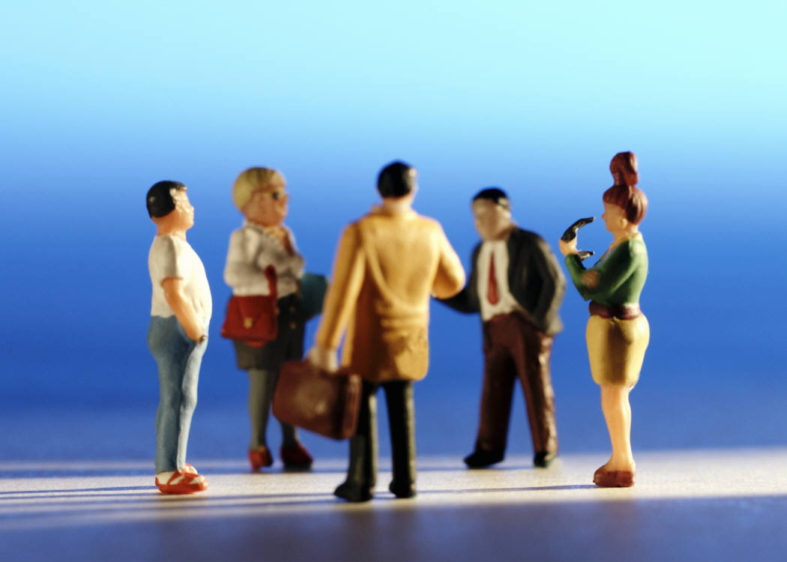
Objective
Describe what sociology is and explain what it means to have a sociological imagination

Slide 16
On a separate piece of paper, make a list of all the groups you can think of…..

Slide 17
Next, circle-underline-star-whatever the groups that you belong to…

Slide 18
The Game of Life
Career--salaries
College—bank loans
Buy/sell house
Getting married
Having babies
Insurance
Retirement

Slide 19
Sociology is…
~~~The scientific study of social structure~~~
*So…..what is social structure?
*Social structure is the patterned interaction of people in social relationships
*How are there “patterns” in the way people interact?

Slide 20
Historical Background of Sociology
Developed in the 1800’s due to rapid social changes in Europe following the Industrial Revolution
Economy based on large-scale production
Growth of urban population
Focus on individual liberties and rights
Scholars believed the social world operated according to systematic properties and laws.

Slide 21
Sociology….
Is concerned with the study of groups—how they are formed and how they change—and with the action of individuals within these groups
Is the study of human beings and their interaction with each other

Slide 22


Slide 23
NAME_________________________
Comte
Name of perspective:
Define:
Key words:
Weber
Marx
People/ideas
Sociology
Martineau
Scientific study of social
structure, study of group,
Study of patterns of social
interaction
Perspectives
Durkheim
Name of perspective:
Define:
Key words:
Name of perspective:
Define:
Key words:
C Wright Mills

Slide 24
Sociologists attempt to explain events without relying on personal factors…societal v. personal

Slide 25
Someone who can’t find a job is _______.

Slide 26
Homelessness is a result of __________.

Slide 27
Immigrants come here because of _______.

Slide 28
Sociologists might explain things like this….
Gangs….young men join gangs because they have been taught by society to be “masculine”
Higher divorce rates…More women divorce because the social trend toward sexual equality
Teen suicide…Teens commit suicide because of peer group expectations of performance, material possessions, and physical appearance

Slide 29

Mugger story…page 9

Slide 30
Group v. Individual behavior
1999 Denver Broncos are Super Bowl Champs!
Other examples?

Slide 31

Conformity…members of a group think, feel, and behave in similar ways. (It’s not a bad thing!)
More on Conformity later!

Slide 32
Sociological Imagination
The idea of American sociologist C. Wright Mills
It means the ability to see the link between society and self
Effects of events, social pressures on our daily lives—social awareness

Slide 33
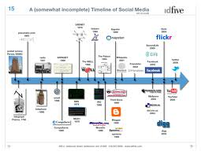
Objective
Describe how the field of sociology developed

Slide 34


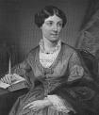


Famous Theorists
(you should know)

Slide 35
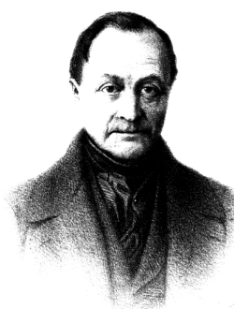
Auguste Comte
French (1798-1857)
• found (father) of sociology; coined the term sociology
• positivism—have to be positive
Focused on social order (statics) and change (dynamics)
Today, most of his ideas have been refusted

Slide 36
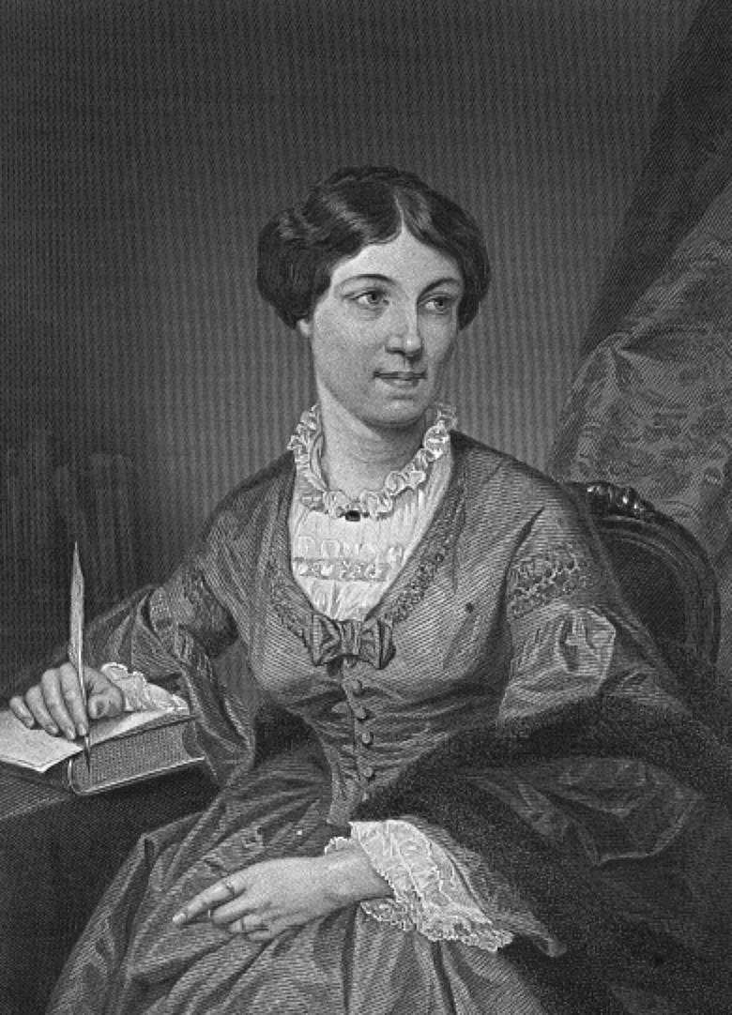
Harriet Martineau
English (1802-1876)
• Translated A. Comte’s work into English
• Concerned with social change and the plight of women
and children in English factories during the early phases
of industrialization
• First acknowledged female sociologist
Wrote about the link between the oppression of women and slavery
• Examined emerging American society (c 1834)

Slide 37
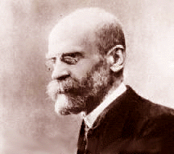
Émile Durkheim
(French) (1858-1917)
• Founded sociology as an academic discipline—1st college Sociology course
• Famous for his study on suicides (1897)
• Use of statistics in sociology
• Key concepts: social facts, social structure social solidarity, collective conscience, mechanical and organic solidarity
• Believed each part of society had a function; the consequences that an element of society produces for the maintenance of its social system & believed Religion produces shared beliefs & values which help maintain social order

Slide 38


Karl Marx
(German) (1818-1883)
• Writer focused on conflict as the primary cause of social change
*Founder of political / economic theory of socialism (communism)
• Considered the founder of the conflict perspective
Classless society!
• Wrote the Communist Manifesto
• Key concepts: proletariat, bourgeoisie, capitalists
Was ousted from many countries due to his radical beliefs and lived life in poverty

Slide 39

Max Weber
(German) (1864-1920)
• Believed that sociologist could never capture the reality
of society but should focus on ideal types that best capture
the essential features of aspects of social reality
• Key concepts: bureaucracy, verstehen, rationalization of the
modern world, people are becoming prisoners of new
technology, loss of individuality
*Interested in separate groups within society & effects of society on
the individual

Slide 40
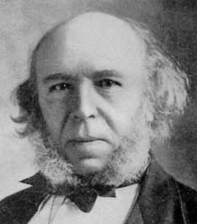
Herbert Spencer
(English) (1820-1903)
• Structural/Functionalist
Strongly influcenced by Chales Darwin
  Believed society is a set of interdependent parts that work together to maintain the system
*Evolution—social change & unrest are natural occurrences during societies move toward stability and perfection
• Coined the term “survival of the fittest” in reference to human social arrangements (Social Darwinism)
• Advocated against social reform efforts to poor people because it disrupts the natural selection process of evolution

Slide 41
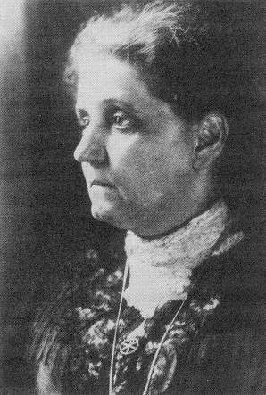
Jane Addams
(American) (1880-1935)
• Won the first Nobel Peace Prize (1931) given to an
American sociologist
• Founded Hull House for the poor in Chicago
• Influenced the “Chicago School” of applied sociology
(social problems)
• Pioneered the study of social problems

Slide 42
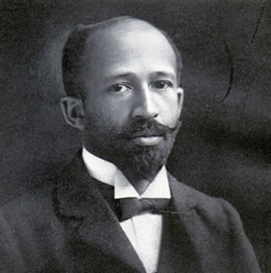
W. E. B. DuBois
(American) (1868-1963)
• First Afro-American PhD graduate of Harvard University
• Concerned with the social position of African-Americans in US
society.
• Wrote The Philadelphia Negro (1899) on race relations
• Used statistics to examine racial discrimination against blacks

Slide 43
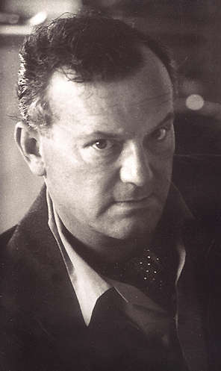
C. Wright Mills
(American) (1916-1962)
• Taught at Columbia University
• Marxist, structural/functionalist theorist
• Key concepts: power elite, radical social change, social
injustices, applied sociology, the “sociological imagination”

Slide 44
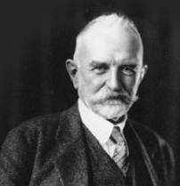
George Herbert Mead
(American) (1863-1961)
• Symbolic/Interactionist theorist
• Believed that the self was a social product acquired by
observing and assimilating the identities of others
• Key concepts: “I” & “me”, significant other, generalized other,
role taking, preparatory stage, play stage, game stage

Slide 45
Sociology
Need green book and folders!
Chapter 1
Mrs. McVey

Slide 46
Objective
Explain how the focuses of the three main theoretical perspectives in sociology differ.
  Key words

Slide 47
Three Sociological Perspectives
Theory is…….?
Perspective is ….a school of thought
…….a way of thinking
….an approach, view point
Conflict Theory
Functionalist Perspective/Functionalism
Symbolic Interactionism

Slide 48
Three Sociological Theories
CONFLICT THEORY Conflict – opposing sides Change –society is always changing Competition POWER | FUNCTIONALISM Everything has a function, reason, or a purpose Society is mostly stable Manifest (main) function Latent (accidental) function Dysfunction | SYMBOLIC INTERACTIONISM Symbols – stand for something else (can be body language, gestures, signs, etc) People interact by mutually understood symbols

Slide 49
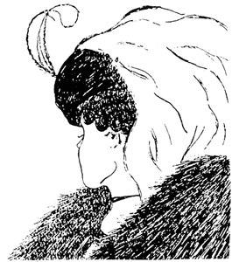
Old woman? Young woman?

Slide 50

Vase or profile?

Slide 51
Functionalism
Sociological approach that emphasizes contributions of each part of society.
Example: family, economy, religion are parts of society and each has a contribution or a “job”
Society is relatively STABLE but a change in one part equals a change in the other parts

Slide 52
Functions…
Manifest functions—intended, recognized result..Main reason for something
Latent functions—unintended, unrecognized results..something that happens by accident
Dysfunctions –negative consequences in society
What are manifest/latent/dysfunctions of attending college?

Slide 53
Conflict Theory
C-Words: conflict, competition, change, and constraint
Power
It is the approach that emphasizes conflict, competition, and constraint. Focuses on disagreements among groups in society.
Groups compete and attempt to preserve and promote their values and interests

Slide 54
Conflict Theory
(or Conflict Perspective)
Power is the ability to control the behavior of others..
  Who has power at Bellevue West? At your house?
Examples of social change and the conflict theory in action…
  Civil Rights Movement
  Women’s movement
  ?? Any ideas or examples of your own??

Slide 55
Symbolic Interactionism
Theory that focuses on interactions among people based on mutually understood symbols—people influence others behavior
Symbol is anything that stands for something else and has an agreed upon meaning
  Those who create & use symbols assign the meanings to them
  We learn the meaning of a symbol from the way we see others reacting to it

Slide 56
Symbolic Interactionism
Once we learn the meanings of symbols we base our behavior (interaction) on them
Examples of mutually understood symbols…

Slide 57



Slide 58



Slide 59



Slide 60


Slide 61


Slide 62


Slide 63


Slide 64


Slide 65
Theoretical Perspectives
P. 31 #2 in groups of 2 or 3 (a-i)
  Functionalism(F), Conflict theory (C), or Symbolic Interactionism (S)
  Then look at page 28-29 Sociology Looks at the Internet and quickly discuss in your group #1 and #2. Be prepared to talk about the dysfunctions of the internet.

Slide 66
Jobs in Sociology
Look at page 12

