Slide 1
THE ROAD TO WWII
Axis Aggression

Slide 2
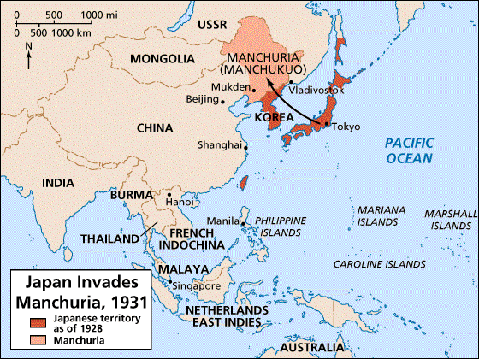
Dictators Challenge World Peace
Japan believed it should have an empire as large as the western powers
In 1931, Japan seized Manchuria

Slide 3
Dictators Challenge World Peace
Results:
Japan was condemned by League of Nations and withdrew
Strengthened their military
Overran much of China
West did little to stop Japan

Slide 4
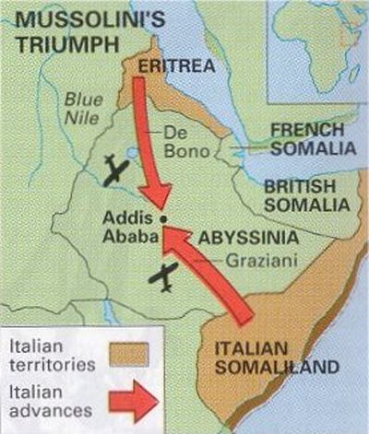
Dictators Challenge World Peace
In 1935, Italy invaded Ethiopia
Wanted revenge for an earlier defeat
Wanted to add Ethiopia to other territories in East Africa
The League of Nations placed sanctions on Italy
Were not enforced

Slide 5
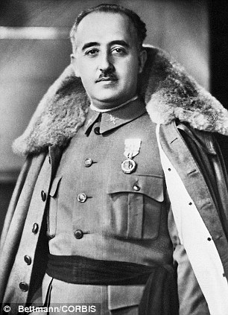
Dictators Challenge World Peace
In 1936, Spain plunged into a civil war led by a conservative general named Francisco Franco
Supported by fascists and conservatives
Became known as nationalists
Franco was aided by Hitler and Mussolini
US, France, and Britain remained neutral
Franco wins power in 1939
Created a fascist dictatorship

Slide 6
Dictators Challenge World Peace
In 1936, Germany invaded the Rhineland
Violated Treaty of Versailles
Little was done to stop Hitler’s advances

Slide 7
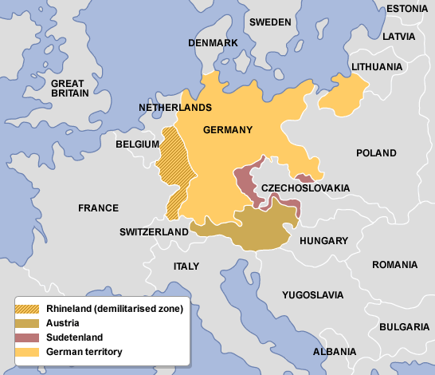

Slide 8
Dictators Challenge World Peace
Hitler took another step that angered the western democracies
Formed an alliance with Italy and Japan
Rome-Berlin-Tokyo Axis
Goal: fight Soviet communism

Slide 9
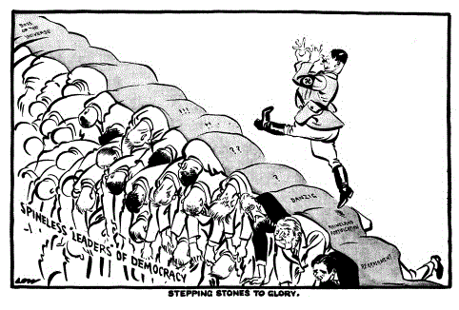
Western Powers
What did western powers do to stop the dictators?
Nothing!
Adopted a policy of appeasement

Slide 10
German Aggression Continues
Hitler wanted bring all German-speaking people into the Third Reich
In 1938, Hitler began the Anschluss, or the unification of Austria and Germany
Austria was appalled but was unable to do anything

Slide 11
German Aggression Continues
Germany’s next victim was Czechoslovakia
Hitler wanted the 3 million Germans living in the Sudetenland to have autonomy

Slide 12
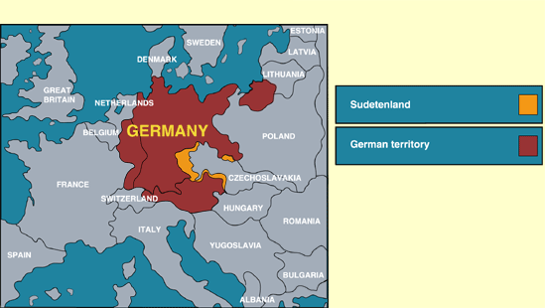

Slide 13
German Aggression Continues
Czechoslovakia was one of two democracies in Eastern Europe
This worried Britain and France but they choose appeasement again
At the Munich Conference in 1938, Hitler promised he would not expand territory anymore
In 1939, he invaded the rest of Czechoslovakia

Slide 14
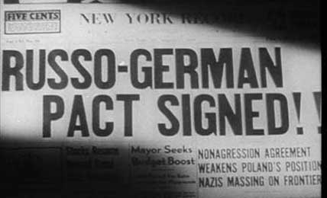
Europe Plunges Toward War
In August 1939, Hitler surprised everyone by announcing a non-aggression pact with the Soviet Union
Would not fight each other
Divide Poland

Slide 15
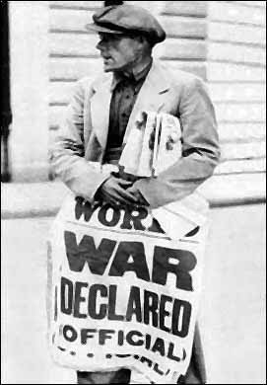
Europe Plunges Toward War
On September 1, 1939, Germany invaded Poland
Invasion of Poland
Britain and France had agreed to protect Poland-WWII began

Slide 16
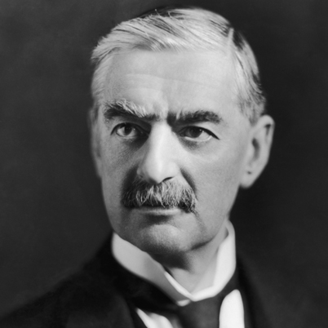
Europe Plunges Toward War
Neville Chamberlain, prime minister of Britain, said, “They had to choose between war and dishonor. They chose dishonor, they will have war.”

