Slide 2
Essential questions
What is Feudalism?
Political order in which nobles offer protection & land in return for service during the Middle Ages
What is serfdom?
Agricultural laborers bound to the land to work on their lord’s estate
Why did Europe become a feudal society?
For safety; to defend themselves from raids/invasions
Besides royalty, what class of people were most privileged during under the feudal system?
Nobility

Slide 3
Renaissance “Rebirth”
World History Chapter 2

Slide 4
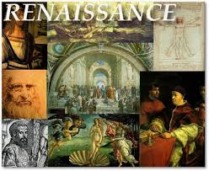
Introduction Video
Renaissance Pure Radiance of the Past
Listen and complete the worksheet
Notes:
Video from McGraw-Hill Connected site

Slide 5
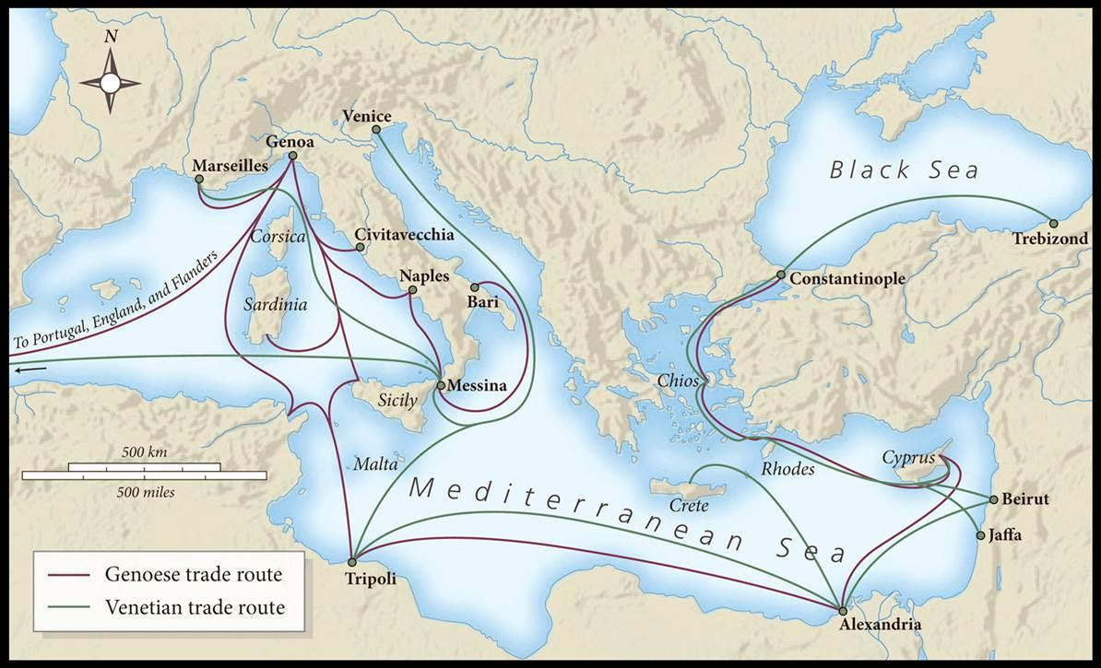
The Major Italian States
Italy was more urban than the rest of Europe during the Middle Ages
Thriving trade – why?
Trade with Byzantine and Islamic civilizations to the East
Silk, sugar, spice
Trade with North Africa
Exchanged goods with English and Dutch merchants
Notes:
Discuss trade routes, Italy’s ideal location

Slide 6
The Major Italian States
Five major Italians states began to dominate due to economic power
Played crucial roles in Italian politics and culture
Milan
Venice
Florence
The Papal States/Rome
Kingdom of Naples

Slide 7
Florence
Northern Italy
Medici Family
Used their money and power to influence the cultural development of the Renaissance
Video
Florence is known as the birthplace of the Renaissance
Notes:
Medici family dates waaay back and were orginally peasants
They become involved in silk/textiles
Then establish the bank which seals their rise to power—their bank became official bank of the church
Cosimo Medici became “leading citizen” or the political leader of Florence
He gave power positions to family and friends – helped Medici family keep control and get richer
They invested in the arts

Slide 8
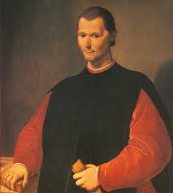
Niccolo Machiavelli
Video -- Overview of his ideas
The Prince
Primary source activity
Notes:
Machiavelli Quote on the test
MACHIAVELLI IDEAS IN THE PRINCE
Politics not restricted by morals
Prince acts on behalf of the state
Ends justify the means
Human nature based on self interest

Slide 9
Society Pyramid

Slide 10
Renaissance Society Pyramid Answer

Slide 11
Renaissance Society
Notes:
Nobles dominate society—low % of population but held important political posts and advised king
Nobles were born not made, expected to educated, have character, grace, and talent

Slide 12
Italian Renaissance Humanism
Humanism is the intellectual movement of the Renaissance based on the study of humanities
Grammar
Rhetoric—persuasive speaking or writing
Poetry
Moral philosophy
history

Slide 13
Renaissance Art Characteristics
Human-centered—human body, people
Religious AND nonreligious
Realism--Imitate nature—convince viewers works were real
Perspective—three dimensional depth to two-dimensional surfaces
Painting expanded to sculpture and architecture
Notes:
Before the Renaissance paintings/sculpture/etcs not religious in nature were viewed as sinful and idolizing other than God
Artwork become owned by the wealthy and powerful, people got their portraits done

Slide 14
Instructions
In groups of 3, travel to each station
Write down the Renaissance artist’s name
Complete short bio information
Fill in the the name of famous works
Relate the artwork to the Renaissance period. How does the art display common ideas, characteristics, themes, from the Renaissance?

Slide 15
The Impact of the Printing Press
Johannes Gutenberg invents the printing press in 1440/1450s
China had printing technology before Gutenberg
Printing press
Cloud Bio
What are ways that printing press changed society?
Rise in literacy
Spread of written books
Printed books were more affordable

Slide 16
Printing Press Impact
How was the impact of printing technology similar to the impact of current information technology?

