Slide 1
Warm-Up (10/2)
#1 What impact did the Enlightenment have?
Started revolutions
Encouraged some rulers to make changes
#2 The American Declaration of Independence, the Bill of Rights, and the Constitution clearly reflect the ideas of which Enlightenment thinker(s)? How?
John Locke, Rousseau, Montesquieu
Elections, natural rights, separation of powers

Slide 2
What is a revolution?
Change in power

Slide 3
ON THE EVE OF REVOLUTION

Slide 4
The Old Regime
In 1789, France still clung to an outdated social system
Everyone belonged to three classes
First Estate
Second Estate
Third Estate

Slide 5
The First Estate
Social Group
Clergy
Percent of Population
0.5%
The had always exerted great influence
They owned 10% of the land
Paid no taxes but collected tithes
Provided some social services
Were criticized if they didn’t

Slide 6
The Second Estate
Social Group
Nobles
Percent of Population
1.5%
They were given top jobs in the government and army
Some owned land but had little income
Some resented absolute monarchs

Slide 7
The Third Estate
Social Group
Everybody else
Bourgeoisie, rural peasants, urban workers
Percent of Population
98%
Resented the privileges enjoyed by other estates
Taxed on everything
Notes:
Taxed on land, soap, salt.
Nobles could only hunt.
Couldn’t kill rabbits that ate crops.

Slide 8
Warm-Up (10/5)
#3 Describe the differences between the three estates in France.
First
Clergy
.5 % of the population
Second
Nobles
1.5% of the population
Third
Everyone else
98% of the population
Only got one vote
Taxed on everything

Slide 9
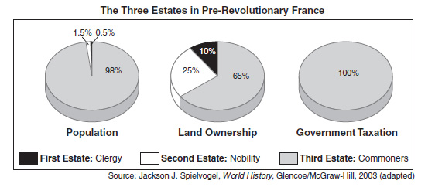
French Estates

Slide 10
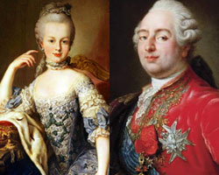
Louis XVI
Louis XVI took control after Louis XIV and Louis XV
He was an ineffective and weak ruler
Married to Marie Antoinette

Slide 11
Economic Troubles
Economic troubles are going to add to the discontent
Louis XIV’s debt
Poor harvests
Failing to call Estates General
Notes:
Louis XV continued to spend money
Jacques Necker was Louis XIV’s financial advisor-reduce spending, reform government, abolish tariffs, tax nobles and clergy-hated it!
Louis XIV did not want to call a meeting of the Estates General, afraid the nobles would try to regain power

Slide 12
The Tennis Court Oath
As things worsened, Louis XVI had no choice but to call a meeting of the estates
The Third Estate was allowed to attend-only men who had property
Under the voting system, each group had one vote
Third Estate was always outvoted
Notes:
Made a list of grievances
Third Estate came with many new Enlightenment Ideas

Slide 13
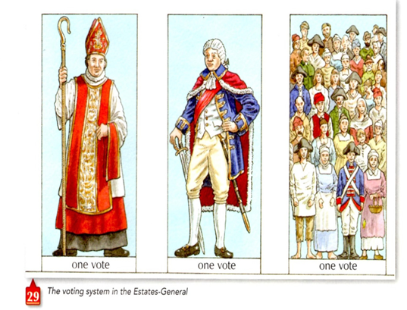
Estates General

Slide 14
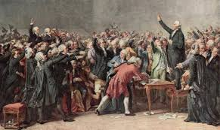
The Tennis Court Oath
The Third Estate took a daring step, they claimed they represented the people of France, and gave themselves the name the National Assembly
Refused to dismiss until they had written a constitution
When they came back to meet, the doors were locked
Moved to a tennis court and swore never to leave until a constitution was written
Notes:
Got support from some members of the First and Second Estate.

Slide 15
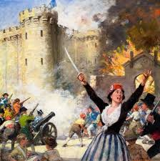
Storming the Bastille
At the same time, rumors spread that royal troops were going to occupy the capital
800 Parisians surrounded the Bastille
Demanded weapons and gunpowder
When they were refused, they stormed the Bastille
This action becomes a symbol of the French Revolution
This was step toward freedom
Notes:
When told of the attack Louis XVI asked, “Is it a revolt?” A noble said, “No, sire, it’s a revolution.”

