Slide 1
Opening Discussion (Monday)
What is one invention that you could not live without? Why?

Slide 2
NEW TECHNOLOGIES
THE INDUSTRIAL REVOLUTION

Slide 3
The Textile Industry
The Industrial Revolution first took hold of the textile industry in Britain
John Kay’s flying shuttle, James Hargreaves’ spinning jenny, and Richard Arkwright’s water frame improved the textile industry

Slide 4
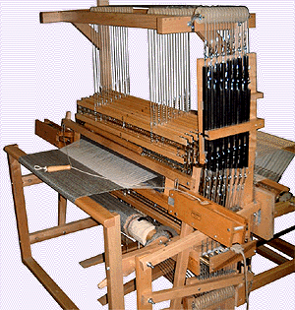

Slide 5
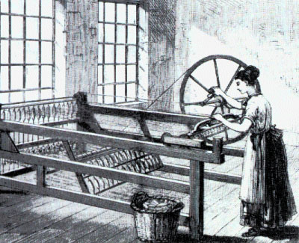

Slide 6
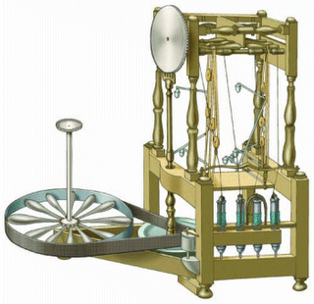

Slide 7
The Textile Industry
These new machines replaced handmade goods
Industrialization in the textile industry resulted in the building of factories to house the machines

Slide 8
Transportation
As production increased, entrepreneurs needed faster and cheaper methods to move goods from place to place
Inventions like the steam locomotive, railroads, and steamships helped transport goods

Slide 9
Electricity
In the late 1800s, a new power source, electricity replaced steam power
Thomas Edison, invented the light bulb
Factories could operate after dark

Slide 10
Medicine and Population
Between 1800 and 1900, the population of Europe more than doubled because the death rate fell
People ate better-farming, food storage, and distribution
Better medicine and sanitation

Slide 11
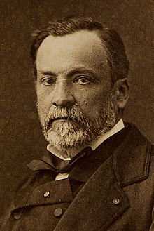
Medicine and Population
Since the 1600s scientists had speculated about the germ theory-microbes cause infectious disease
In 1870, Louis Pasteur made a direct link and public sanitation improved

Slide 12
Medicine and Population
Other advancements were made in medicine
Anesthesia
Antiseptics
Eventually, a cure for tuberculosis, yellow fever, and malaria

Slide 13
Activity
Think of an invention that would make your life more convenient or improve it
Working with a partner, you will create an ad for your new invention
MUST BE SCHOOL APPROPRIATE!

