Slide 1
Warm-Up
Predict:
After overthrowing the monarchy and experiencing the Reign of Terror, what type of ruler do you think the people of France may want?
Why?
Any ideas on who it may be?

Slide 2
NAPOLEON’S RISE TO POWER

Slide 3
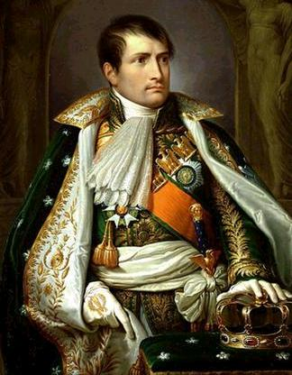
Early Life
Napoleon Bonaparte was born in Corsica
His family were nobles but had little money
He was sent to France for military training at 9
When the revolution began, he wanted to make a name for himself

Slide 4
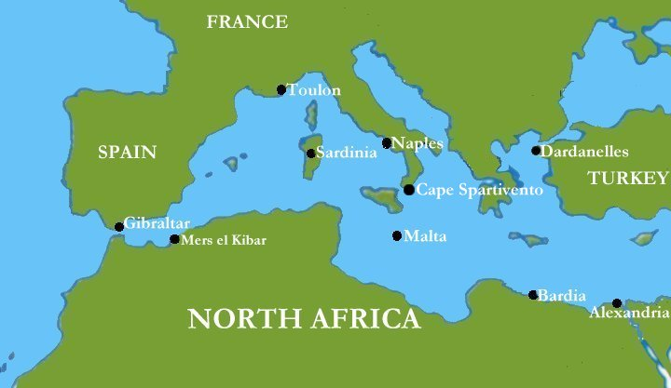
Early Successes
During the revolution, Napoleon quickly rose through the ranks in the army
Drove British forces out of Toulon
Counterrevolutionary forces
Occupied by Britain
Captured northern Italy, forced the Hapsburgs to make peace
Hid stories of disaster in Egypt
Wanted to disrupt British trade with India

Slide 5
Napoleon Takes Control
He overthrew the Directory and set up the Consulate
Named himself consul for life
Eventually acquired enough power and gave himself the title “Emperor of the French”

Slide 6
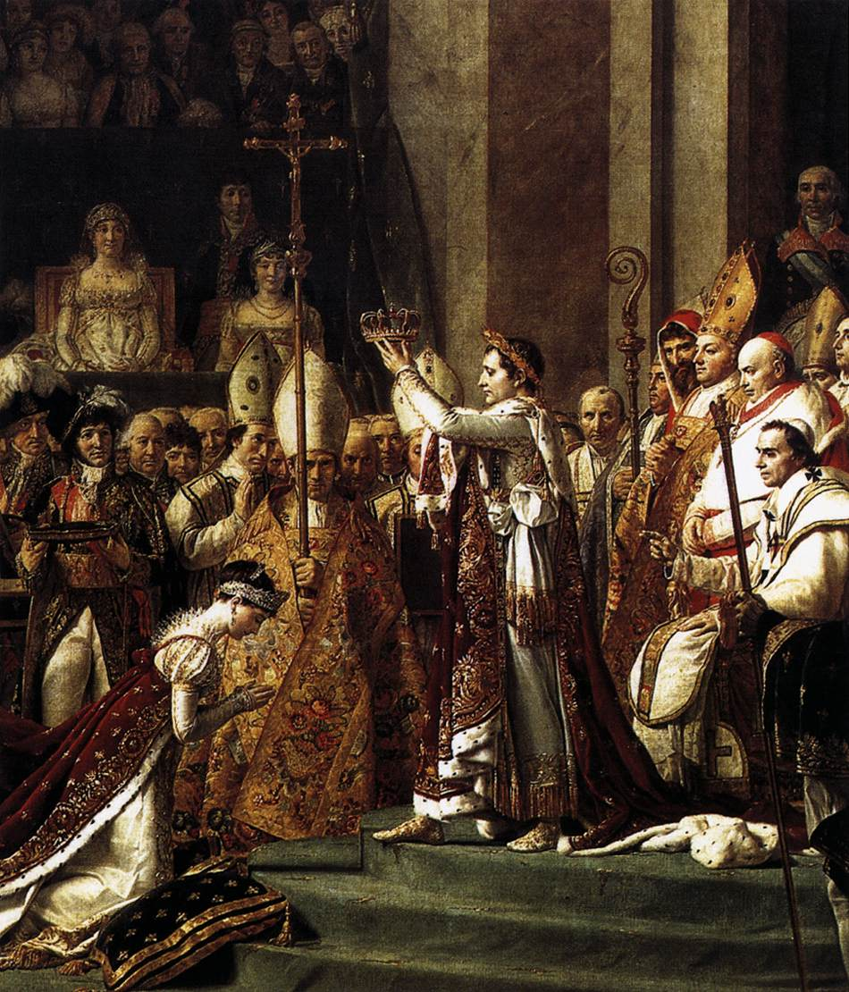

Slide 7
France Under Napoleon
As Napoleon rose to power, he held a plebiscite, or ballot, in which people vote
The French strongly supported him
To understand why, we must look at his policies

Slide 8
Reforms
Problem:
Poor relationship with the Catholic Church
Solution:
Recognized the Church
Church did not ask for land back
Result:
Relationship improved

Slide 9
Reforms
Problem:
No unified set of laws
Solution:
The Napoleonic Code
Result:
Reflected Enlightenment ideas
Equality
Religious toleration
Women lost rights gained during the French Revolution

Slide 10
Napoleonic Code
Based on the idea that a law based on common sense & equality replaced one based on custom, societal division & absolute monarchs’ divine right
It was not that it came from God or a monarch but because it was fair & just built on enlightenment ideas of rights, all male citizens were supposed to be equal, (the code did not extend to emancipating women, who were subjugated to fathers and husbands)

Slide 11
Reforms
Problem:
Need for talented workers
Solution:
Advancement based on merit
Result:
Members of the middle-class had jobs in the government and military

Slide 12
Strengthening the Empire
As a military leader, Napoleon valued rapid movements and using large armies
Always had a new plan, so opposing forces could never anticipate his moves
“I grew up on the field of battle, and a man such as I am cares little for the life of a million men.”
Napoleon

Slide 13
Strengthening the Empire
Napoleon annexed territories to France
The Netherlands, Belgium, Italy, Germany
Abolished the Holy Roman Empire
He cut Prussian territory in half
He also used diplomacy to control Europe
Put friends and relatives on thrones

Slide 14
The Response
Many within France were overcome with nationalism
Parades filled the streets of Paris
While other nations failed to defeat Napoleon, Britain was determined to win
Defeated Napoleon at the Battle of Trafalgar
Enforced a blockade
Notes:
Battle of Trafalgar: Off the west coast of Spain; since an invasion wouldn’t work, enforced a blockade; seized neutral ships (War of 1812); failed to bring Britain to its knees

Slide 15
