Slide 1
World Leaders During WWII

Slide 2
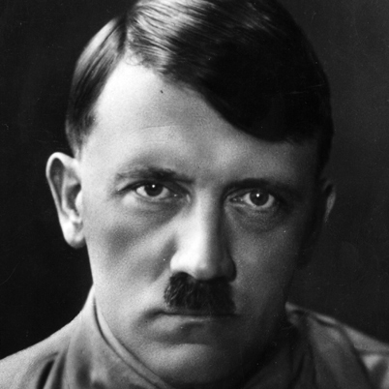
Adolf Hitler
Germany
Axis

Slide 3
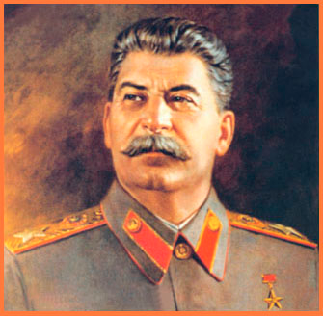
Joseph Stalin
Soviet Union
Axis then Allied

Slide 4
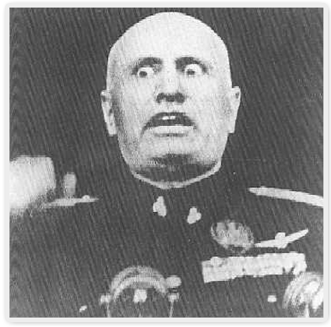
Benito Mussolini
Italy
Axis

Slide 5
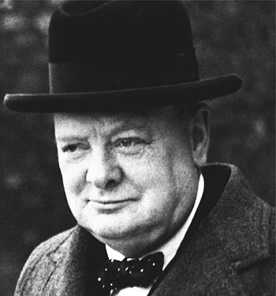
Winston Churchill
Great Britain
Allied

Slide 6
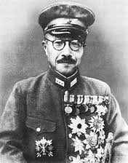
Hideki Tojo
Japan-Military Leader
Axis

Slide 7
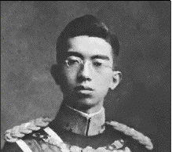
Emperor Hirohito
Japan
Axis

Slide 8
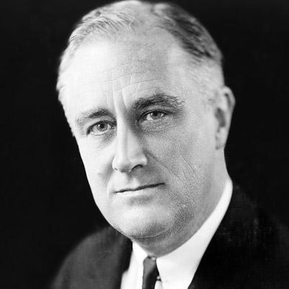
Franklin D. Roosevelt (FDR)
U.S.
Allied

Slide 9
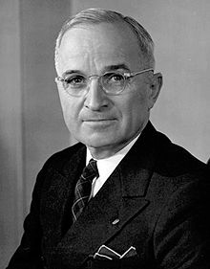
Harry Truman
U.S.
Allied

Slide 10
AXIS ADVANCES
World War II

Slide 11
Early Axis Gains
One French general at the beginning of WWII said, “Hitler will collapse the day we declare war on Germany.”
Could not have been more wrong
War will last for 6 years

Slide 12
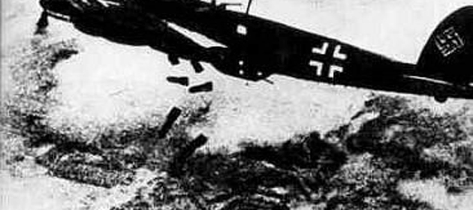
Early Axis Gains
Germany stormed into Poland revealing their enormous power
What is blitzkrieg?
Lightning war
First, planes would bomb the country
Then, tanks and troops moved quickly into the country

Slide 13
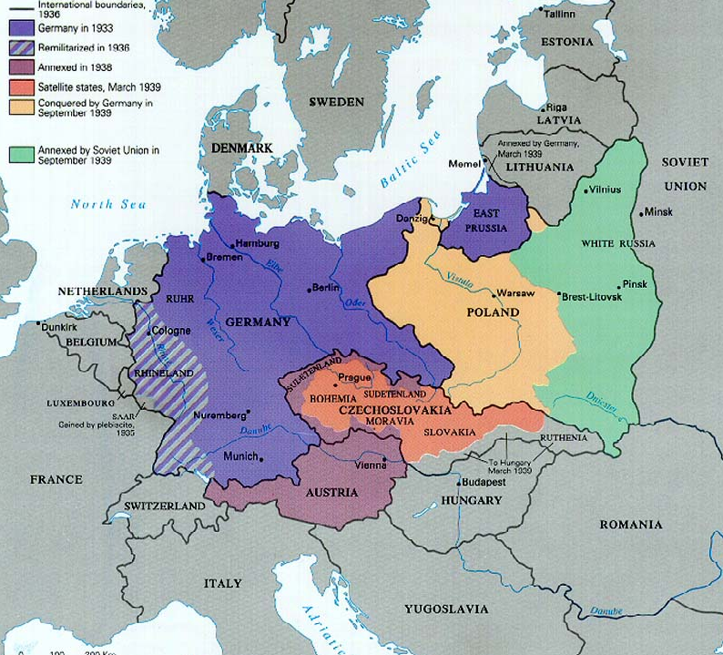

Slide 14
Early Axis Gains
In April 1940, Hitler launched a blitzkrieg against Norway, Denmark, the Netherlands, and Belgium
All will soon fall

Slide 15
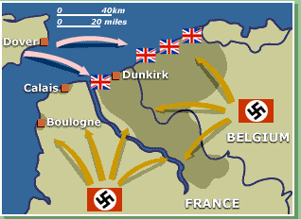
Miracle at Dunkirk
By May 1940, German forces were pouring into France
British forces were sent to help
They became trapped between the Nazis and the English Channel

Slide 16
Miracle at Dunkirk
In a desperate attempt, Britain sent naval vessels, merchant ships and fishing boats to rescue troops
They were able to rescue 300,000 troops

Slide 17
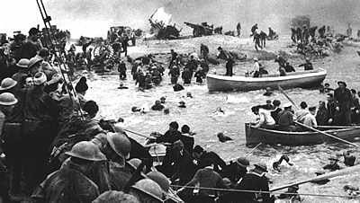

Slide 18
Early Axis Gains
While British troops were being rescued, Germany and Italy headed into Paris
France will not put up much of a fight
France surrendered on June 22, 1940
Germany will occupy northern France
In the south, Germany set up a “puppet state”, with its capital at Vichy

Slide 19
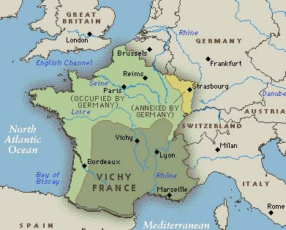

Slide 20
The “Free French”
Some French officers escaped to England and set up a government
The “free French” were led by Charles de Gaulle
Worked to liberate the homeland
Resistance fighters used guerrilla tactics against German forces

Slide 21
Early Axis Gains
Axis armies also pushed into the Balkans
Greece, Yugoslavia, Bulgaria, and Hungary were all added to the Axis powers in 1941

Slide 22
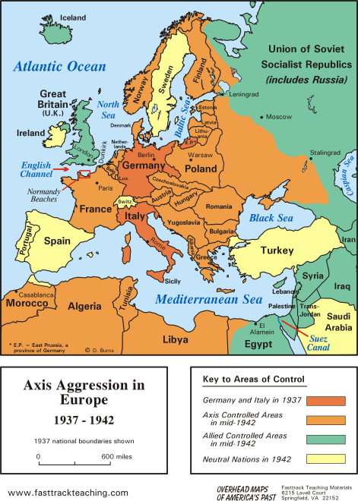

Slide 23
Early Axis Gains
With the fall of France, Britain stood alone
Winston Churchill was determined to defend the homeland
German responded by launching a bombing campaign against the city of London in August 1940

Slide 24
London Blitz
The bombing continued for 57 nights
Much of the city was destroyed
15,000 people lost their lives
Despite Hitler’s desires, the bombing strengthened British morale

Slide 25
Operation Barbarossa
The London Blitz did not have the outcome Hitler expected
He turned his attention to a new target-the Soviet Union
Why is this surprising??
Had signed a non-aggression pact

Slide 26
Operation Barbarossa
Hitler wanted the natural resources of the Soviet Union, crush communism, and defeat Stalin
His decision would be costly

Slide 27
Effects
Stalin’s army was unprepared
The Great Purge
The Russians lost 2.5 million men
Destroyed factories, farm equipment, and crops
Churchill agrees to help
Was not prepared for brutal winter
Seize Leningrad
Soviet Union
Germany
Notes:
Rationed food (2 pieces of bread/day)
Boiled wallpaper
Boiled leather-”jellied” meat

Slide 28
Map Directions (pg. 471)
Great Britain
Soviet Union
France
Germany
Italy
Poland
Czechoslovakia
Norway
Sweden
Finland
Turkey
Spain
Portugal
Austria (Hungary)
Romania
Greece
Bulgaria

Slide 29
Map (pgs. 471 and 483)
Great Britain
Soviet Union
France
Germany
Italy
Poland
Czechoslovakia
Austria
Hungary
Greece
Bulgaria

Slide 30
Map Directions
Color Axis Powers Red
Color Allied Powers Green
Leave others (neutral countries) white or color yellow
Page 483 will help!

