Slide 1
Causes of Imperialism Picture/Test Anaylsis

Slide 2
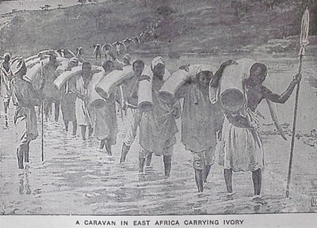
A

Slide 3
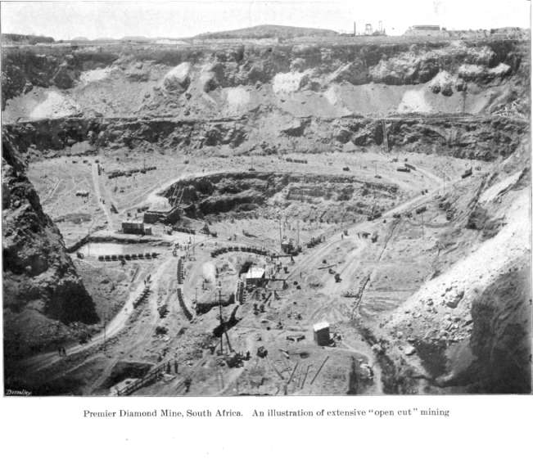
B

Slide 4
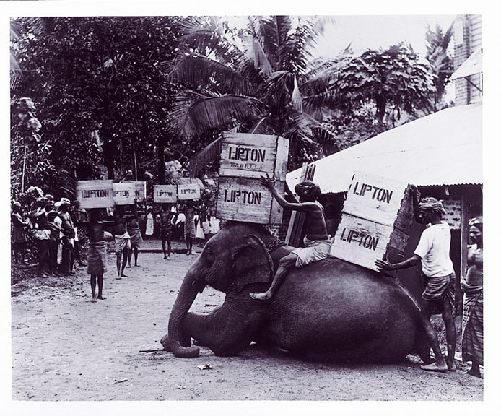
C

Slide 5
D
It may be quite true that some negroes are better than some white men, but no rational man, cognizant of the facts, believes that the average negro is the equal, still less superior, of the average white man. The highest places in the hierarchy of civilization will assuredly not be within the reach of our dusky cousins (Thomas Huxley, Lectures and Lay Sermons, 1865, page 115).

Slide 6
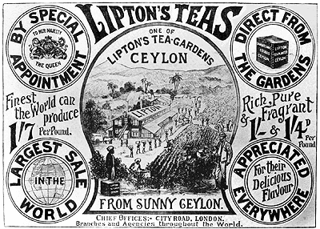
E

Slide 7
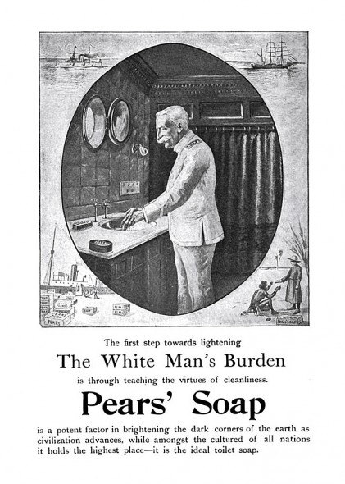
F

Slide 8
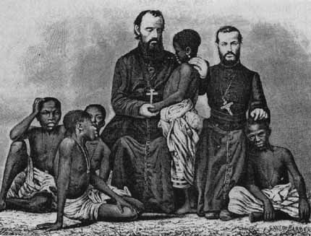
G

Slide 9
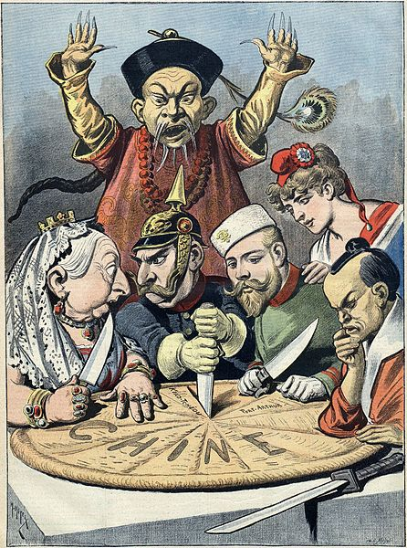
H

Slide 10
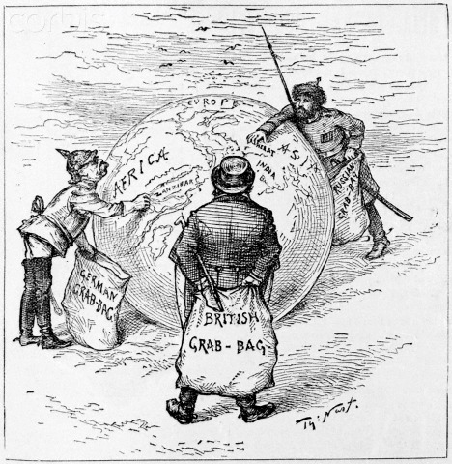
I

