Slide 1
Warm-Up 10/30
Take out your Warm-Up worksheet BUT do not answer any questions!

Slide 2
Warm-Up 10/31
11. Which group benefitted the most from the Industrial Revolution?
The middle class
12. What was a result of the discovery that germs cause disease?
Better sanitation
13. How did Darwin challenge traditional beliefs?
Suggesting life evolved
15. By the 1900s, which nations were the world’s leading industrial powers?
Germany and the U.S.
16. Describe political consequences and changes brought about by the Industrial Revolution. (HINT: think about how working conditions changed)
Better working conditions
No child labor
Limited working hours
Allowed strikes and labor unions
Monopolies and big businesses grew

Slide 3
IMPACT OF THE INDUSTRIAL REVOLUTION

Slide 4
Impact of the Industrial Revolution
The Industrial Revolution Spreads
During the Early Industrial Revolution, Britain stood alone
However, by the mid-1800s, other nation joined the race
The U.S. and Germany became the leading nations, Japan, Canada, New Zealand, and Australia also thrived
There was uneven development
Russia
Social changes
Access to goods
Cause
Effect
Notes:
Social Changes: child labor, urbanization
Access to Goods: large quantity available, cheaper, not only wealthy could afford goods

Slide 5
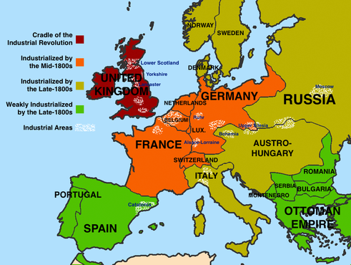

Slide 6
Impact of the Industrial Revolution
New Technologies
Talented individuals created new products and machinery
Spurred economic growth
Development of steel
Dynamite
Electricity-light bulb
Assembly line
Cause
Effect
Notes:
Steel was lighter, harder, and more durable that iron…it was also cheaper.
Dynamite: Alfred Nobel

Slide 7
Impact of the Industrial Revolution
New Methods of Transportation and Communication
Needed to quickly transport goods
“Age of the Automobile”
Airplanes
Telegraphs and telephones
Cause
Effect
Notes:
Automobiles: Otto then Benz, then Daimler; Ford’s car reached 25 mph!
Airplanes: 1903 the Wright brothers; commercial flight 1920s

Slide 8
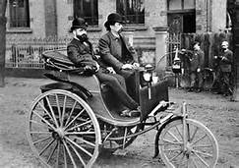
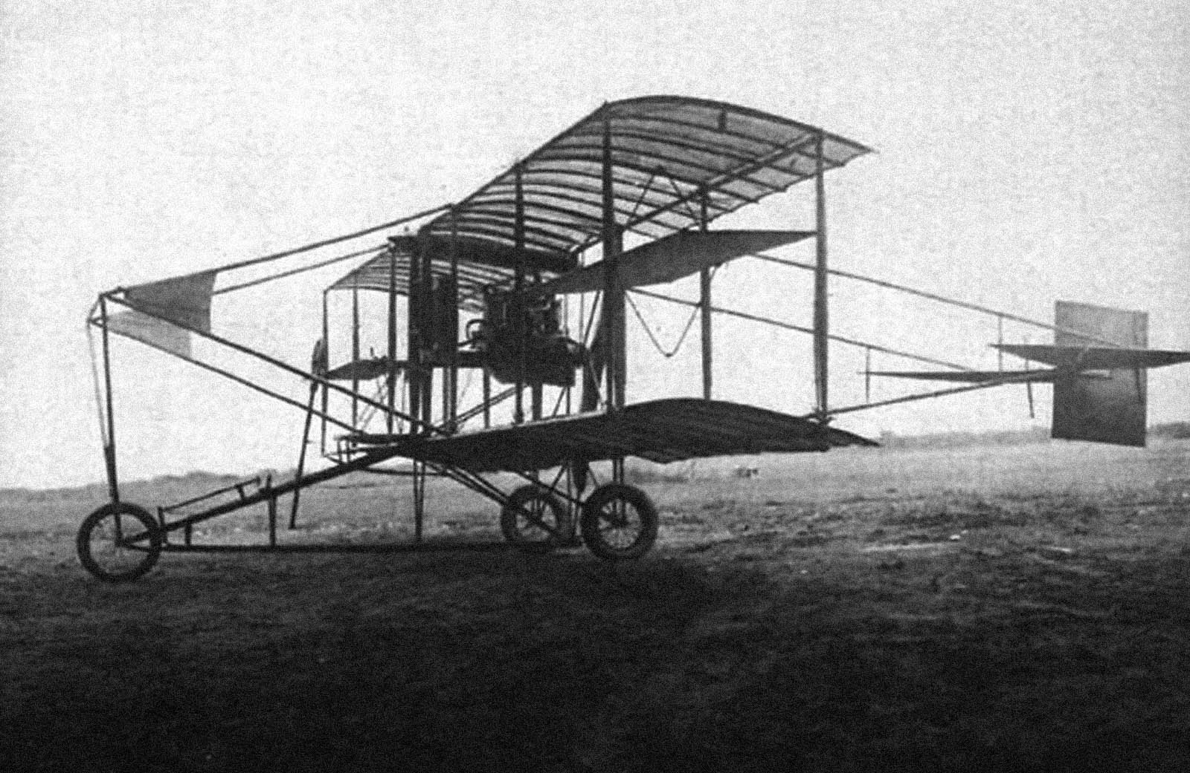

Slide 9
Impact of the Industrial Revolution
New Directions for Businesses
Entrepreneurs needed large amounts of capital to invest in new technologies
Sold stocks in companies
Rise of “big business”
Formed corporations
Creation of monopolies
Oil (Rockefeller)
Cause
Effect

Slide 10
Impact of the Industrial Revolution
The Germ Theory
Idea that germs cause disease
Led to improved sanitation
Developed vaccines
Rabies, TB
Pasteurization
Developed anesthesia
Hospitals still were not perfect!
Later discovered doctors needed to sanitize
Cause
Effect
Notes:
Vaccines-rabies and anthrax
Discovered yellow fever and malaria were traced to mosquitoes
Doctors needed to sanitize!

Slide 11
Impact of the Industrial Revolution
Rapid Urbanization
Industrialization
Looking for jobs
Changed landscape of the city
Built offices, department stores, and theaters
Urban renewal
Improved poor areas
Still a tough place to live!
Streetlights
Sewage systems
Cause
Effect

Slide 12
Impact of the Industrial Revolution
Working Class Struggles
Industrial life was difficult
At first, strikes and labor unions were illegal
Mutual-aid societies
Aid sick/injured workers
Expanded suffrage
Legalized unions and strikes
Regulated working conditions
Outlawed child labor
Limited work hours
Created pensions and disability insurance
Standard of living rose
Push for public education
Cause
Effect

Slide 13
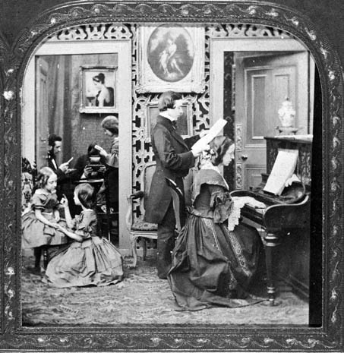
Impact of the Industrial Revolution
Rise of the Middle-Class
A more complex social structure emerged during the IR
Midlevel business people, doctors, scientists, lawyers
Greatly benefitted from the Industrial Revolution
Lived in larger homes
Wore luxurious clothes
Cause
Effect
Notes:
Had a unique set of values-etiquette (write letters, host a dinner party, children “seen but not heard”)
Most had a cook and a maid
Women stayed home

Slide 14
Impact of the Industrial Revolution
Women Push for Equal Rights
Campaigned for fairness in marriage, divorce, and property laws
Also supported the temperance movement
By the late 1800s, were gaining more rights
Property
Suffrage expanded
New Zealand, Australia before the 1900s
Cause
Effect

Slide 15
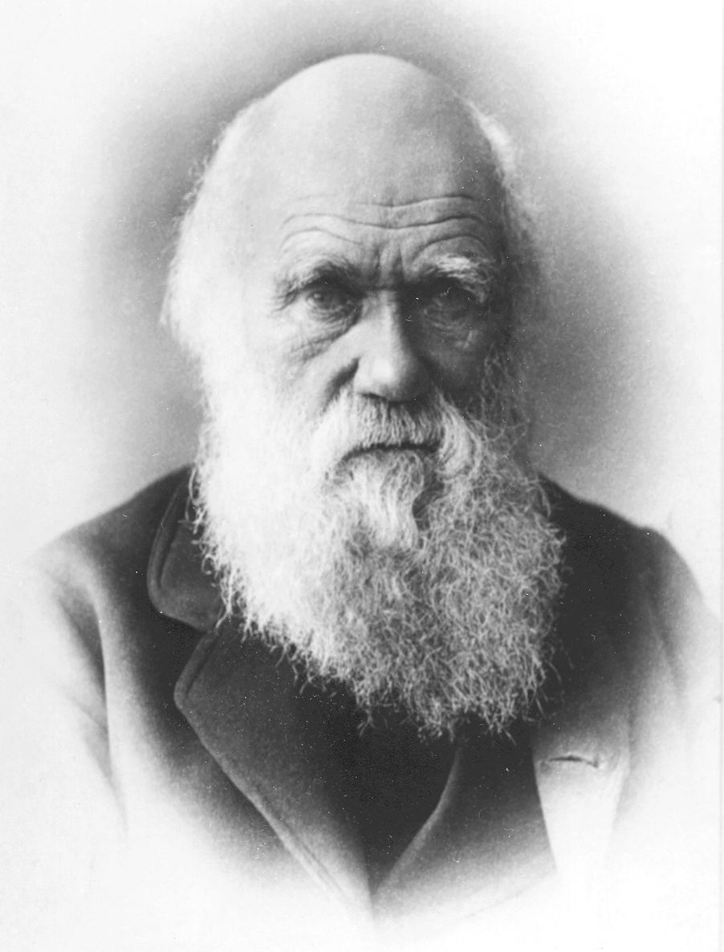
Impact of the Industrial Revolution
Darwin’s Theory of Natural Selection
Challenged traditional beliefs
Life had evolved
Social Darwinism
One racial group is superior to another
Cause
Effect

