Slide 1
Warm-Ups
#5: Why did Europeans want to find sea routes to Asia?
Muslims controlled land routes
Sea routes may be faster
#6: How did countries in Asia respond to European explorers?
At first, welcomed trade, began to restrict
Europeans didn’t make a good impression
Forced to trade and convert (SE Asia/India)
#7: Why was Korea nicknamed the “Hermit Kingdom”?
Completely isolated itself

Slide 2
Activity
Goal: To understand what life was like in Africa before the slave trade and how life changed after the slave trade
Read through your excerpt
Underline, circle key ideas
Should be able to explain to other students
As a group, decide which facts are most important
Write on board
Copy down other groups’ information

Slide 3
European Exploration in Africa

Slide 4
European Outposts in Africa
In the 1400s, Portuguese ships explored the coast of West Africa
Wanted a sea route to India and riches
Built small forts to trade, collect food and water, repair ships
Lacked power to push into African interior
Attacked coastal cities
Not much profit=poverty
Soon other Europeans (Dutch, French, English) established forts along the western coast
Notes:
Other countries exchanged muskets, tools, and cloth for gold, ivory, hides, and slaves

Slide 5
The Atlantic Slave Trade
In the 1500s, Europeans began viewing slaves as the most important item of African trade
Slavery was not a new idea
Needed to fill labor demands
Spain
African leaders had two choices:
Resist (extremely difficult)
Participate
Notes:
Not new: Egyptians, Greeks, Romans, Indians, Aztecs, Arab empire

Slide 6
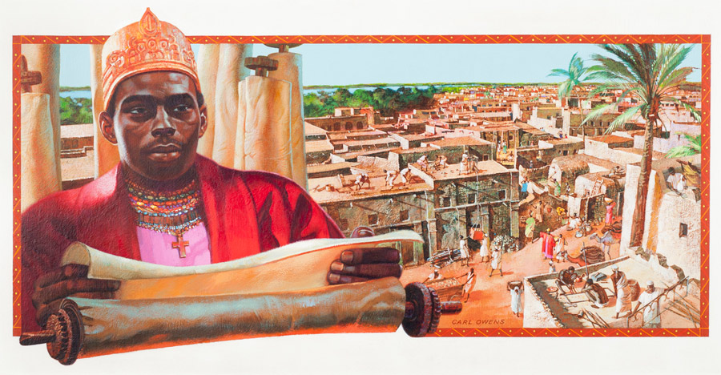
Resisted Europeans
Motivations
Impact
Trade in human lives was evil
Led to drastic depopulation
Protect culture and kingdoms
Were unsuccessful in permanently halting slave trade
Notes:
Affonso I of Kongo: had initally encouraged Portugal to help develop Kongo in to a modern Christian state, appalled at amount of slaves purchased; tried to stop slave trade
The almamy of Futa Tora (Senegal): not allowed to move slaves through Futa Toro for sale abroad; refused bribes; eventually unsuccessful

Slide 7
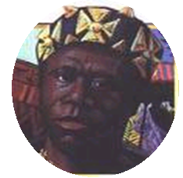
Participated in Slave Trade
Motivations
Impact
Sold conquered peoples
Wanted to make money
Made a profit
Exchanged gold and silver for slaves
Created large and powerful kingdoms
Played European rivals against one another to protect interests
Notes:
Asante kingdom-Osei Tutu

Slide 8
Warm-Ups
#8: Which area of life in Africa do you think will be the most impacted by the slave trade? It can be negatively or positively. Explain your answer!

Slide 9
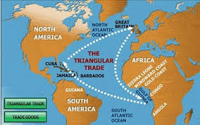
Primary Source Activity
How did people experience the Middle Passage?
One part of the Triangular Trade
Read through primary source documents and answer questions.
Complete chart if time
Which document(s) is/are the most reliable?
Explain your answer!

Slide 10
Activity
Options
Groups of 3
Small group with Mr. Fischer (3rd hour)
Individually
Google Classroom
Code: e38bpb

Slide 11
Exit Ticket
Turn in documents and grab a Post-it Note
Write your name on the Post-it Note
Which source(s) do you think was/were most reliable in describing the Middle Passage? Why?
Portuguese Textbook
Slave Ship Captain
Slave Ship Doctor
Diagram
Autobiography of Former Slave

