Slide 1
Warm-Ups
What is fascism?
Extreme nationalism
Blind loyalty to the state
Oppressive
Violent
Why were Italians attracted to fascism?
Order in a time of uncertainty

Slide 2
Warm-Up
How did the Great Depression affect Germany/world?
Unemployment
Poor economy
What helped Hitler gain power in Germany?
Economic troubles-promised to fix them
Promoted nationalism

Slide 3
Activity
Working with a partner, you will examine primary source documents that discuss what it was like living in Hitler’s Nazi Germany
Take one sheet at time and answer the questions in the packet

Slide 4
HITLER AND THE RISE OF NAZI GERMANY

Slide 5
After WWI
How did the Treaty of Versailles impact Germany?
Gave up land
Reduced size of armed forces
Paid reparations

Slide 6
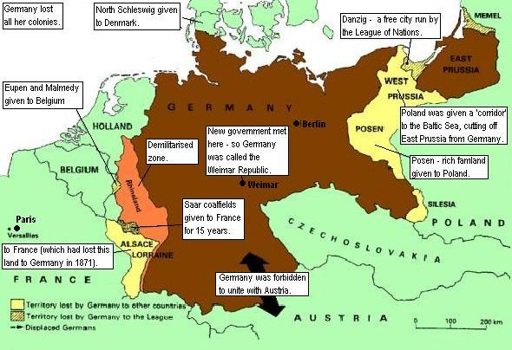

Slide 7
The Weimar Republic
After WWI, Germany faced the possibility of a revolution
Germany drafted a constitution and created a democratic government known as the Weimar Republic
Parliamentary government
Chancellor
Women could vote
Bill of rights

Slide 8
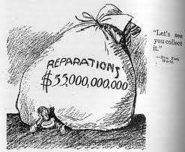
The Weimar Republic
Faced many problems from the start
Versailles Treaty
Many political parties
Communists, conservatives
Inflation

Slide 9
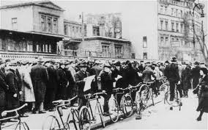
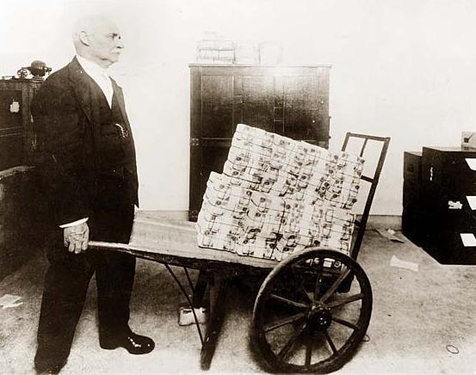
The Weimar Republic
What is inflation?
Activity
Reading

Slide 10
The Great Depression
Germany needed help
Western powers
Reduced reparations
Could access the coal-rich Ruhr Valley
However, as they began to recover a worldwide event set them back
The Great Depression

Slide 11
A New Leader Emerges
As Germany’s economy spiraled out of control, Germans turned to an energetic new leader
Adolf Hitler
He gained power by promising to solve the economic crisis

Slide 12
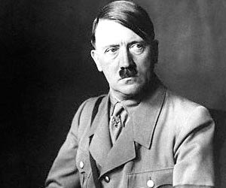
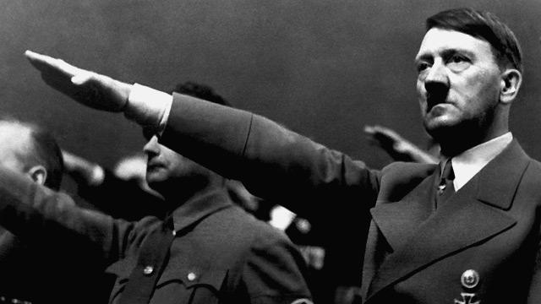
Adolf Hitler
Hitler Biography

Slide 13
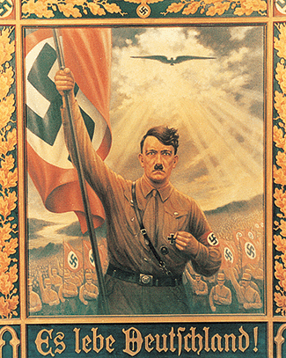
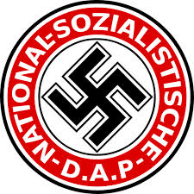
Adolf Hitler
In 1919, Hitler joined the National Socialist German Workers, or Nazi, party
He quickly became leader

Slide 14
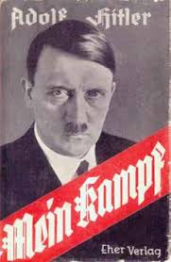
Adolf Hitler
In 1923, Hitler was arrested and tried for treason for trying to seize power in Munich
While in prison, Hitler wrote Mein Kampf
Expressed Hitler’s obsessions
Nationalism
Racism
Anti-Semitism

Slide 15
Adolf Hitler
In Mein Kampf, he also blamed the Marxists (Communists), Jews, corrupt politicians, and business leaders for the poor economy
Claimed Germany needed a strong leader
His ultimate goal was to become the leader of Germany

Slide 16
Adolf Hitler
Hitler was elected chancellor in 1933
Government feared the growth of Communism
Thought Hitler could be controlled
He immediately suspended civil rights and destroyed other political parties
Notes:
STOP!

Slide 17
How Would You Vote?
Each group will be given one character
German citizen after WWI
Read through your character’s bio and summarize it
Then, read through the platforms of each party
Summarize goals (ignore positives/negatives)
Next, decide how your character would vote
Finally, how would you vote?
A: Communist
B: Weimar
C: Nazi

Slide 18
Hitler’s Third Reich
To achieve his goals, Hitler organized an efficient system of terror, repression, and totalitarian rule
Nazis controlled all areas of German life
His secret police, Gestapo, rooted out opposition

Slide 19
Hitler’s Third Reich
Few Germans feared Hitler because he had ended unemployment and increased German power

Slide 20
Hitler’s Third Reich
To combat the Great Depression, Hitler launched a public works program
Built highways
Built homes
Replanted forests
Built up military

Slide 21
Hitler’s Third Reich
Like the Fascists and Communists the Nazis forced ideology on the young people
“Hitler Youth” pledged absolute loyalty to Germany and prepared for war

Slide 22
Hitler’s Third Reich
Hitler also wanted the Aryan race to survive
Women were given rewards for having “pure-blooded Aryan” babies

Slide 23
Purging German Culture
The Nazis sought to purge German culture
Denounced modern art and jazz
Burned books

Slide 24
Purging German Culture
Hitler also wanted to rid Germany of Christianity which he saw as “weak”
Closed Catholic schools and silenced clergy

Slide 25
The Campaign Against the Jews Begins
In 1935, the Nuremberg Laws placed restrictions on Jews
Forbidden from:
marrying non-Jews
Attending or teaching at German schools
Holding government jobs
Practicing law or medicine
Publishing books

Slide 26
The Campaign Against the Jews Begins
On November 7, 1938, Kristallnacht, or “Night of the Broken Glass” took place
Nazi-led mobs destroyed Jewish communities, shops, and synagogues

Slide 27
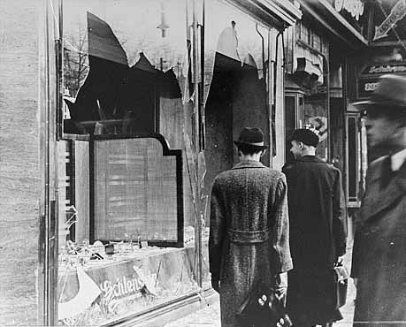

Slide 28
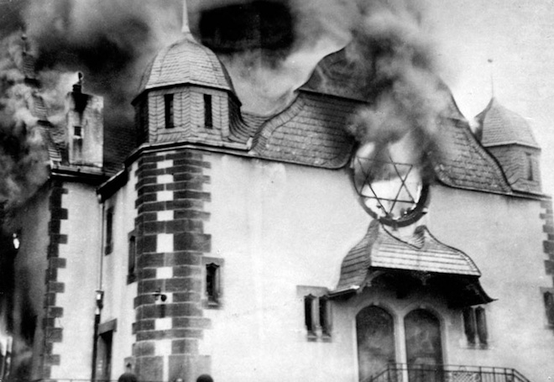

Slide 29
The Campaign Against the Jews
World was outraged but did little to stop Hitler
Eventually, Hitler called for the extermination of all the Jews- “final solution”

