Slide 1
Geography

Slide 2
What is geography?
What do you think of when you hear “geography”?
the study of the physical features of the earth and its atmosphere, and of human activity as it affects and is affected by these, including the distribution of populations and resources, land use, and industries.

Slide 3
Why do we study geography?
Website
What is geography?
Jobs in geography

Slide 4
Projections: Show the image of the Earth onto a flat surface
Planar Projection: shows the Earth centered around the poles
Cylindrical Projection: based on the projection of the globe onto a cylinder; centered on the Equator distorts near the poles
Conic Projection: based on placing a cone over part of the globe; indicates distances and directions fairly accurately
Mercator Projection: accurately displays directions and shapes of landmasses

Slide 5
Planar Projection

Slide 6
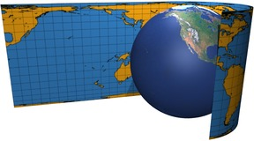
Cylindrical Projection

Slide 7
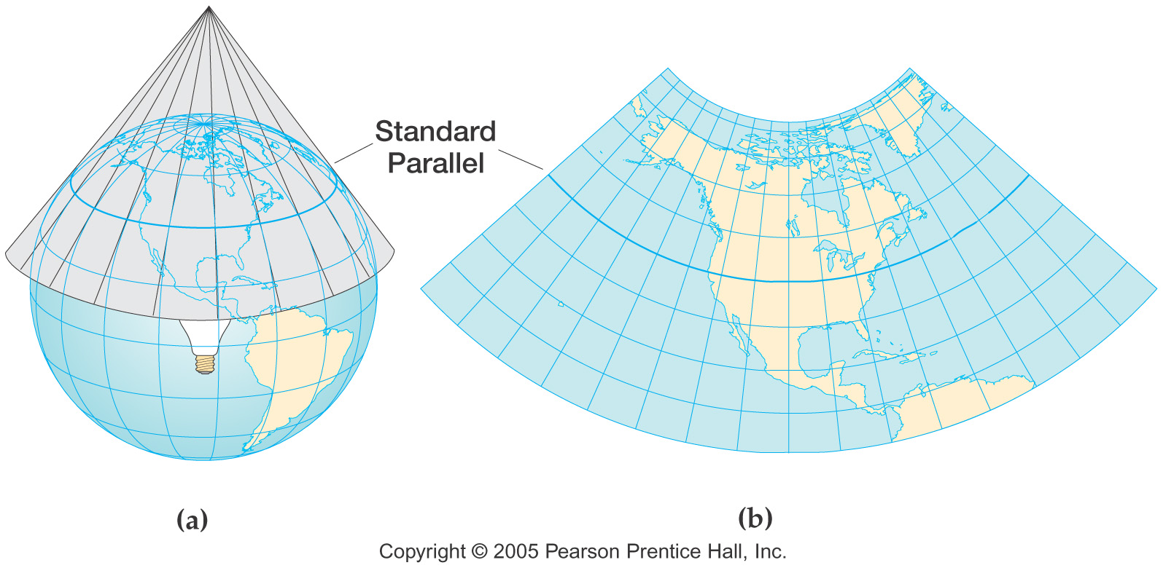
Conic Projection

Slide 8
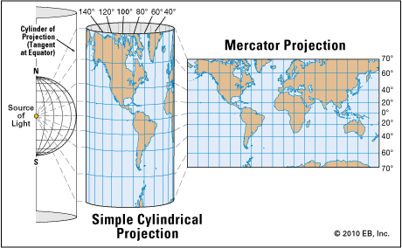
Mercator Projection

Slide 9
Determining Location
Latitude: Lines that circle the Earth parallel to the Equator measured North and South of the Equator
Equator: Measured at 0 degrees latitude
North and South Poles: Measured at 90 degrees latitude
Longitude: Circle the Earth from Pole to Pole measured east and west of the Prime Meridian
Prime Meridian: Measured at 0 degrees longitude
Global Grid: Helps determine absolute location using placements of latitude and longitude

Slide 10
Determining Location
Hemispheres: Divide the Earth
Northern Hemisphere: North of Equator
Southern Hemisphere: South of Equator
Eastern Hemisphere: East of Prime Meridian
Western Hemisphere: West of Prime Meridian

Slide 11
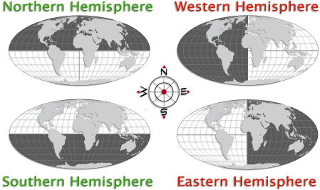

Slide 12
Types of Maps
Physical Map: shows location, shape, and topography of Earth’s physical features
Political Map: shows boundaries and locations of politics units like countries, states, and cities
Qualitative (Thematic) Map: focused on a kind of information or a single area
Use colors, symbols, lines, dots, etc. to show specific ideas

Slide 13
Reading Maps
Key: lists and explains the symbols, colors, and lines used on the map, also called a legend
Compass Rose: indicates directions usually including the four cardinal directions (north, south, east, west) with the points of a star
Scale Bar: shows the relationship between map measurements and the actual distances on the Earth
By laying a ruler on the scale bar, you can calculate how many miles or kilometers are represented per inch or centimeter

Slide 14
Stop and Check
Take out your maps from yesterday.
Does your map include the following:
A title?
A key?
A compass rose?
A scale?
If not, try to add them!

Slide 15
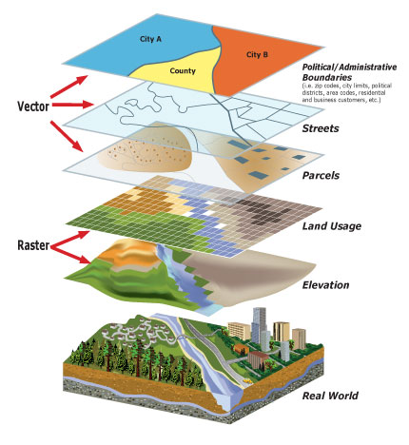
Geographic Information Systems (GIS)
Modern technology has changed the way maps are made
Most cartographers use software called Geographic Information Systems (GIS)
Uses data from maps, satellite images, text, and statistics
Converts into a digital code and then produces a map

Slide 16
Map Identifications- Political and Culture Regions
South Asia
South America
North Africa
Oceania
Sub-Saharan Africa
Middle East
Western Europe
Latin America
North America
Eastern Europe
Central America
East Asia
Russia
Southeast Asia

Slide 17
Map Identification – label the 5 oceans
Indian
Pacific
Atlantic
Southern
artic

Slide 18
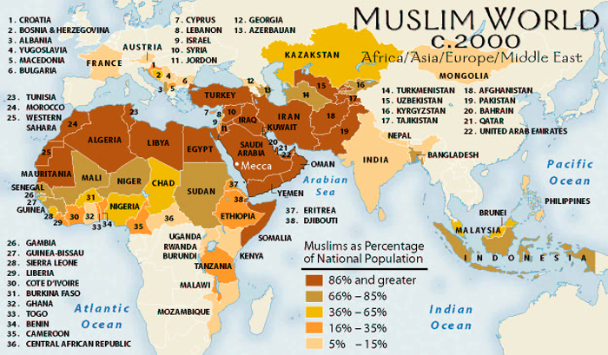
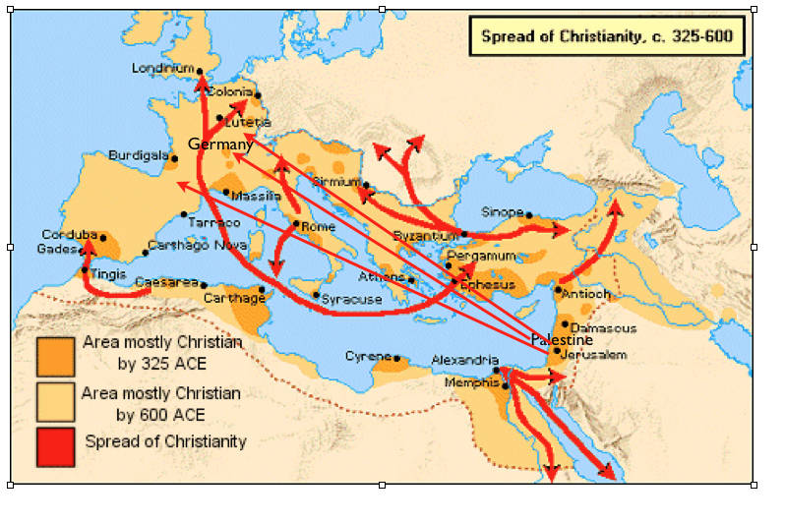
Human Geography
People shape the world in which they live, they settle in certain places but not others.
People use and affect the environment they live in
Culture Region: include a collection of countries whose people practice the same religion and speak a common language (a region that shares a culture)
Cultural Diffusion: the way that cultural innovations and ideas spread into other areas

Slide 19
5 Themes of Geography
Location: Where it is
Absolute Location: the exact location on the Earth’s surface based on latitude and longitude
Relative Location: in relation to another place
Place: The characteristics that make a location unique
Regions: Areas that share characteristics
Movement: How and why people/things move
Human-Environment Interaction: Relationship between people and their environment

