Slide 1
FROM LENIN TO STALIN
The Russian Revolution

Slide 2
Building the Communist Soviet Union
Lenin spent much of his first few years squashing the civil war
He now needed to focus on rebuilding Russia

Slide 3
Government
The new government united the states into the Union of Soviet Socialists Republic (USSR)
In 1922, the Communists produced a constitution
Legislature
Voting rights

Slide 4
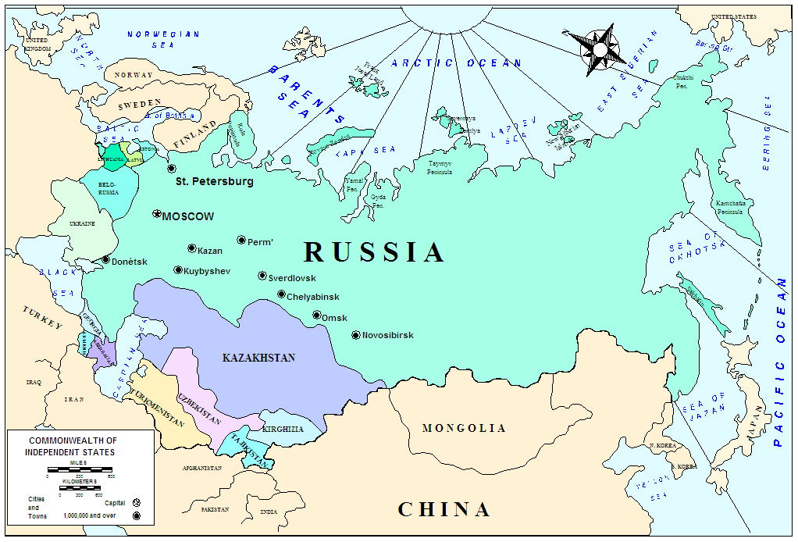

Slide 5
Government
The government told the people they owned the means of production, political power, and resources
However, the Communist party (the government) held all the power

Slide 6
Lenin’s New Economic Policy
In 1921, Lenin developed the NEP
Businesses were allowed to open for private profit
Effects:
Helped the economy
People trusted the government
Standard of living improved
Saw this as a temporary fix

Slide 7
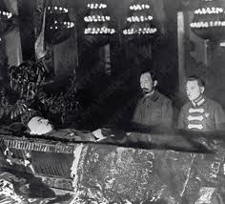
Lenin’s Death and the Rise of Joseph Stalin
Lenin suffered 3 strokes from 1922 to 1923
In 1924, he died from complications from the strokes

Slide 8
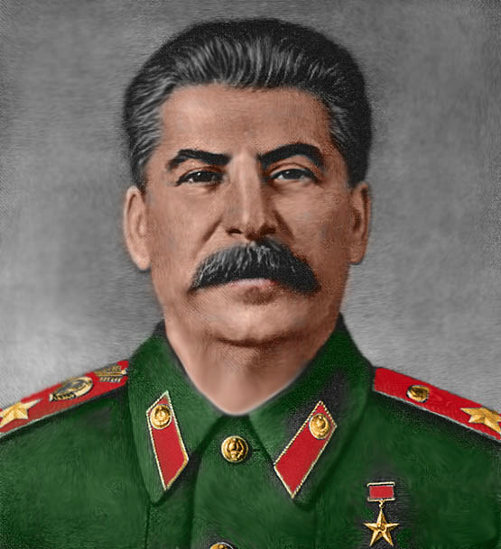
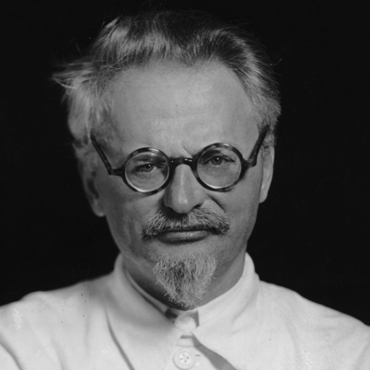
Lenin’s Death and the Rise of Joseph Stalin
There were two contenders in the Communist Party
Joseph Stalin
Leon Trotsky
Joseph Stalin will become the leader

