Slide 1
Grab 5 different colored pens, pencils, markers, or crayons!

Slide 2
Warm-Ups (Question #2)
What are the three major reasons for exploration?
G-
God (wanted to spread Christianity)
G-
Gold (wanted to find gold and other treasures to gain wealth)
G-
Glory (wanted the fame and fortune that came along with new discoveries)

Slide 3
Opening Activity
Take out your explorers chart and study!
Correctly match the descriptions with the explorer
7 minutes
Move clockwise (x2)
Check other group
Fix
Use chart to check yours

Slide 4
EUROPEAN EXPLORERS

Slide 5
Technology and Exploration
Advancement in technology was necessary for successful exploration
Cartographers
Astrolabe
Caravel
More weaponry on ships

Slide 6
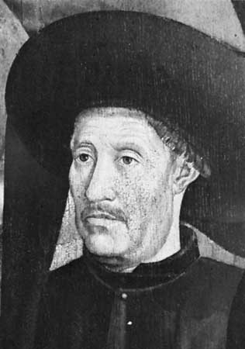
Henry the Navigator (1420)
Also known as Prince Henry of Portugal
Was excited to explore, wanted to find gold, and spread Christianity
Prince Henry helped Portugal lead the way in exploration
Notes:
During seize of country in North Africa, PH was inspired to look for sea route-heard stories of great wealth
Organized scientists, cartographers, and other experts-redesigned ships, prepared maps, and trained captains-sent out to explore western coast of Africa

Slide 7
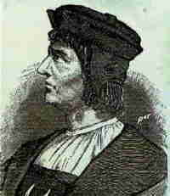
Bartolomeu Dias (1488)
Sailed for Portugal
Continued conquest for Portugal after Prince Henry’s death
In 1488, rounded the southern tip of Africa, known as the Cape of Good Hope because it opened a sea route to Asia

Slide 8
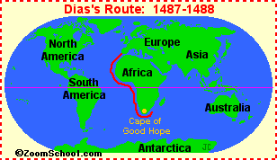
Notes:
Cape of Good Hope was challenging because of the winds and turbulent seas (Indian and Pacific Oceans meet here)

Slide 9
Christopher Columbus (1492)
Financed by Ferdinand and Isabella of Spain
Wanted gold and to spread Christianity after driving Muslims from Spain
Successes
Found new sea routes
Mistakes
Did not know about North and South America
Underestimated the size of the Earth
Thought he had reached the East Indies
Notes:
Portugal’s successes spurred other nations into action
Columbus wanted to reach the Indies
Other Europeans/explorers realize Columbus had found a route to continents previously unknown

Slide 10
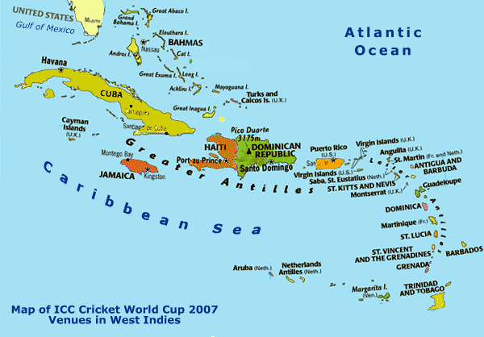
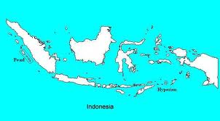

Slide 11
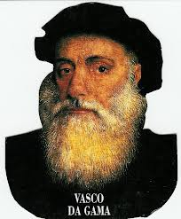
Vasco da Gama (1498)
Sailed for Portugal
Sailed around the Cape of Good Hope
Set up spice port in Calicut
Extremely profitable
Eventually created a vast trading empire
Notes:
Led 4 ships around the Cape of Good Hope
Spent ten months at sea, reached Calicut
Voyage home was difficult (lost many from hunger, thirst, and scurvy)
Survivors made a great profit (3,000% profit)

Slide 12
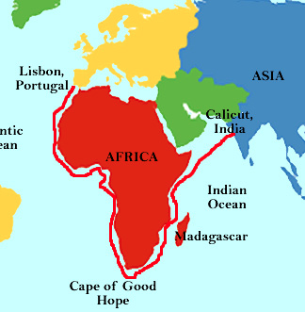

Slide 13
Pedro Alvarez Cabral (1500)
In 1493, Pope Alexander VI stepped in to settle disagreements between Spanish and Portugal explorers
Line of Demarcation
Treaty of Tordesillas (1494)
Was blown off course as he sailed around Africa
Landed in Brazil and claimed it for Portugal
Portuguese culture heavily influences the country today
Notes:
Divided non-European world into two zones
Spain trade to the west, Portugal to the east
Brazil was to the east of the line

Slide 14
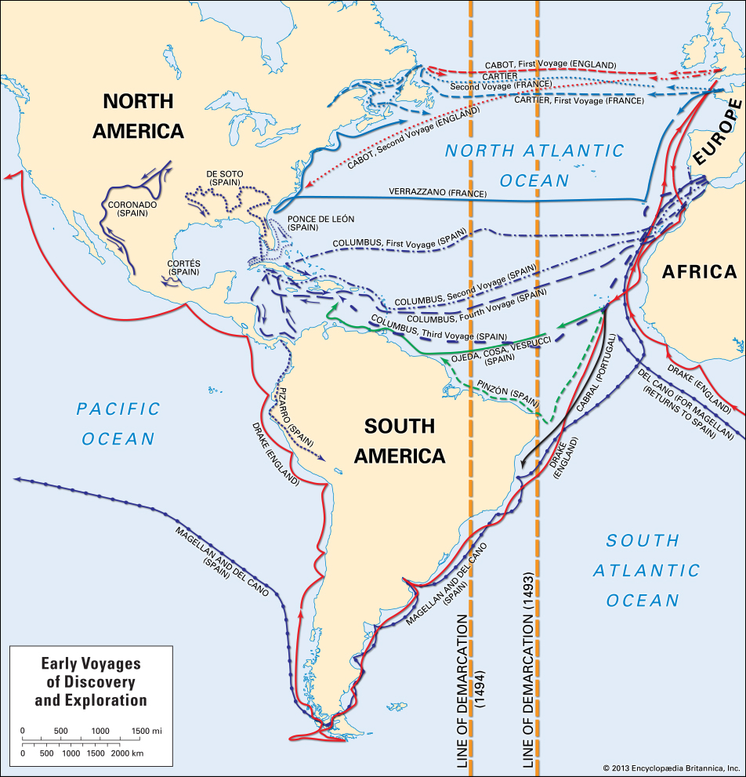
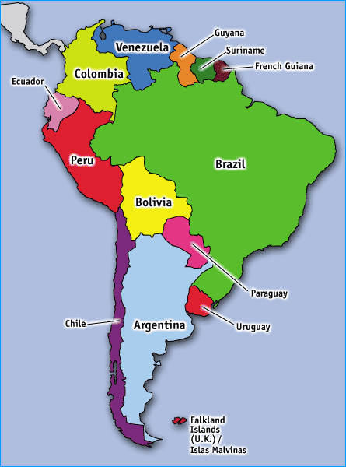

Slide 15
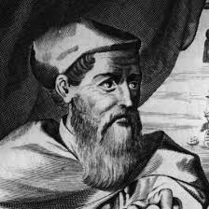
Amerigo Vespucci (1499-1502)
Sailed for Italy
Explored the “New World” Christopher Columbus had discovered
The Americas were named after him

Slide 16
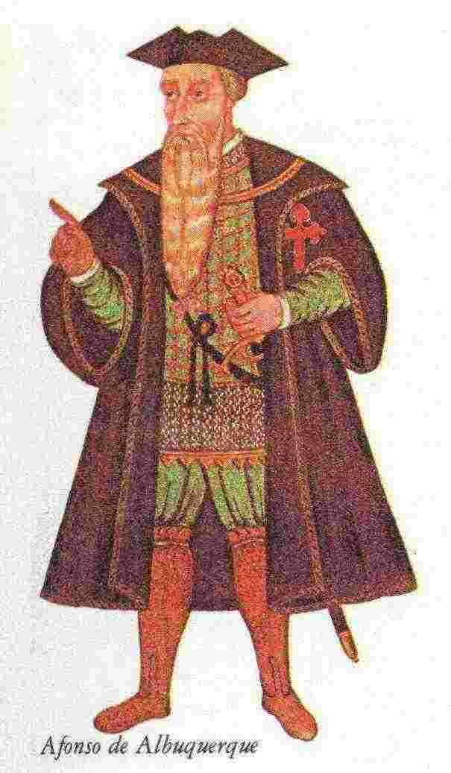
Afonso de Albuquerque (1503-1506)
Sailed for Portugal
Landed at vital port
Controlled the sea route linking India, Southeast Asia, and China
His ultimate goal was conquest of this area
Used force to take over this area

Slide 17
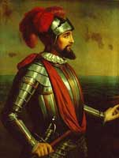
Vasco Nunez de Balboa (1513)
Explored for Spain
Hacked his way through the tropical forests of Panama
“Discovered” the South Sea (Pacific Ocean)

Slide 18
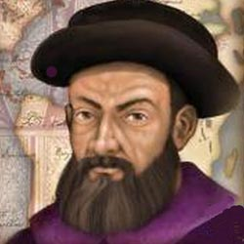
Ferdinand Magellan (1519-1522)
Was from Portugal but sailed for Spain
Despite brutal storms he charted a passage that became known as the Strait of Magellan
Is credited with being the first to circumnavigate the world
Notes:
Set out with 5 ships
Landed in the Philippines; was killed; one ship and 18 sailors completed the voyage (possibly slave)

Slide 19
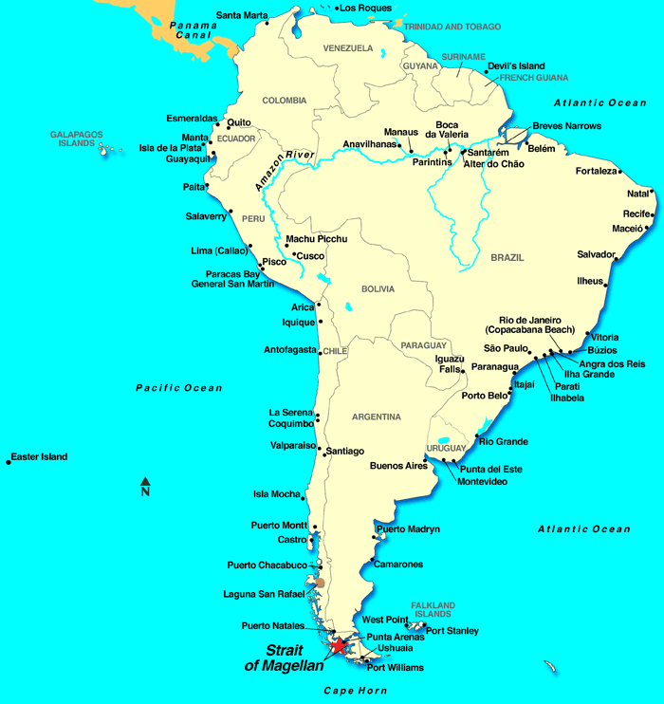

Slide 20
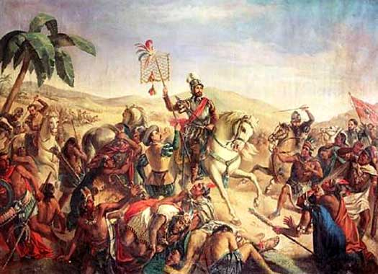
Hernan Cortes (1519)
Was a conquistador from Spain
Landed on the coast of Mexico in 1519
Made alliances with conquered people and overthrew the Aztec ruler Moctezuma

Slide 21
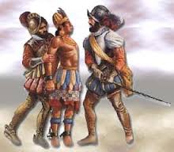
Francisco Pizarro (1532)
Another conquistador from Spain
Landed in Peru in 1532 just after a bloody civil war
Overthrew the Incan ruler and spread power and influence across South America
Notes:
Civil war was between two brothers competing for power

Slide 22
Map Activity
First:
Label the continents
Color Portugal, Spain, Italy
Second:
Choose five explorers
Third:
Trace their routes from their starting point, to the their end point
Fourth:
Write the date(s) of their travel
One accomplishment
*Can be written directly on route*

Slide 23
Why Explore?
What were some of the reasons Europeans wanted to explore?
God
Gold
Glory
Gold, God, Glory
Exploration Rap

