Slide 1
Warm-Ups
10. Who is the Prussian monarch who used the army to strengthen the country?
Frederick the Great
11. Who is the Russian monarch who carried social and economic reforms to modernize his country? (HINT: westernization)
Peter the Great
12. List two results of the Thirty Years’ War.
Netherlands and Swiss Federation gained independence
Depopulation in Germany
Germany further divided
13. Peter the Great wanted to:
Westernize
14. During the 1700s, which two nations battled to control the German states?
Austria and Prussia

Slide 2
Key Players
Parliament
Check monarch’s power
Charles I
Absolute monarch of England, executed
Roundheads
Support Parliament
Cavaliers
Support Charles I
Oliver Cromwell
Leads Roundheads, rules England

Slide 3
THE TUDORS AND PARLIAMENT
England was ruled by the Tudor dynasty from 1485-1603
Divine right
Good relationship with Parliament
Henry VIII constantly asked for money to fight wars
Elizabeth I (Henry VIII’s daughter) also had good relationship with Parliament
Notes:
Power was limited by Parliament, but Parliament did what was asked of them by the monarchs

Slide 4
THE EARLY STUARTS
Elizabeth I dies without a direct heir
Stuarts of Scotland become ruling family
Were not popular
Poor relationship with Parliament
Problems inherited give way to “century of revolution”
Parliament against the monarchy

Slide 5
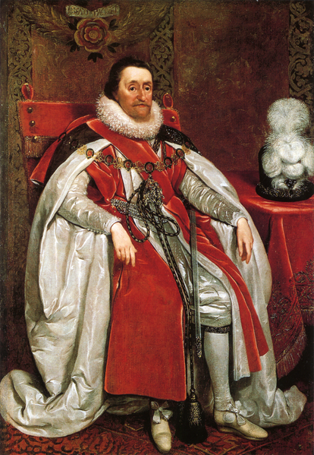
Before the War
James I
Argued with Parliament over money, foreign policy, and divine right
Notes:
When Parliament wanted to discuss giving more money, James I dissolved Parliament.
James I clashed with dissenters, Protestants and Puritans, who wanted to “purify” society

Slide 6
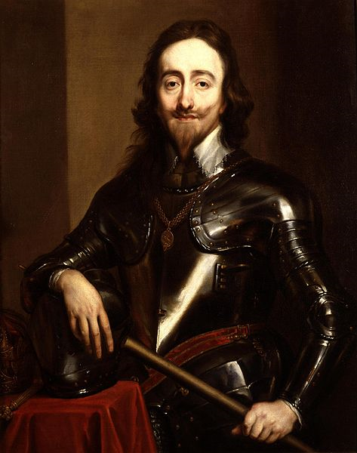
Before the War
Charles I
James I’s son
Inherits throne in 1625
Behaves like an absolute monarch
Imprisons foes
Ignores Parliament
Notes:
He is asked to sign the Petition of Right to stop him from doing these things. He agrees but then dissolves Parliament so he can do what he wants.

Slide 7
Before the War
Charles I
Rules without Parliament for 11 years
Eventually, reassembles Parliament because he needs money to squash Scottish rebellion
Parliament revolts
Notes:
Scots were angered by what they saw as the revival of Catholic practices

Slide 8
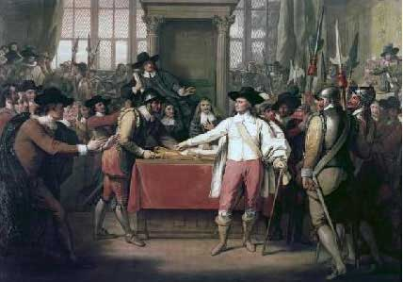
Before the War
The Long Parliament
Met off and on from 1640 to 1653
Declared it could not be dissolved without its own permission
Effect:
Triggered the greatest political revolution in English history

Slide 9
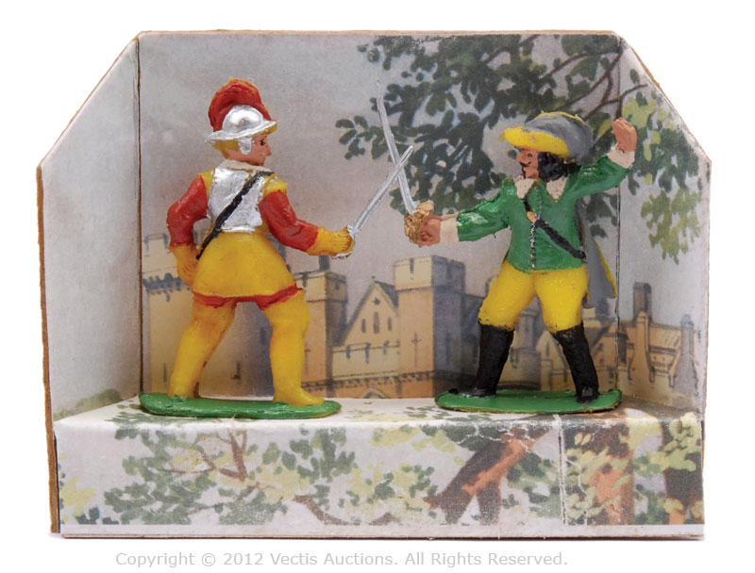
During the War
The English Civil War began when Charles I lashed back at Parliament
Lasted from 1642-1649
The war began to challenge the power of absolute monarchs

Slide 10
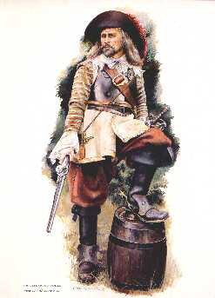
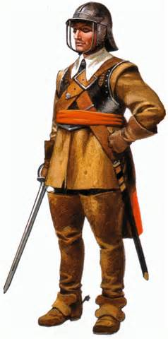
During the War
At first, it seemed the Cavaliers would win
Wealthy
Well-trained
However, the Roundheads were lead by Oliver Cromwell
A skilled general
Organized the “New Model Army”

Slide 11
During the War
Outcome
The Roundheads, surprisingly, defeated the Cavaliers in a series of battles
King Charles I is captured and put on trial
He is tried for being a “tyrant, traitor, murderer, and public enemy”

Slide 12
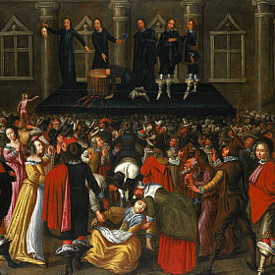

Slide 13
During the War
Charles I is tried and executed by his own people
This had never happened before
English Civil War sent a clear signal that no ruler could claim absolute power and ignore the rule of law

Slide 14
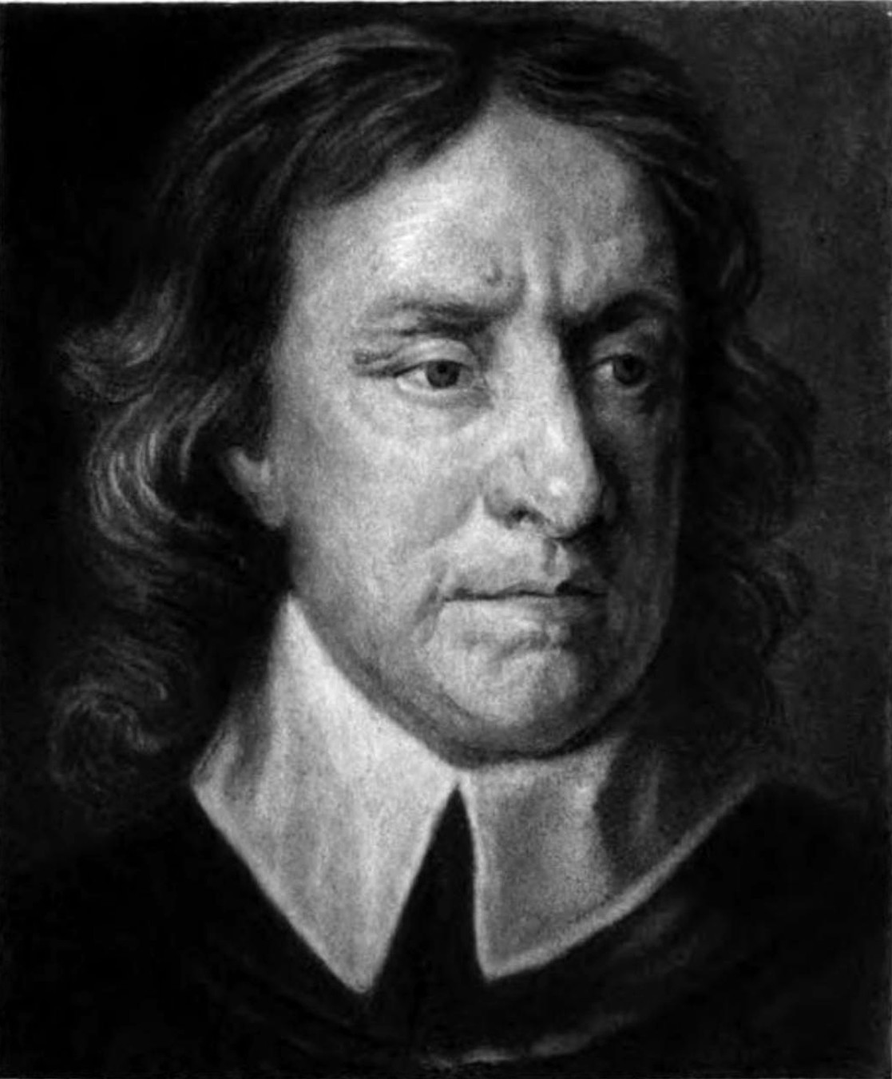
After the War
The House of Commons abolished the monarchy and declared England a republic
Oliver Cromwell was chosen as the new leader
Why?

Slide 15
After the War
The new government faced many threats
Uncrowned heir, Charles II
Levellers
Had to exile Irish Catholics
Oliver Cromwell gave himself the title Lord Protector and ruled through the army to enforce stricter rules
Notes:
Levellers were one group who thought the poor should have as much say in government as the wealthy
Nobles were horrified at this

Slide 16
After the War
Oliver Cromwell and other Puritans wanted to make significant changes
Purify society
Fine those ignoring the Sabbath
Rid of dancing, taverns, gambling
Mandatory education
Better treatment of women
Marriages based on love
Women were allowed to preach sermons
Did not allow Catholics to worship but did allow Jews to return to England after more than 350 years of exile

Slide 17
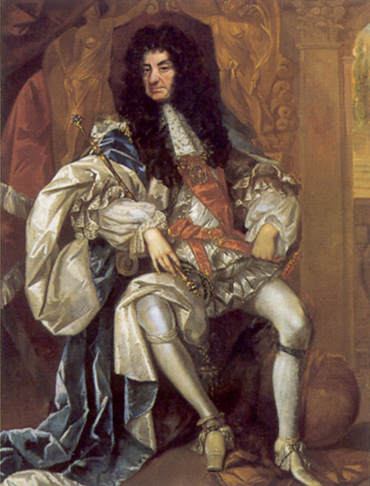
After the War
Oliver Cromwell died in 1658, the Puritans lost their grip on England
Many people were tired of military rule and Puritan ways
Charles II was allowed to rule England

Slide 18
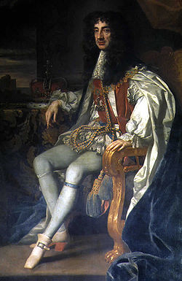
AFTER THE WAR
Charles II was welcomed back to London
He was a popular ruler and made positive changes
Opened theaters and taverns
Tolerated other religions
Dealt well with Parliament
However, he is still an absolute
monarch!

Slide 19
Activity: Execute or Keep?
Read through each statement
Place it in the correct column: Execute or Keep
Which side do you support?

Slide 20
Warm-Ups
15. During the 1600s, the power of the English monarch was limited by:
Parliament
16. Why did the English Civil War send so many shockwaves throughout Europe?
First time a ruler had been tried and executed by his own people
17. Who was Oliver Cromwell?
Leader of the Roundheads during the English Civil War

Slide 21
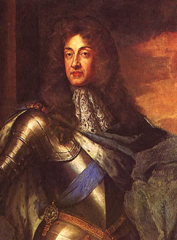
FROM RESTORATION TO GLORIOUS REVOLUTION
James II, Charles II’s brother, will inherit the throne
He was not a well-liked or effective ruler
Flaunted Catholic faith
Suspended laws as he felt necessary
Appointed Catholics to high offices

Slide 22
FROM RESTORATION TO GLORIOUS REVOLUTION
Parliament asked James’s Protestant daughter, Mary, and her Protestant husband, William II to rule after a “bloodless overthrow”
This is known as the Glorious Revolution

Slide 23
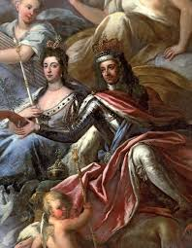

Slide 24
FROM RESTORATION TO GLORIOUS REVOLUTION
Before they could be crowned, they had to sign the English Bill of Rights
This guaranteed the superiority of Parliament over the monarchy
Parliament must meet regularly
“Power over the purse”
No Roman Catholic could rule again
Habeas corpus
Trial by jury

Slide 25
FROM RESTORATION TO GLORIOUS REVOLUTION
Glorious Revolution does not create democracy but a limited monarchy
A constitution or legislative body limits the power of the monarch

Slide 26
Activity
Read through the new law
Decide what it means
Put it into your own words/modern language
Have it approved
Write it on large sheet of paper

Slide 27
Warm-Up
Which document did William and Mary sign before they were allowed to take power?
The English Bill of Rights

Slide 28
What’s Being Violated?
The king attempts to imprison people who are going to vote for Oliver Cromwell.
The king believes France is going to attack even though there is a declared peace. He requires the townspeople to volunteer for the army.
Parliament passes a law stating the consequence for stealing is death.

Slide 29
What’s Being Violated?
The king dissolves Parliament.
Parliament implements an 11pm curfew for all English citizens. The king decides to cancel the curfew.
The king creates a law stating Protestants cannot have arms for protection.

Slide 30
RAP
Read through the paragraphs
Write the main idea and at least 2 supporting details!

