Slide 1
THE END OF WWI

Slide 2
Collapsing Morale
By 1917, 3 years into the war, morale of the troops and civilians had begun to collapse
Countries faced several difficulties:
Bankruptcy
Casualties
Food shortages
Failure of generals

Slide 3
Revolution in Russia
Three years of war had hit Russia especially hard
Stories of incompetent generals and corruption and food shortages made those in Russia angry

Slide 4
Revolution in Russia
Riots broke out and lead to the overthrow of the czar
At first, the Allied Powers welcomed this
Thought Russia would become democratic and be a better ally

Slide 5
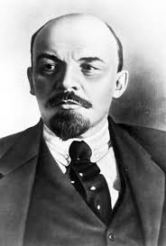
Revolution in Russia
However, Vladimir Lenin, the new leader after the czar had other plans
He promised to pull Russian troops out of the war
In 1918, Lenin signed the Treaty of Brest-Litovsk with Germany
Russia was no longer involved in WWI

Slide 6
Russian Revolution
Russia’s withdrawal had an immediate impact and was especially positive for Germany
Germany could focus efforts and troops on the Western Front

Slide 7
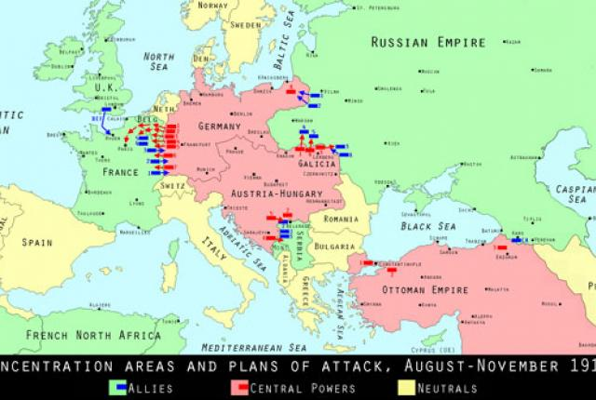

Slide 8
U.S. Enters the War
However, Germany would soon face another enemy
The United States entered WWI on the side of the Allied Powers in 1918
VIDEO
Reading

