Slide 1
DIVISION AND DEMOCRACY IN FRANCE

Slide 2
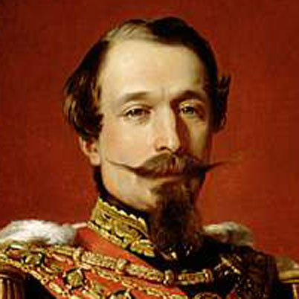
Napoleon III
After the revolution of 1848, Napoleon III set up the Second Empire (elected)
Most in France viewed Napoleon III as a positive, successful leader
Strong leader
Gave hope to lower classes
Liked his name

Slide 3
Napoleon III
Napoleon III ruled as a dictator
Debate was limited
Strict censorship was in place
However, in the late 1860s he began to ease controls
Lifted censorship
Gave legislature more power
New constitution

Slide 4
Napoleon III
France prospered at mid-century because of the promotion of industry and large-scale ventures
French entrepreneur, Ferdinand de Lesseps organized the building of the Suez Canal
Linked the Mediterranean with the Red Sea and the Indian Ocean

Slide 5
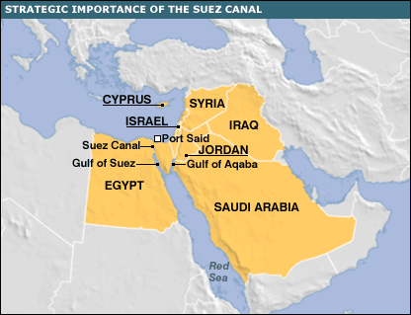

Slide 6
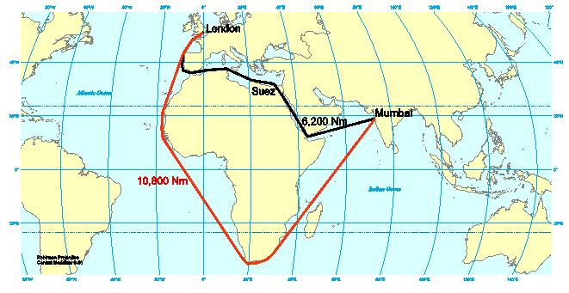

Slide 7
Napoleon III
Napoleon’s worst failures were in his foreign affairs
Intervention in Mexico
Wanted Mexico to repay debt
Lost more 336 million francs when debt was 60 million francs
Franco-Prussian War
Lost to Bismarck

Slide 8
The Paris Commune
In 1871, an uprising broke out in Paris
Rebels set up the Paris Commune
The goal was to save France from royalists and create socialist society
Met for about 60 days

Slide 9
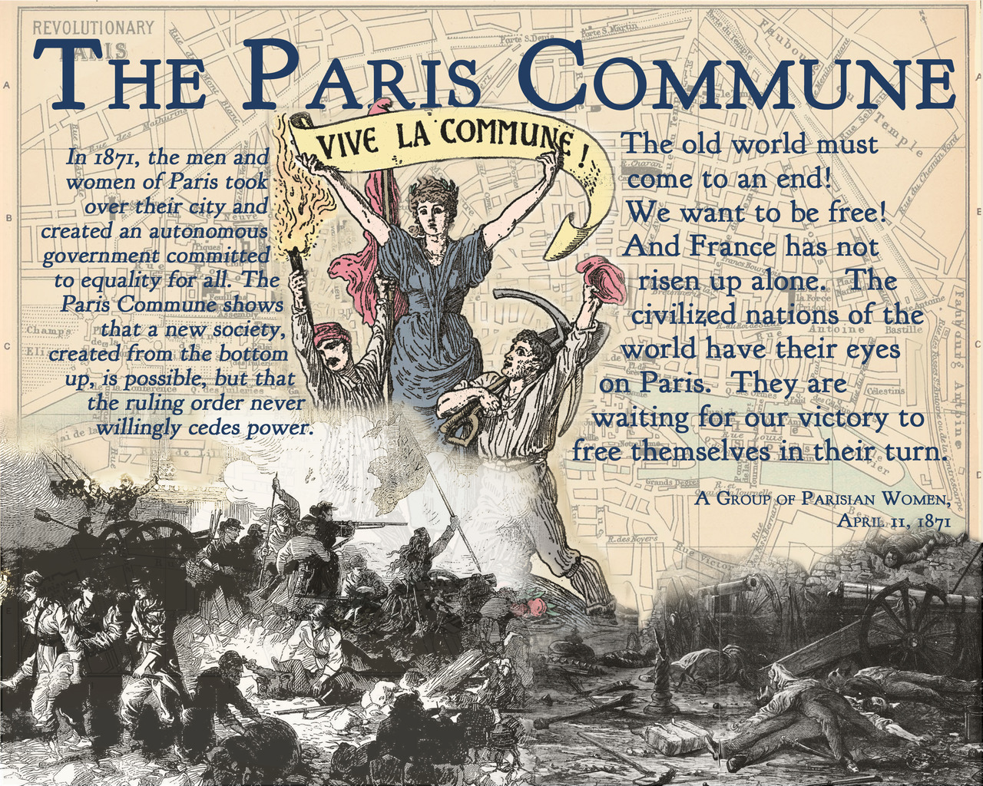

Slide 10
The Paris Commune
The National Assembly ordered them to disband, the Commune refused
Troops were sent in to take control and civil war raged for weeks
Government forces slaughtered the Communards and disbanded them

Slide 11
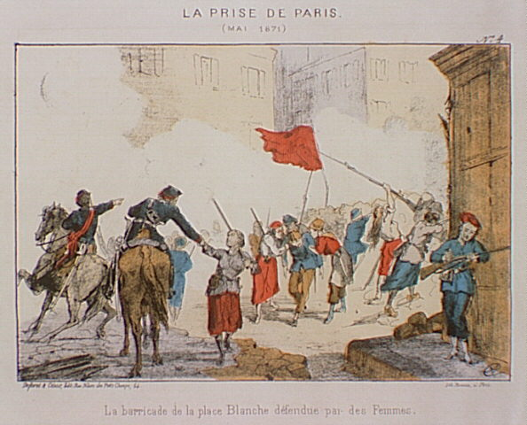

Slide 12
The Paris Commune
Impact
Separation of church and state
Pensions to children
Feminist movement

Slide 13
The Third Republic
Despite the difficulties they faced, the Third Republic remained in place for 70 years
They faced many challenges
Many political parties
Political scandals

Slide 14
France
By 1914, France was the largest democratic country in Europe
Constitution
Prosperous economy
Overseas empire
However, still faced other issues
Industrial Germany
Franco-Prussian War

Slide 15
Alfred Dreyfus
Alfred Dreyfus was an officer in the French army. He was accused of spying against Germany. He was wrongly accused and convicted, mainly because he was Jewish. He was sentenced to a penal colony. His family worked to clear his name. His case made news and inspired the Zionist movement. The Zionist movement is the demand for a Jewish homeland in Palestine.

