Slide 1
Question of the Day Monday August 25, 2014
In general, how did the people of Asia feel about the Europeans who wanted to trade with them? Did they trade with them?
They thought the Europeans had no manners and inferior goods. Most countries chose to isolate themselves and not trade with Europeans.
Portugal lost control over trade in Asia to what other European country?
The Dutch from the Netherlands

Slide 2
Conquest in the Americas
Spanish & Portuguese colonies in America

Slide 3
Conquistadors
Spanish conquistadors (conquerors) followed Columbus and settled in the Caribbean
Conquistadors were after gold, looking to spread Christianity, and looking to bring glory and honor to their countries
Europeans unknowingly brought diseases such as smallpox, measles, and the flu to Native Americans who had no immunity. It is estimated the population of the Caribbean Natives declined by 90% after exposed to Europeans.

Slide 4
Cortes
Herman Cortes landed in Mexico in 1519 with 600 men, 16 horses, and a few cannons
Cortes sailed with 11 chips to look for gold, silver and other “riches”
He traveled inland and “discovered” Tenochtitlan, the capital of the Aztec empire.

Slide 5
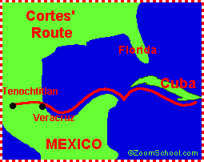
Cortes’ route to mexico

Slide 6
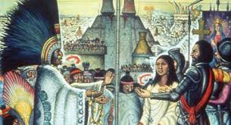
Cortes & Moctezuma

Slide 7
The Fall of Tenochtitlan
Many people hated Aztec overlords, they sacrificed thousands of captives to their gods
Cortes made alliances (friendships) with those against Moctezuma
At first, Moctezuma welcomed Cortes to his capital. Then, the fighting broke out, driving Spaniards out of the city
Cortes captured and DEMOLISHED Tenochititlan in 1521.
What is now Mexico City was built on the ruins of Tenochtitlan
Notes:
Quote from an Aztec onlooker on p. 85 “Broken spears lie in the road; We have torn our hair with grief; The houses are roofless now, and their walls are red with blood”

Slide 8
Pizarro
Francisco Pizarro was inspired to explore by Cortes
He arrived in South America (Peru) in 1532, right after a bloody civil war ended
Pizarro was assisted by those who recently lost the civil war. They slaughtered thousands and eventually captured the king
Pizarro asked for a huge ransom of gold and riches for the king, the Incas paid it, Pizarro killed him anyway

Slide 9
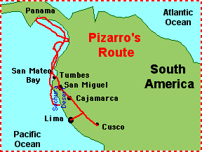
Pizarro’s Route

Slide 10
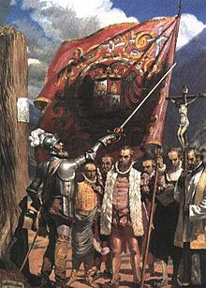
Pizarro
Pizarro in Peru with his followers in 1535

Slide 11
Reasons for victory
How could a few hundred European soldiers conquer Native American Empires of with millions of people?
1. Superior military technology
Horses, muskets, cannons, metal helmets & armor
2. Disease
Smallpox, measles, & influenza
3. Alliances
Division & discontent among Native Americans, the conquistadors convinced rivals to fight with them against long standing enemies

Slide 12
Results
Native Americans tried to resist invaders and there were some short revolts among the Incas
Spanish took existing gold and silver, then forced the Natives to mine for sliver in Peru and Mexico that was then taken to Spain, making Spain wealthy

