Slide 1
Warm-Ups
6. Which country was heavily influenced by Portuguese culture?
Brazil
7. France had more ___________ in the Americas, but England had more __________.
Territory, people

Slide 2
The Columbian Exchange

Slide 3
Activity
Why do people trade?
Look at your item
List two benefits of your good
Food, luxury, necessity?
List one negative of your good
Lead to greed? Lead to death/destruction?

Slide 4
Activity
Trade your item for something better!
Everyone must make TWO exchanges
Try to convince other students the benefit of taking your good

Slide 5
Old World vs. New World
The Columbian Exchange was an exchange of goods, people, disease, ideas between the New World and the Old World.
Old World
Europe
New World
The Americas

Slide 6
The Columbian Exchange
Read through the passage on the Columbian Exchange and answer questions 3 and 4.

Slide 7
What is the Columbian Exchange?
Christopher Columbus began a global transfer of goods, food, animals, people, ideas, and disease from the Old World to the New World. This exchange had many benefits including_________ and some negatives including_________.

Slide 8
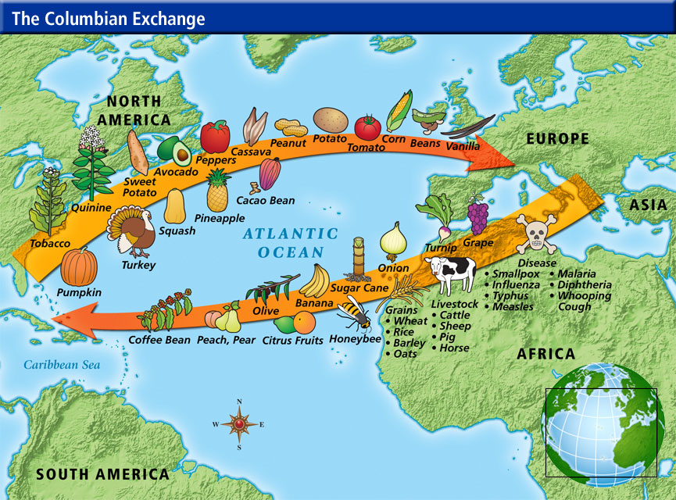

Slide 9
GOOD and BAD
Fortunately
Wider variety of foods
Population growth
Better infrastructure
Wealth
Unfortunately
Overpopulation
Disease
Fortunately
New foods
Newer technology
Horses
Unfortunately
Disease
Native-on-native violence
Destruction of cultures/languages
OLD WORLD
NEW WORLD

Slide 10
Warm-Up
Grab a blue and green pen from the back table.
#8 Who began the Columbian Exchange?
Christopher Columbus
#9 What is the Columbian Exchange?
Transfer of goods, ideas, people, and diseases between Europe and the Americas.
#10 Name one benefit and one negative of the Columbian Exchange.

Slide 11
Quick Review
Divide desks
Label one side Cause one side Effect
List as many causes and effects of the exploration as you can!

Slide 12
Review
Divide your paper into 6 parts and label each box:
Vocabulary
Explorers
Impact of exploration in Asia
Impact of exploration in Africa
Impact of exploration in the Americas
The Columbian Exchange
List as much information as you can about each topic.
If there is a topic you are struggling with, highlight it!

Slide 13
Project
Students will choose two projects from the grid
May suggest another project
Need to tell us which project you are choosing and supplies needed
Will be completed individually
Due: Thursday, September 4

Slide 14
