Slide 1
Strengthening Germany
Chapter 10, Section 2

Slide 2
Review
Who helped unify Germany?
Otto von Bismarck
How was he able to do so?
Realpolitik
Strengthened army
Fought wars to gain territory and power

Slide 3
The following painting shows William I being crowned emperor of a united Germany.
What does the predominance of military uniforms suggest?

Slide 4
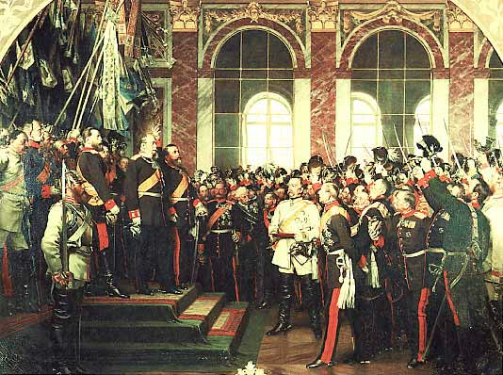

Slide 5
The German Empire
After Germany was unified, Bismarck established a legislature and drafted a constitution
Bismarck still had the power to veto, held a lot of power still

Slide 6
The German Industrial Giant
Germany emerged as the industrial giant in Europe
What factors may have lead to this?
Large, educated population
Ample iron and coal resources
Had built railroads and founded companies

Slide 7
Science, Government, and Industry
Government supported research and development
Hired trained scientists to work at universities
Developed synthetic chemicals and dyes
Issued a single currency and reorganized the banking system

Slide 8
The Iron Chancellor
What do the following quotes tell us about Bismarck’s rule?
“When you want to fool the world, tell the truth.”
People never lie so much as after a hunt, during a war, or before an election.”

Slide 9
Foreign and Domestic Policy
Foreign
Domestic
Keep France weak
Build up Austria and Russia
Leave Britain alone
Crush all opposition to his rule

Slide 10
Campaign Against the Church
Bismarck distrusted Catholics
Believed their true allegiance was to the Church not state
Launched Kulturkampf
“battle for civilization”
Passed laws so state could supervise Catholic education
Wanted to approve appointments of priests
Plan backfired, learns from his mistake

Slide 11
Campaign Against Socialists
Bismarck feared socialism would cause a revolution
Passed laws that dissolved socialists groups; shut own newspapers; banned meetings
Backfired, is forced to change stance
Awards German workers health insurance, retirement benefits

Slide 12
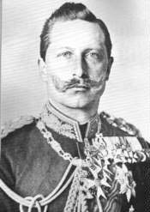
Kaiser William II
William II will replace his grandfather as kaiser (emperor)
Wanted to leave his own mark on Germany
Asked Bismarck to resign
Implemented social welfare programs
Improved education
Focused on military dominance

