Slide 1
Nationalism
What is nationalism?
What are some of the positive and negatives associated with nationalism?

Slide 2
Otto von Bismarck and German Unification
Chapter 10, Section 1

Slide 3
Why Unite Germany?

Slide 4
Why Unite Germany?
In the early 1800s, Germany was divided into several states
Share common culture
Located in Prussia and the Austrian Hapsburgs

Slide 5
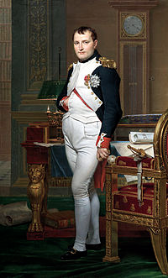
Why Unite Germany?
Napoleon’s Impact
Annexed lands
Dissolved the Holy Roman Empire
Organized German states as he saw fit

Slide 6
Why Unite Germany?
Napoleon’s Impact
At first, some Germans welcome the modern policies
Freed the serfs
Made trade easier
Abolished laws against the Jews
Other resented France’s significant impact
Wanted to free their lands and unite Germany

Slide 7
Why Unite Germany?
Prussia tries to help by introducing the Zollverein
Encouraged economic unity among German states
States still divided
William IV rejects throne
Does not want a throne offered by “the people”

Slide 8
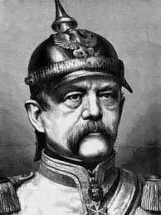

Slide 9
Otto von Bismarck
Early Years
Otto von Bismarck was born in Prussia
His family belong to the Junker class
He will serve as a diplomat until 1862
In 1862, he is named chancellor by King William I
United German states within a decade under Prussian rule

Slide 10
Otto von Bismarck
Realpolitik
Realistic politics based on the needs of the state
Believed that power was more important than principles
His ultimate goal was to gain power by strengthening the army

Slide 11
Otto von Bismarck
Wars with Denmark and Austria
Wanted to form an alliance with Austria
Seized provinces in Denmark and “liberated” them
Bismarck will turn on his former ally
Starts a war with Austria

Slide 12
Otto von Bismarck
Wars with Denmark and Austria
War lasted 7 weeks
Bismarck will be victorious
Annexed other German states
Dissolved the Austrian-led German Confederation

Slide 13
Otto von Bismarck
The Franco-Prussian War
French leader Napoleon III became nervous after Bismarck’s victory in Austria
Bismarck uses propaganda to remind Germans of previous invasions by Napoleon

Slide 14
Otto von Bismarck
Franco-Prussian War
Bismarck’s forces are stronger than Napoleon’s
France was unorganized and poorly supplied
Napoleon III was forced to surrender

Slide 15
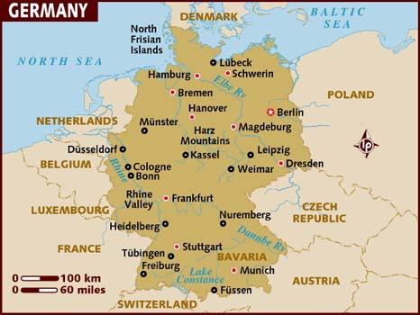
German Unification
Unified in 1871
Today

