Slide 1
Warm-Up 10/27
1. What is the bourgeoisie?
Upper class
2. What is the proletariat?
Working class
3. Name two impacts of the Industrial Revolution based on the activity completed on Friday.
Overcrowding
Pollution
Disease
Death

Slide 2
THE INDUSTRIAL REVOLUTION BEGINS

Slide 3
Options
Large group
Independent
Book (pgs. 196-202)
Table

Slide 4
A Turning Point in History
In the 1750s, people used handmade tools; made their own clothes; and grew their own food.
They didn’t travel a lot.
Industrial age will change all of this.
Trains
Telegraphs
Improved medicines

Slide 5
The Agricultural Revolution
The Dutch led the way
Built dikes to reclaim land from the sea
Combined fields
Mixed different kind of soil to get higher crop yields
Improved farm machinery
Jethro Tull invented the seed drill to disperse seeds
Enclosure Movement
Farm output rose
Profits rose
Migration into cities
Peasants lost jobs due to Enclosure Movement
Population explosion
Due to declining death rates
Reduced risk of famine
Britain’s population increased from 5 million to 9 million in about 100 years
Changes
Impact
Notes:
Agricultural Revolution led way for IR
Combined fields to make better use of land
Used fertilizer, planted turnips to help renew soli
Enclosure Movement
Rich landowners took over and fenced land that once belong to peasants

Slide 6
New Technologies
Energy had been mostly provided by humans and animals
During the 1700s, people harnessed a new energy source-coal
New methods of textile production
Flying shuttle
Spinning jenny
James Watt improved steam engine-became an important source of power
Coal produced iron
Iron was a necessary material
Machines/steam engines
New textile machines led to the building of factories
Changes
Impact
Notes:
Another factor that triggered the IR was new technology
Business owners could change the way work was done

Slide 7
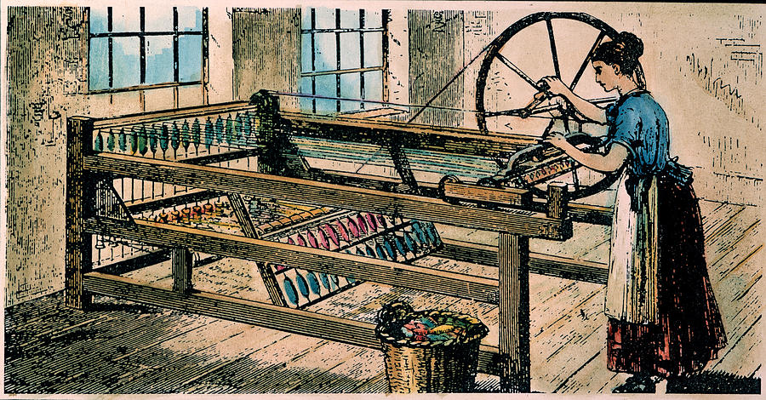

Slide 8
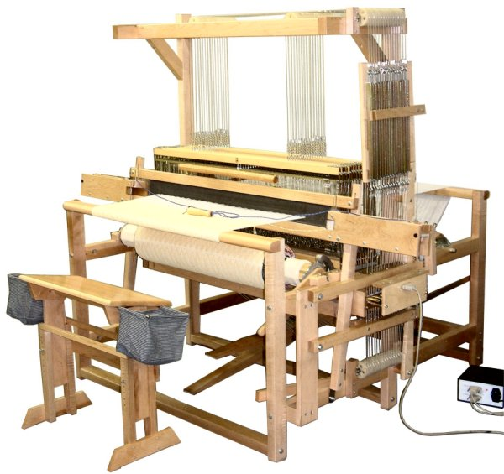

Slide 9
New Methods of Transportation
As production increased, business owners needed more efficient methods of transportation
Built turnpikes
Created canals
Built stronger bridges
Steam locomotive
Steamboats
Turnpikes charged people who used the roads
Profits!
Railroad and steam engines allowed for expansion of markets
Changes
Impact

Slide 10
Britain Leads the Way
Britain was the first nation to industrialize
It became the model for other countries in Europe and around the world

Slide 11
Why Britain?
Resources
Large supply of coal
Lots of iron
Large population-agricultural revolution
Economic Conditions
Prosperous trade
Business class had money to invest
Demand for goods
Political and Social Conditions
Stable government

Slide 12
Video
Opening Ceremony of the 2012 Summer Olympics
Shows the changes that occurred in Britain during the Industrial Revolution
Rural landscape to city

Slide 13
Essay Chart
Write down negative and positive effects based on the activity we completed on Friday
Do not write the opinion paragraph!

Slide 14
Exit Ticket
Objectives:
Understand events leading to the IR
Why Britain led the way
How well could you explain today’s information to another student?
Any questions? Need any information explained again?

