Slide 1
Warm-Up 11/18
1. Describe the difference between domestic policy and foreign policy.
Domestic-within country
Foreign-relationship with other countries
2. What are social reforms?
A change or movement focused on society
3. What is discontent?
Dissatisfaction with one’s situation

Slide 2
AN AGE OF IDEOLOGIES

Slide 3
Challenging Ideas
At the Congress of Vienna, the powers of Europe tried to uproot revolutionary ideas
However, there were several competing ideologies, ideas about politics and economies, that plunged Europe into more than 30 years of turmoil

Slide 4
Political Group | Social Group | Goals
Conservatives | Monarchs, landowners, church leaders | Restore royal families Suppress revolutionary ideas
Liberals | Bourgeoisie | Constitutions Government protect basic rights Elections Separation of Powers Laissez-faire economics
Nationalists | Ethnic groups | People with a common heritage have their own states
Notes:
Conservatives: Enlightenment would led to chaos; change should come slowly
Liberals: Wanted all men to have the right to vote
Nationalists: Europe had been greatly divided by wars, treaties, marriages-resentment grew, can lead to intolerance and persecution

Slide 5
Reading
Reading will further explain nationalism
What is it?
What causes nationalism?
What are effects of nationalism?
Predict:
What may happen as a result of nationalism?

Slide 6
Revolts Against the Old Order
Spurred by ideas of liberalism and nationalism, revolutionaries fought against the old order
During the 1800s, several rebellions erupted in Europe
Serbia
Greece
Spain
Italy

Slide 7
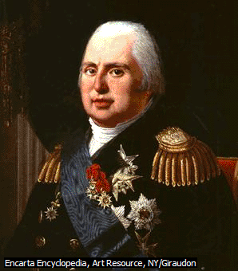
The French Revolution of 1830
After the Congress of Vienna, Louis XVIII was returned to power
Did have a constitution
Allowed limited freedom of press
His compromises made few happy
Ultraloyalists
Liberals wanted to extend suffrage
Radicals wanted a republic
Working class wanted decent pay

Slide 8
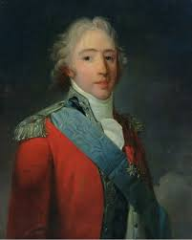
The French Revolution of 1830
Louis XVIII died in 1824, Charles X inherited the throne
He suspended the legislature, limited suffrage, restricted the press
Liberals and radicals attacked soldiers and gained control of Paris their actions forced Charles X to abdicate and flee

Slide 9
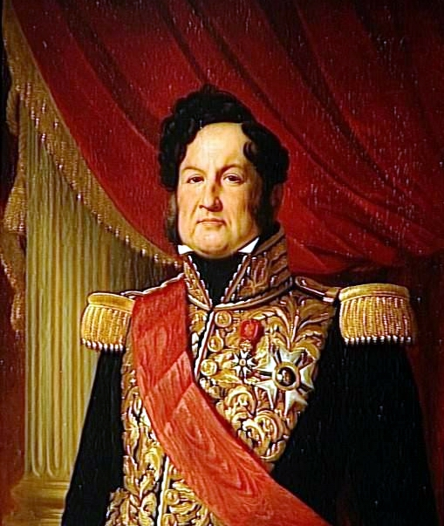
The French Revolution of 1830
With the king gone, Louis Philippe is chosen to rule
Extended suffrage to wealthy
Favored the middle-class

Slide 10
The French Revolution of 1848
In the 1840s, discontent grew
In February 1848, the government silenced critics and prevented public meetings leading to a revolt
Louis Philippe abdicated and the new government faced many difficulties

Slide 11
The French Revolution of 1848
By June, the upper- and middle-class had won control of the government
Shut down national workshops
Workers protested
Riots broke out and 1,500 people were killed

Slide 12
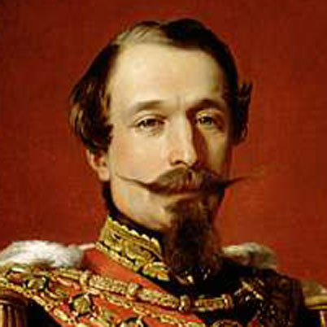
The French Revolution of 1848
Louis Napoleon was elected and gave him self the title Napoleon III, calling himself emperor
His policies will be disastrous for France

Slide 13
Latin American Wars of Independence
By the late 1700s, revolutionary ideas had spread to Latin America
Discontent was rooted in the social, racial, and political system that had emerged under 300 years of Spanish rule

Slide 14
Latin American Wars of Independence
Spanish-born peninsulares dominated Latin American political and social life
Growing population of creoles, mestizos, and mulattoes were angered with being denied rights

Slide 15
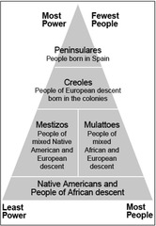

Slide 16
Latin American Wars of Independence
As Enlightenment ideas spread, many pushed for a revolution
It wasn’t until Napoleon Bonaparte invaded Spain in 1808, that leaders in Latin America pushed for independence
Spain appeared weak

Slide 17
Independence in Latin America
Haiti, Mexico, Venezuela, Colombia, Ecuador, and Brazil will all gain independence from their European rulers

