Slide 1
Take out a piece of paper and number it from 1-10.

Slide 2
Opening Discussion (Thursday)
What happened to Louis XVI and Marie Antoinette?
They were executed by guillotine
What was the goal of Robespierre’s Reign of Terror?
To crush any opposition to the Revolution
What happened to Robespierre?
He was executed by the guillotine

Slide 3
Opening Discussion (Friday)
What were positive results of the French Revolution?
Changed social order, abolished monarchy, nationalism, church under state control
Who did the Directory choose as their new leader?
Napoleon Bonaparte

Slide 4
AFTER THE REIGN OF TERROR

Slide 5
Reaction to the Reign of Terror
Moderates wanted to move away from Robespierre’s ways
They produced another constitution
The Constitution of 1795 guaranteed:
A two-house legislature
Members would be elected

Slide 6
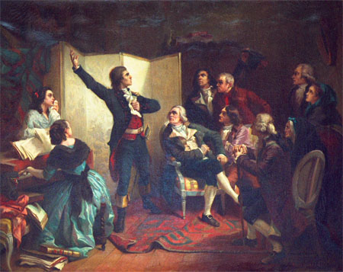
Reaction to the Reign of Terror
The middle-class and professional people (bourgeoisie) became the dominant power in society
They were known as the Directory

Slide 7
Reaction to the Reign of Terror
The Directory faced several challenges
War with Austria and Great Britain
Returning émigrés
Pushed for constitutional monarchy
Notes:
Emigres-nobles, clergy, and others who had fled France who spoke out against the revolution

Slide 8
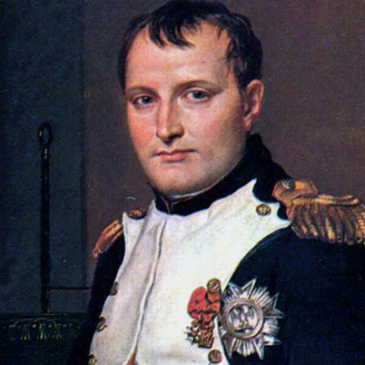
Napoleon Bonaparte
As chaos threatened, politicians turned to Napoleon Bonaparte
Strong military leader and hero
Thought he would advance their goals-backfires

Slide 9
Impact of the Revolution
Many women were disappointed that the Declaration of the Rights of Man did not grant equality to women
However, they will gain some rights
Divorce is easier
Could inherit property
Notes:
Divorce was made easier to weaken Catholic Church

Slide 10
Impact of the Revolution
By 1799, the French Revolution had dramatically changed France
Changed social order
Monarchy was overthrown
Church was under state control
Surge of nationalism
Notes:
State schools
Systems to help the poor, old soldiers, war widows
Abolished slavery in their Caribbean colonies

