Slide 1
Warm-Up 9/17
#5 What are three facts you learned about Philip II from the reading?
Spanish Armada
Oppressed Protestants, Muslims
Loved Catholicism
#6 Who is the English monarch who encouraged sea captains to plunder Spanish treasure ships?
Elizabeth I

Slide 2
Warm-Ups 9/21
#7 In the late 1500s, France was torn apart by religious wars between the _________________ and the _____________.
Catholics and Huguenots
#8 When Louis XIV became king, what measures did he take to strengthen the nation?
Strengthened the army
Used mercantilist policies
Strengthened bureaucracy
#9 Why did Louis XIV call himself the “sun king”?
Believed kingdom revolved around him

Slide 3
Absolute Monarchs in Europe
By the mid-1700s, absolute monarchs rule 4/5 lead powers in Europe
Led to competition, fighting
Rise of new ideas
Austria and Prussia
The Thirty Years’ War
Hapsburg Austria
The Rise of Prussia
Russia
Peter the Great
Westernization
Catherine the Great
Absolute monarch

Slide 4
Louis XIV and the Palace of Versailles
In the countryside near Paris, Louis XIV turned a royal hunting lodge into the Palace of Versailles
Extremely expensive
Displayed the finest paintings and statues
Gorgeous gardens with millions of flowers and large fountains
Became a symbol of the king’s wealth and power

Slide 5
ABSOLUTE MONARCHS
France

Slide 6
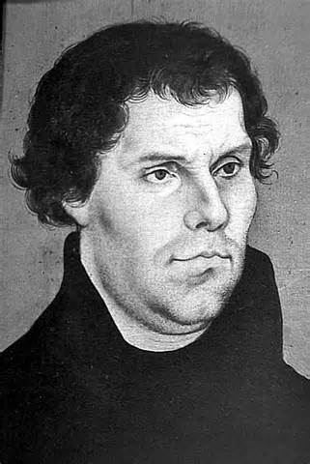
1560-1590
From the 1560s to the 1590s France was torn apart by religious wars between the Huguenots (French Protestants) and Catholics.
Martin Luther spread ideas that challenged the Catholic Church
Notes:
Martin Luther began began spreading new ideas which challenged the Catholic Church.
Catholic majority and Catholic rulers were angered by this.

Slide 7
1560-1590
The worst incident occurred on St. Bartholomew’s Day, August 24, 1572
3,000 Huguenots were massacred at a noble wedding
For many, this symbolized the complete breakdown of France
Notes:
Wedding of queen’s daughter Margaret to the future king, Henry IV.

Slide 8
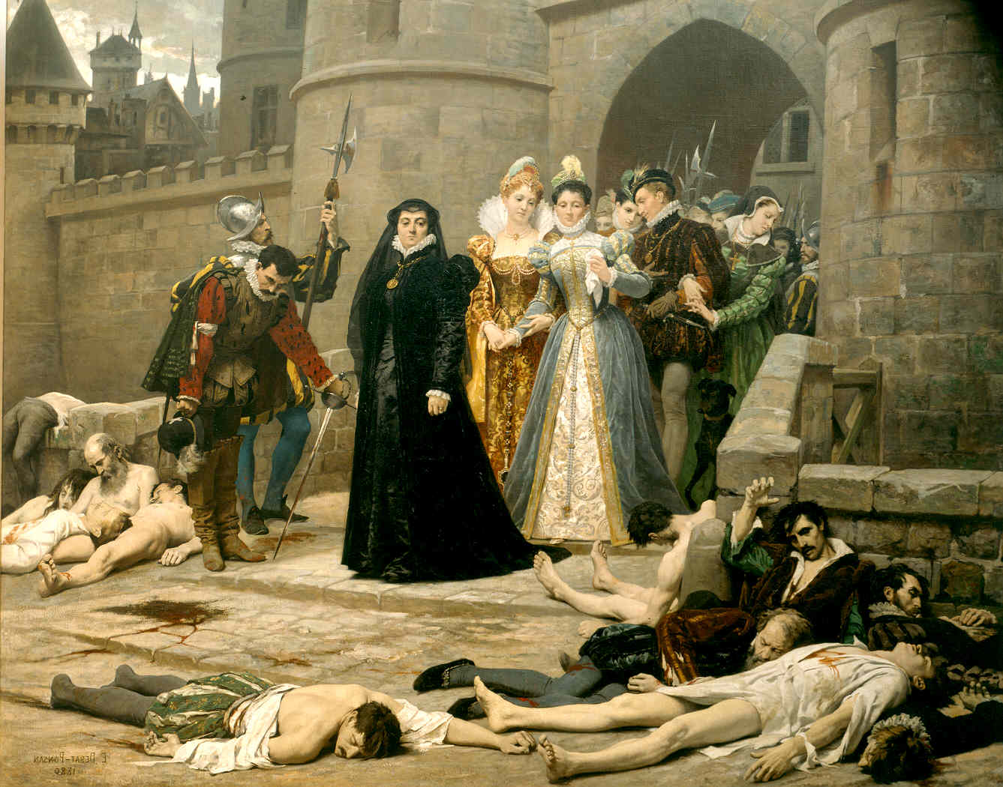
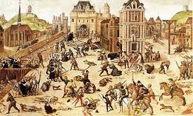

Slide 9
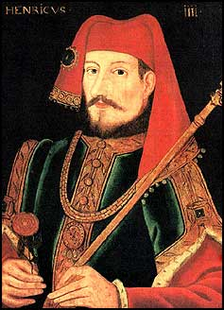
1590-1610
In 1589, Henry IV became king
Henry IV converted to Catholicism to please the majority of people
In 1598, he issued the Edict of Nantes-Protected the Huguenots

Slide 10
1590-1610
Henry IV made several changes to the way people lived
Government “reached into every area of French life”.
Improved roads
Built bridges
Revived agriculture
He wanted a “chicken in every pot”
A good dinner for everybody!
The people allowed him to have a great amount of power in order to restore order in a time of chaos
Notes:
Why do you think people allowed the king to become more involved/controlling?
To restore order in a time of chaos.

Slide 11
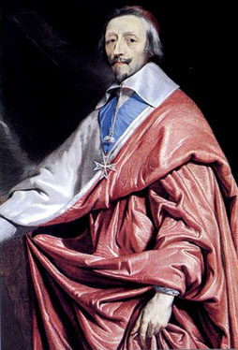
1610-1660
Henry IV was assassinated by a fanatic, so his son (Louis XIII) became king
He was a very weak, young king
He was only 9!
Cardinal Armand Richelieu took control
Did not protect Huguenots
Cut the power of the nobles
These two groups did not bow to royal authority
Destroyed the cities of the Huguenots
Defeated the private armies of nobles and destroyed their castles
Notes:
Henry IV was stabbed my a fanatic who hated him for his religious compromises
Louis XIII was 9 when he inherited the throne.
King’s power will diminish, nobles regain power.
Destroyed castles, cities, took away private armies.

Slide 12
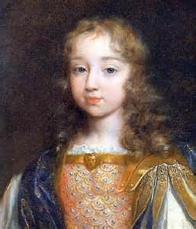
1660
At the age of 5, Louis XIV became king
Cardinal Mazarin ruled for him until he was 23
Very similar to Richelieu
Raised taxes
Strengthened central government
Notes:
There was a rebellion/uprising among the nobles, merchants, peasants, and urban poor (Louis would not forget this)

Slide 13
1660
Louis XIV took the name the Sun King
“Just as the sun stands at the center of the solar system, so the Sun King stands at the center of the nation.”
Believed in divine right
His royal power was never checked
Notes:
Why do you think he chose the name “the Sun King”?
“Just as the sun stands at the center of the solar system, so the Sun King stands at the center of the nation.”
Remembered the anger of the nobles during a rebellion to rid of Mazarin-wanted to make sure it never happened again.
Received economic advice from Jean Baptiste Colbert

Slide 14
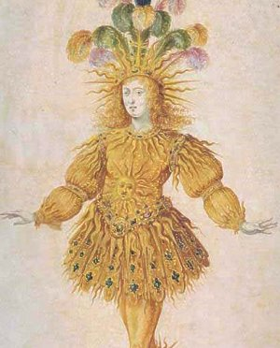

Slide 15
Strengthening Royal Power
He made drastic changes to maintain absolute power
Strengthened the bureaucracy-he made the important decisions
Strengthened the army
Enforced policies at home and abroad

Slide 16
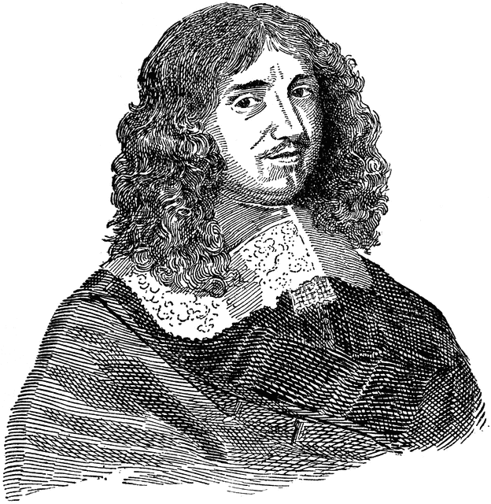
Financing the Monarchy
Jean Baptiste Colbert worked as Louis XIV’s finance minister
Used mercantilist policies
Cleared lands for farming
Encouraged mining
Put high tariffs on imported goods-encouraged citizens to buy only French goods
Policies made France the wealthiest state in Europe

Slide 17
Wars of Louis XIV
Louis XIV poured vast amount of resources into wars to expand French borders
At first, he did gain some territory, later his wars were much more disastrous
War of Spanish Succession
Alliances fought to maintain a balance of power to prevent any one nation from dominating Europe
Notes:
Louis wanted to unite the crowns
His grandson Philip V had inherited the throne of Spain, other countries feared this unification
England, Holland, Prussia, and Austria

Slide 18
The Edict of Nantes
Louis XIV saw the Protestants as a threat to religious and political unity
In 1685, he revoked the Edict of Nantes
More than 100,000 Huguenots fled France
This exodus hurt France’s economy
Huguenots were the most hard-working and prosperous group in France

Slide 19
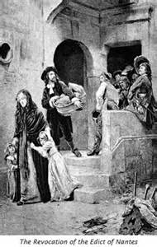

Slide 20
Louis XIV
Louis XIV ruled for 72 years
Longest reign in modern European countries
His reign set the stage for absolute monarchs to rule until the French Revolution
"Do not follow the bad example which I have set you; I have often undertaken war too lightly and have sustained it for vanity. Do not imitate me, but be a peaceful prince, and may you apply yourself principally to the alleviation of the burdens of your subjects."

Slide 21
Activity
Read through “ A Day in the Life”, complete a comic strip that shows the life of Louis XIV
OR
Write a three-paragraph journal entry about the life of an absolute monarch

